Slide 2
Revenue Generation and Improved Outcomes-Choctaw Nation Medicare Preventive Service Program
Brian Wren Pharm.D., BCPS
CAPT, USPHS
Chief Analytics/Revenue Officer
Choctaw Nation Health Services Authority

Slide 3
Presentation Objective
Focus on Annual Wellness Visit as the basis of an enhanced elder care initiative
Choctaw Nation Health Services Authority (CNHSA) program outline and experience

Slide 4
Medicare Annual Wellness Visit
Not to be confused with Initial Preventive Physical Examination (IPPE)
Utilized to develop a personalized prevention plan
Risk assessment is performed
Medicare covers once every 12 months

Slide 5
Medicare Annual Wellness Visit
Health risk assessment (HRA) is performed and utilized to provide patients with an individualized prevention plan
IDL & ADL
Fall Risk
Safety
Hearing
Depression Screening
Alcohol Screening
Family History
Chronic Conditions
Medications
Allergies Medical Incidents
Body Mass Index

Slide 6
Medicare Annual Wellness Visit
Provide patient with written screening schedule (checklist) for the next 5-10 years
Health education, additional service referrals or scheduling for other preventive services or education
Other services as indicated such as advance care planning services

Slide 7
CNHSA Program and Experience
Program began late 2017 as an extension of existing healthy aging services.
Utilize front end staff that utilize scripting to educate patients on the contents and importance of the exam and schedule patients for visits.
Nurses conduct the visit
The following provider types are reimbursable: Physician (doctor of medicine or osteopathy), Qualified non-physician practitioner (physician assistant, nurse practitioner, or certified clinical nurse specialist), Medical professional (including a health educator, registered dietician, nutrition professional, or other licensed practitioner), or a team of medical professionals directly supervised by a physician (doctor of medicine or osteopathy)

Slide 8
Program Benefits
Unique opportunity to “case manage” this population and ensure patients are receiving all preventive services indicated
Many additional benefits have been realized such as case management services and health system navigation.
Enhanced provider engagement.
The visit has evolved to include Medicare Counseling and premium sponsorship evaluation.
Consent for Medicare Chronic Care Management Services is also obtained for future service expansion.

Slide 9
Implementation Considerations
Identify your patient population
Develop program guidelines and HRA
Educate existing care team on the objectives and potential downstream effects of the visit.
CNHSA has adopted this model as a additional layer of care

Slide 10
Additional Considerations
Ensure patients that this is not a “physical” or a “problem” focused visit.
Strive to provide a “value add” to patients for coming to the visit.
Develop a mechanism for staff to ensure that patients can receive preventative services indicated as a product of the visit.

Slide 11
AWV Billing Information
AWV HCPS CODES | BILLING CODE DESCRIPTORS
G0438 | Annual wellness visit; includes a personalized prevention plan of service (PPS), initial visit
G0439 | Annual wellness visit, includes a personalized prevention plan of service (PPS), subsequent visit
G0468 | Federally qualified health center (FQHC) visit, ippe or awv; a FQHC visit that includes an initial preventive physical examination (IPPE) or an annual wellness visit (AWV) and includes a typical bundle of medicare-covered services that would be furnished per diem to a patient receiving an IPPE or AWV

Slide 12
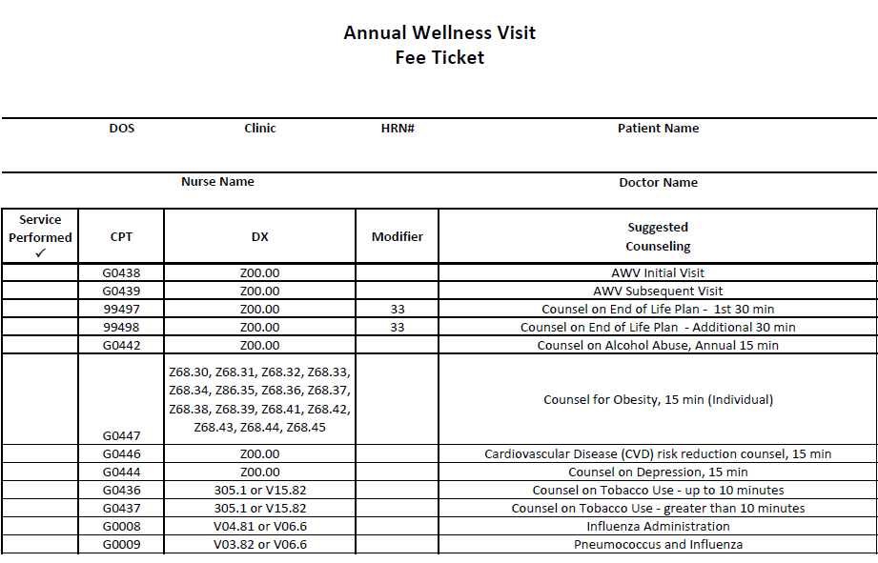

Slide 13
In Closing…
The Medicare Annual Wellness Visit can be utilized as an initial move into enhanced care management of this population.
The exam promotes patient engagement in their own preventive care plan.
The health care organization can also utilize the opportunity to evaluate patient for premium sponsorship.
Patient response has been entirely positive and outcomes are improving.

Slide 14
Resources
https://www.cms.gov/Outreach-and-Education/Medicare-Learning-Network-MLN/MLNProducts/Downloads/AWV_Chart_ICN905706.pdf

