Slide 2
INDIAN HEALTH SERVICE
Mission:
…to raise the physical, mental, social, and spiritual health of American Indians and Alaska Natives to the highest level

Slide 3
Annual Patient Services:
Inpatient Admissions: 39,305
Outpatient visits: 13,742,0788
40 Urban Programs

Slide 4
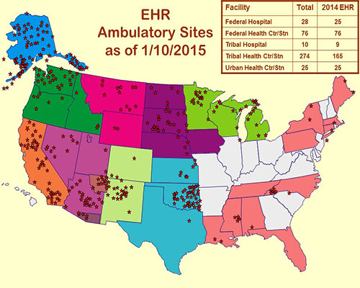
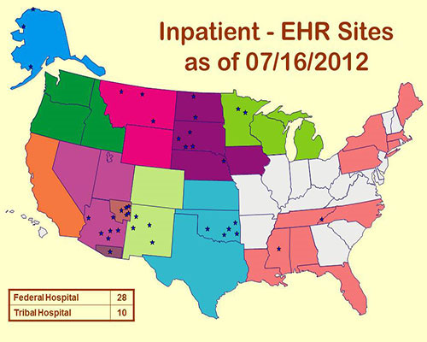
EHR Deployments in IHS

Slide 5
National HIT Modernization High Level Activities
HIT Modernization Research Project
IHS System Selection and Acquisition/Build
Begin Implementation
Rolling Implementation
Stabilization
Operations & Maintenance

Slide 6
Governance Challenge
Governance decides
What to do
Change Control
Protects the Environment and Executes
Ideas, Improvements, New Functionality
Drives Change
Experts guide How to do it

Slide 7
EHR Governance
EHR Governance is the process by which you standardize your clinical practices and set them up to work electronically. Without predictable clinical practices, you won’t be able to get predictable clinical outcomes, and your EHR implementation will be challenging.
…it is more than change control

Slide 8
EHR Governance
•Electronic Documentation – How/when to create it, sign/authenticate it, use it?
•Medication Order Standards– How/when to order certain medications? Non-formulary medications? In code blue/emergency situations? Over the phone?
•Standards for lab/radiology orders– How/when to order certain tests?
•Training standards – How do you train new employees? Existing employees? Implementation?
•Clinical Tool Development – How do you develop order sets? Policies? Protocols? Documentation?

Slide 9
IHS Barriers to Digital Services
Low bandwidth and/or high latency networks in Rural areas
Poor infrastructure reliability at some locations (e.g. power, network, etc.)
Not every shared or cloud service meets the requirements for every stakeholder
Capital funding challenges

Slide 10
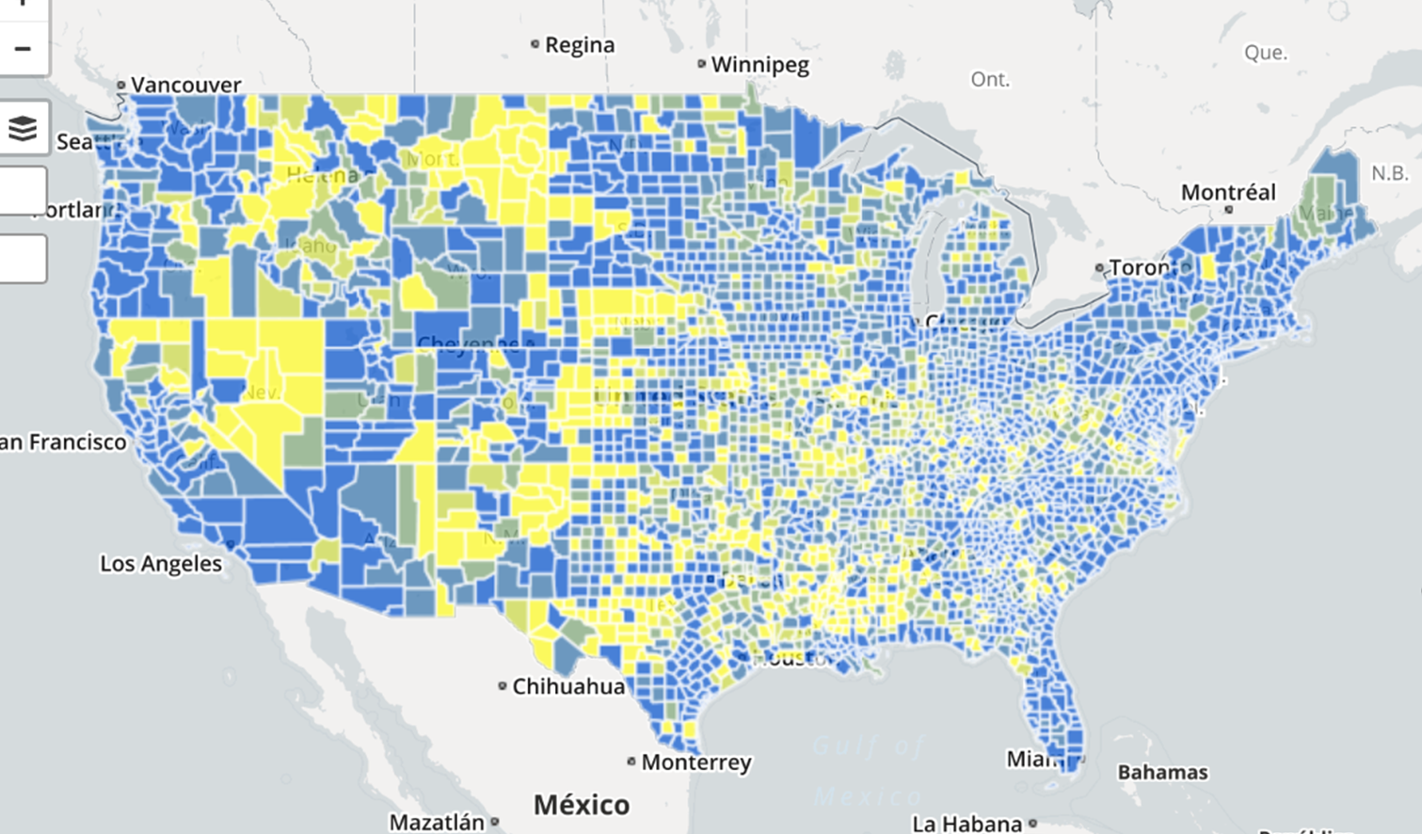

Slide 11
2015 FCC Study
17 percent of all Americans (55 million people) lack access to 25 Mbps/3 Mbps service.
53 percent of rural Americans (22 million people) lack access to 25 Mbps/3 Mbps.
  By contrast, only 8 percent of urban Americans lack access to 25 Mbps/3 Mbps broadband.
Rural America continues to be underserved at all speeds: 20 percent lack access even to service at 4 Mbps/1 Mbps, down only 1 percent from 2011, and 31 percent lack access to 10 Mbps/1 Mbps, down only 4 percent from 2011.
63 percent of Americans living on Tribal lands (2.5 million people) lack access to 25 Mbps/3 Mbps broadband
85 percent living in rural areas of Tribal lands (1.7 million people) lack access.

Slide 12
Network Modernization
Bandwidth needs grow over time, but the majority of IHS facilities cannot increase network bandwidth without significant upgrades
Modern wired broadband uses Ethernet Circuits over fiber cable.
Many rural parts of the U.S. still use Time Division Multiplex (TDM) over copper cable. Limited upgrade options
Migrating to Ethernet is very expensive (>$1M per location in many cases)– Mostly because of the special construction costs to lay underground fiber.
Monthly bandwidth costs after Ethernet upgrades are generally lower at most IHS facilities, but significantly higher for approximately ~10% of IHS facilities surveyed.
58%
of All IHS Circuits are T1 (1.5Mb)
200
Tribal and Federal locations only have a T1 connection to the IHS network

Slide 13
Thank you
Mitchell Thornbrugh
Acting Chief Information Officer
Indian Health Service
m: (240)620-3117 | w: (301)443-2019
Mitchell.Thornbrugh@ihs.gov

