Slide 1


638 Tribal Self-Governance in the 2018 Farm Bill
Empowering Indian Country through economic development and greater food access
2019 Tribal Self-Governance Annual Consultation Conference
April 3, 2019

Slide 2
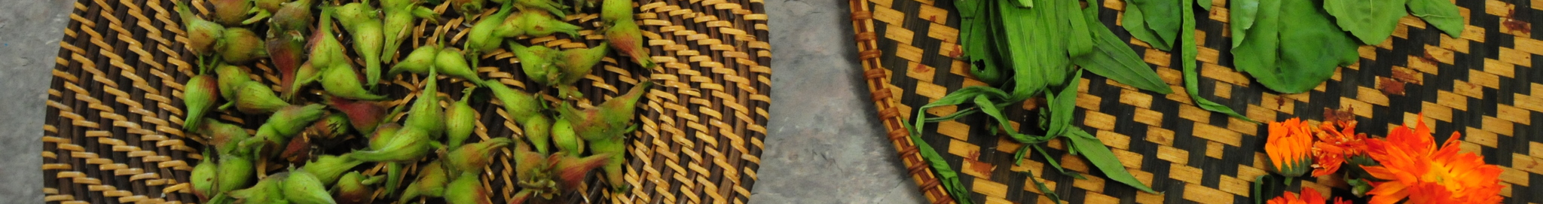

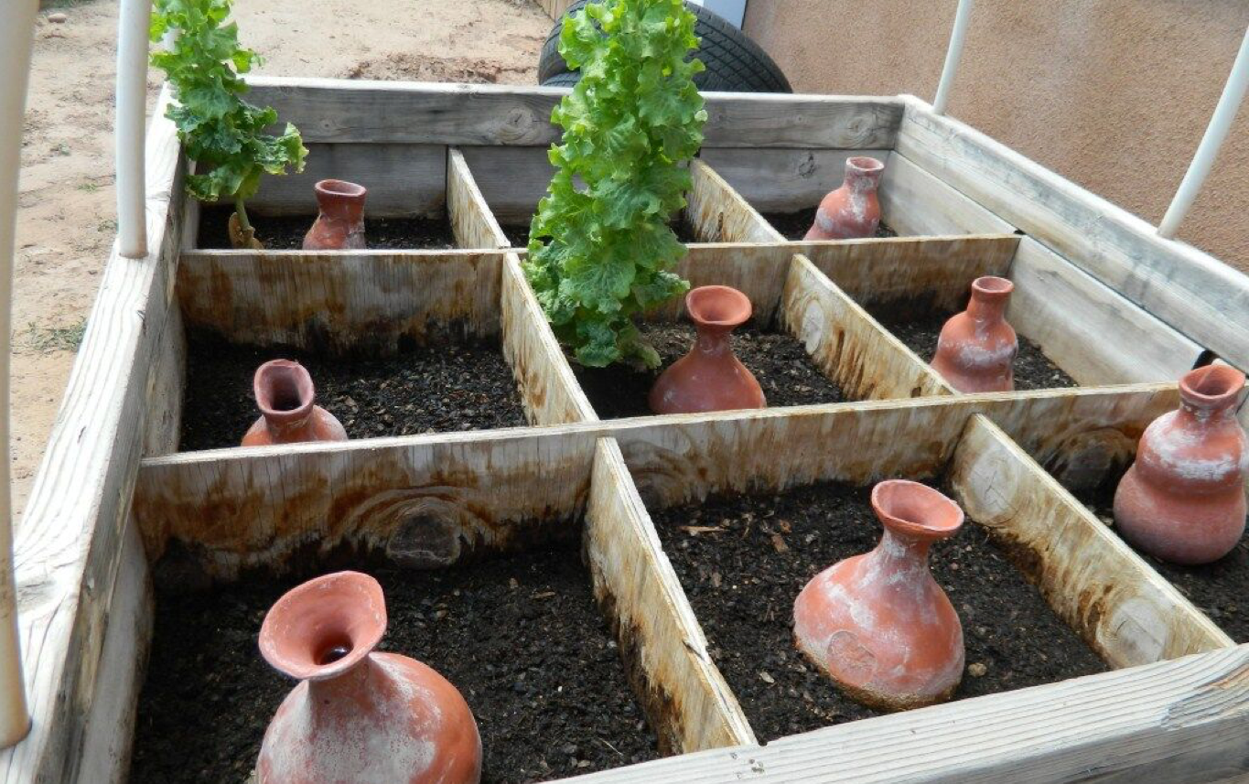
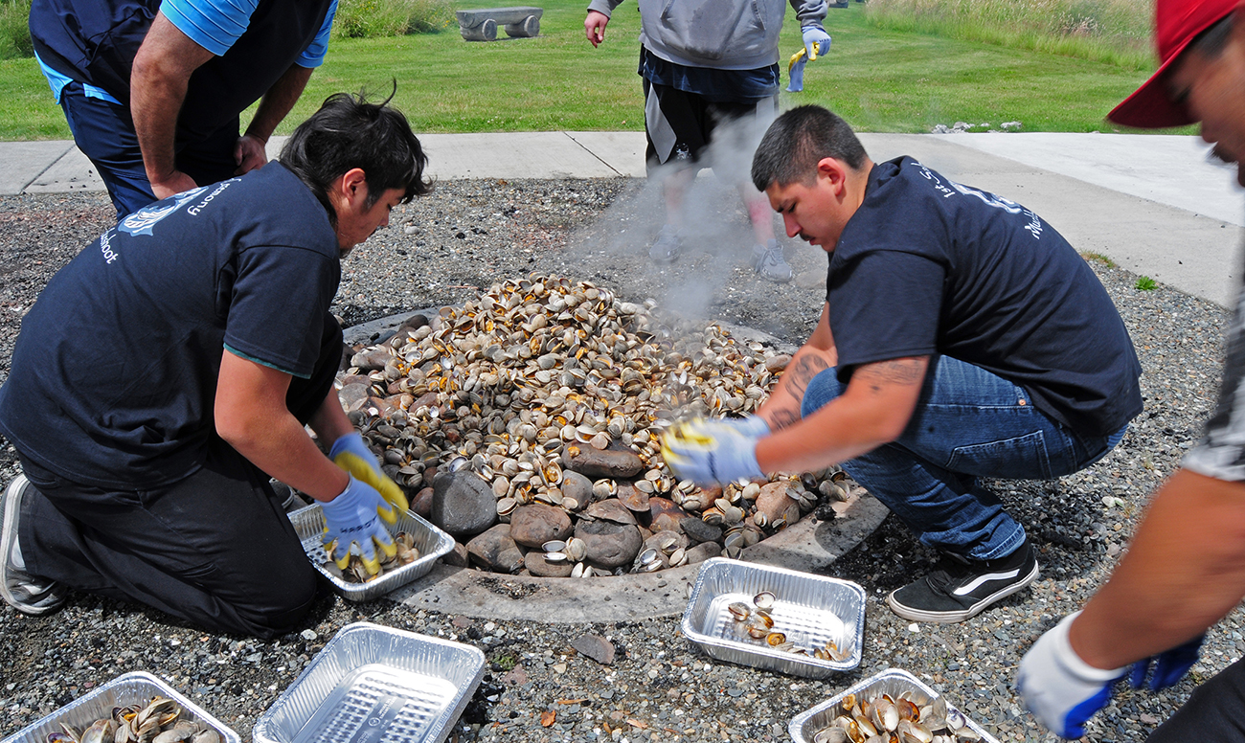
Indigenous Food and Agriculture Initiative
University of Arkansas Office of Economic Development
Our Mission
Enhance health and wellness in tribal communities by advancing healthy food systems, diversified economic development, and cultural food traditions
in Indian Country.
We Empower Tribal governments, farmers, ranchers, and food businesses:
Complex strategic planning and technical assistance;
Creating new academic/professional executive education programs in food systems and agriculture;
Developing solutions and opportunities through research in partnership with Tribes and Tribal organizations; and
Increasing student enrollment in
land grant universities in food and
agricultural-related disciplines.
Est. in 2013 at the School of Law
Vice-Chancellor Stacy Leeds
Founding Director Janie Simms Hipp
Moved with Vice-Chancellor Leeds to Office of Economic Development

Slide 3
Our Work in Indian Country
Tribal Governments & Producers
Tribal Food Systems & Cultural Traditions
Federal
Indian
Law and Policy
Food & Agriculture Law and Policy
Business and Economic Development
Capacity & Knowledge
Relationships & Networks
Training and Education Expertise
Outreach Capabilities
Notes:
FSMA Food Safety Training and Outreach
Native American Tribal Center for Food Safety Outreach, Education, Training and Technical Assistance – www.nativefoodsafety.org
Alternative Curriculum Development & Culturally Appropriate Training
Model Tribal Food and Agriculture Code - www.tribalfoodcode.com
Food Policy Roundtable Discussions
Support the National Association of the Food Distribution Programs on Indian Reservations (NAFDPIR)
Annual Native Youth in Food and Agriculture Leadership Summit – in Year 6!
Scaling-Up Project
Native Farm Bill Coalition – Research Partner

Slide 4





Regaining Our Future:
An Assessment of Risks and Opportunities for Native Communities in the 2018 Farm Bill
Commissioned by the Shakopee Mdewakanton Sioux Community
Release at NCAI Mid Year Conference in June 2017
Compendium of information on the Farm Bill, Indian Country’s involvement, the asks of Tribes, Tribal organizations, and a review or potential opportunities in the 2018 reauthorization
http://seedsofnativehealth.org/farm-bill-report-and-title-summaries/

Slide 5

Native Farm Bill Coalition
Membership
Over 170 Tribes represented
  77 Native Nations passed resolutions/sent letters of support
  15 Intertribal/Native Orgs and Tribal Authorities/Businesses:
    Affiliated Tribes of Northwest Indians
    All Pueblo Council of Governors
    American Indian Alaska Native Tourism Association (AIANTA)
    First Nations Development Institute
    Four Bands Community Fund CDFI
    Ho-Chunk, Inc.
    Indigenous Food and Agriculture Initiative (research partner)
    Intertribal Agriculture Council
    National Association of Food Distribution Programs on Indian Reservations
    National Congress of American Indians
    National Indian Education Association
    National Indian Health Board
    Northwest Indian Fisheries Commission
    Salish and Kootenai Housing Authority
    United South and Eastern Tribes SPF
  Ally Organizations
    MAZON: A Jewish Response to Hunger
    National Sustainable Agriculture Coalition

Slide 6
What’s the Farm Bill &
What Can it mean for Indian Country?
  5-year bill – 2018 Farm Bill $428 billion ($867 billion over 10 years)
    One of the only truly rural development focused pieces of legislation
    Second-largest non-defense spending bill Congress passes
    Provides a vast majority of the funding for USDA’s program
      Commodities, Crop Insurance, Conservation, Trade, Nutrition, Credit, Rural Development, Research, Education, Forestry, Energy, Horticulture, Infrastructure, Housing, Broadband
Commodities
Conservation
Trade
Nutrition
Credit
Rural Development
Research/Education
Forestry
Energy
Horticulture
Crop Insurance
Miscellaneous

Slide 7
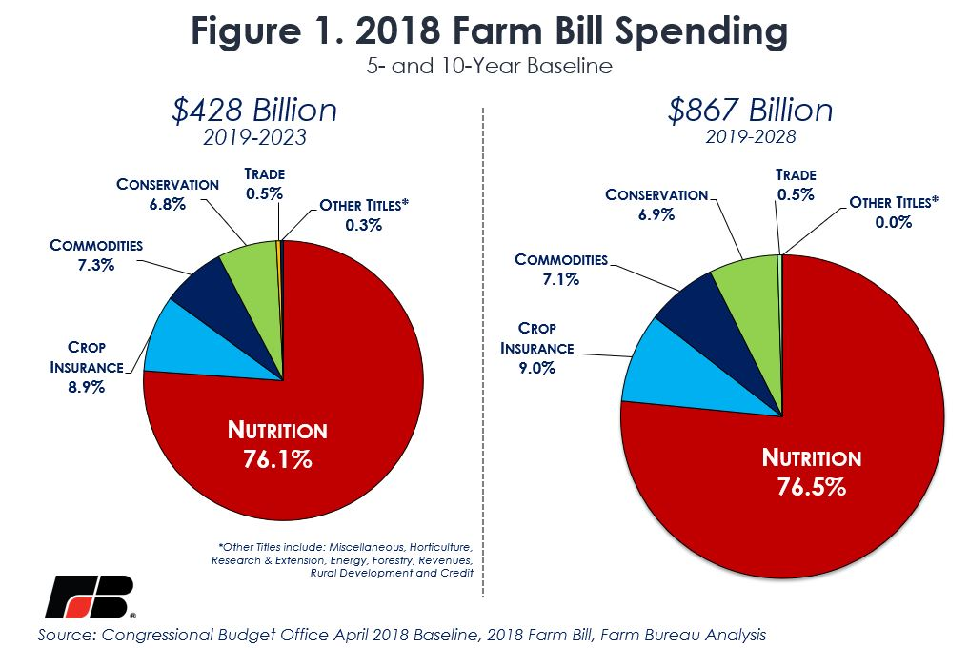
The 2018 Farm Bill – Pub. L. No. 115-334

Slide 8
What’s the Farm Bill &
What Can it mean for Indian Country?
  Represents rural and urban partnership that’s existed for over 40 years through the Nutrition Title and Farm Programs
    Nutrition Title acts as a “price support” for crops’ SNAP/Food Stamps helped secure votes of urban congressional representatives
    Now dynamics shift – 20 percent of rural households receive federal food assistance;
    Over 25 percent in Indian Country with some communities reaching over 50 percent
  Provides a substantial amount of infrastructure and research funding opportunities
  Can have a very strong tribal/state/local deference in authority
  Supports Conservation and Value-Added
  Credit access and loan/grant authorities

Slide 10
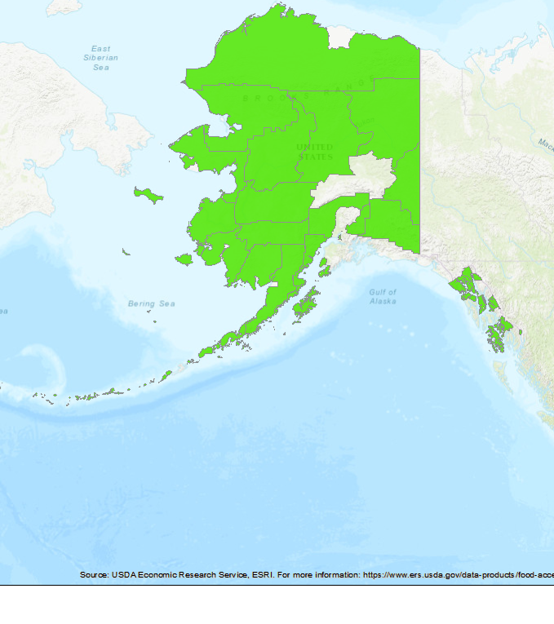

Slide 12
Current Scope of Ag in
Indian Country – People/Land
71,947 Native Farm Operators - $3.2 BILLION
57 million acres of land in Indian Country are already engaged in food and agriculture (2012 USDA Census of Agriculture)
  Example: 20 million of the 26 million acres in Arizona involved in food and agriculture is under direct Tribal control
  One of the largest contiguous farms in the U.S. is Navajo-owned (NAPI).
American Indian and Alaska Native Farm Operators and Farm lands
USDA Ag Census Year | 2007 | 2012
Total Native Farm Operators | 77,437 | 71,947
Acres Operated | 58.1 million | 57.2 million
Avg. Acres per Operation | 946 | 1,020

Slide 13
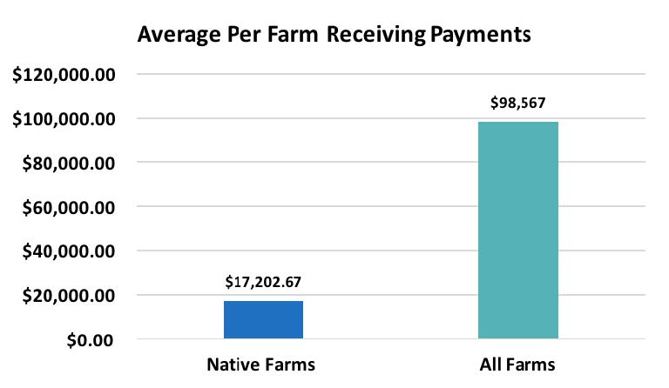
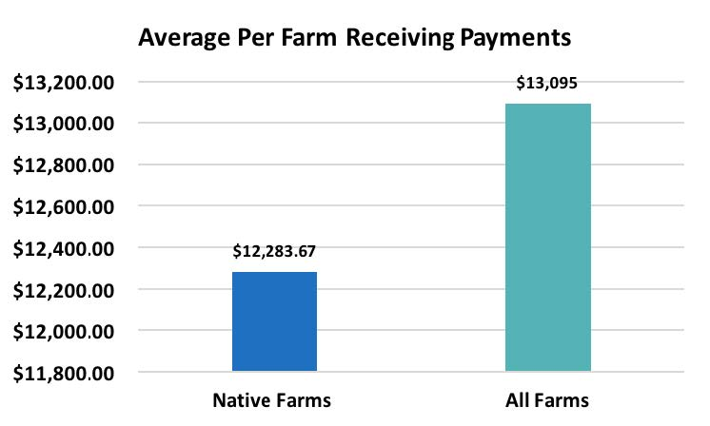
Average Farm Payments
Arizona, Nevada, and Utah
North Dakota, South Dakota, & Nebraska

Slide 14
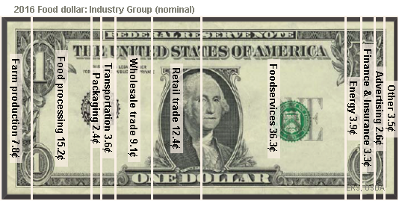

Importance of Value Added
Value added means more jobs, lower costs
3 steps would more than TRIPLE Reservation Economies

Slide 15
2018 Farm Bill Top Opportunities for Indian Country
  Tribal Administration of Nutrition Programs: Supplemental Nutrition Assistance Program/Food Distribution Program on Indian Reservations
    “638”,Increased authority, regional model, traditional foods, no matching, etc.
  Tribal Parity, Sovereignty, and Self-Determination
    “638” Forestry; Conservation; and Improved Access to Credit
  Rural Development: “SUTA” and Technical Assistance
  Increase Support and Access to healthy, traditional, local, and regionally produced food by Native Farmers and Ranchers
  FRTEP, Research, Education, and TCUs Equality

Slide 16



63 Tribal-Specific Provisions
39
27
9
7
6
Tribal Parity
Provisions
Access to Funding
Provisions
Training &
Infrastructure
Provisions
Technical
Assistance & Outreach Provisions
Traditional & Native Produced Food Provisions
62%
41%
14%
11%
9%
*Some tribal provisions may fall under multiple categories

Slide 17
Final 2018 Farm Bill Tribal Provisions:
Title I – Commodities
Inclusion in Supplemental Agricultural Disaster Assistance – Section 1501
  Adds tribes and tribal organization to definition of an eligible producer for the program.
  Required 75 percent reimbursement of the losses for beginning and veteran farmers and ranchers under the Tree Assistance Program.
Notes:
Parity

Slide 18
Final 2018 Farm Bill Tribal Provisions:
Title II – Conservation
Alternative Funding Arrangements to Support Tribal Access to Conservation Programs – Section 2503(c)
  Requires USDA to work with tribal producers and provide alternative funding arrangements for two essential conservation programs: Environmental Quality Incentives Program (EQIP) and Conservation Stewardship Program (CSP).
  This change is important as it requires the Secretary to provide tribal producers full access to EQIP and CSP programs while working within effective and traditional tribal agriculture structures and systems of cooperation.
Notes:
Parity, $

Slide 19
Final 2018 Farm Bill Tribal Provisions:
Title III – Trade
Increased Opportunities and Access to Overseas Markets – Section 3312
  Increases opportunities for tribes and tribal producers to participate in international U.S. trade delegations
Notes:
Parity, Trad/Native produced food

Slide 20
Final 2018 Farm Bill Tribal Provisions:
Title V – Credit
Improving Access to Credit for Tribal Producers – Section 5415
  Requires a GAO Study on access to the Farm Credit System in Indian Country
  GAO currently reaching out to interview people for study
Notes:
$

Slide 21
Final 2018 Farm Bill Tribal Provisions:
Title VI – Rural Development
Building Infrastructure and Economic Development Opportunities – Sections 6201, 6204, 6302, 6205, 6209, 6211, 6505,
  Establishment of Technical Assistance Program—Creates a permanent tribal technical service and assistance office across all USDA Rural Development funding authorities
  Provides refinancing authority for Rural Development programs currently within the Substantially Underserved Trust Areas (SUTA) designation
  Tribal priority, inclusion, and access to two broadband programs to build infrastructure and economic development opportunities in Indian Country – increase broadband program to $325 million (from $25 mil.)
Notes:
TA, $, Parity

Slide 22
Final 2018 Farm Bill Tribal Provisions:
Title VII – Research
Inclusion and Parity for Tribal Colleges and Universities (TCUs) – Sections 7109, 7120, 7502
  Adds 1994 TCUs as eligible for the McIntire-Stennis Forestry program capacity funding
  Reauthorization of support for TCUs, updating 1994 tribal colleges list
  Creates a Native American student scholarship fund for tribal students who attend land grant universities and colleges
  TCU inclusion in the Children, Youth and Families at Risk (CYFAR) and the Federally Recognized Tribes Extension Program (FRTEP)
Notes:
Parity, $

Slide 23
Final 2018 Farm Bill Tribal Provisions:
Title X – Horticulture
Local Agriculture Market Program – Section 10102
  Establishes tribal eligibility in local food programs to grow, process, and market Native foods.
Notes:
$, Parity, TA

Slide 24
Final 2018 Farm Bill Tribal Provisions:
Title X – Horticulture
Local Agriculture Market Program – Section 10102
  Establishes tribal eligibility in local food programs to grow, process, and market Native foods.
Legalization of Industrial Hemp – Sections 10113 & 10114
  Legalizes hemp farming and authorizes new state and tribal plans to self-regulate, develop, and expand hemp production; also provides technical assistance to tribes and requires that states permit a tribe to transport across a state hemp that is lawfully produced under this Act
Notes:
$, Parity, TA

Slide 25
Final 2018 Farm Bill Tribal Provisions:
Title XII – Misc.
Upholding the Trust Responsibility – Sec. 12301, 12406, 12510
  Maintains the Office of Tribal Relations within the Office of the Secretary to report directly to the Secretary of Agriculture
  Provides additional tribal government and producers eligibility and permanent baseline funding for the combined Farming Opportunities Training and Outreach (FOTO) program for beginning and socially disadvantaged farmers and ranchers
  Codifies the existence and access to federal agency resources and technical assistance for Tribal Promise Zones. Not included: competitive enhancement provisions.
Notes:
OTR: Parity
TAC: Parity, TA
FOTO: Parity, $, Infrastructure

Slide 26
Final 2018 Farm Bill Tribal Provisions:
Title XII – Misc.
Tribal Advisory Committee – Section 12303
  Establishes a new 11-member Tribal Advisory Committee through the Office of Tribal Relations to provide advice to the Secretary on Tribal-related issues and policies (Similar Structure to TTAC):
    3 members appointed by the Secretary;
    2 members appointed by the Senate Committee on Indian Affairs of the Senate (Chair and Vice-Chair get 1 appointment each);
    2 members appointed by the U.S. Senate Committee on Agriculture,(Chair and Ranking get 1 appointment each); and
    4 members appointed by the U.S. House Committee on Agriculture of the House of Representatives Chair and Ranking get 2 appointment each).
Notes:
OTR: Parity
TAC: Parity, TA
FOTO: Parity, $, Infrastructure

Slide 27
Final 2018 Farm Bill Tribal Provisions:
Title VIII – Forestry
Self-Governance and Parity for Healthy Forestry Management – Section 8624
  Good Neighbor Authority - Makes tribal governments eligible to exercise Good Neighbor Authority for forestry management agreements with states and USDA
Notes:
Parity

Slide 28
Final 2018 Farm Bill Tribal Provisions:
Title VIII – Forestry
Self-Governance and Parity for Healthy Forestry Management – Section 8703
  638 Demonstration Project - Establishes a Tribal Self-Governance Demonstration Project for management of Forest Service and Bureau of Land Management lands adjacent to Indian lands under the Tribal Forest Protection Act
  USDA – Forest Service is starting this process; this will be the first 638 provision that is implemented
  What will it look like?
  Cooperative Management Agreements plus 638 Contract
  NFBC Tribal Roundtable on 638 Forestry at ATNI on May 23, 2019
Notes:
Parity

Slide 29
Final 2018 Farm Bill Tribal Provisions:
Title IV – Nutrition
Supporting Tribal Self-Governance and Management of FDPIR – Sections 4003(a)-(b)
  New “638” tribal self-determination contracts demonstration project allowing ITOs to purchase food for the Food Distribution Program on Indian Reservations (FDPIR)
  Requires $5 million direct appropriation
Notes:
Traditional/Native grown food, Parity, $

Slide 30
Final 2018 Farm Bill Tribal Provisions:
Title IV – Nutrition
Supporting Tribal Self-Governance and Management of FDPIR – Sections 4003(a)-(b)
  Lowers tribal match to 20 percent; waiver of match and full USDA funding required for tribes with economic hardships; and ability to use other federal funding to reach the match requirement
  Allows for two-year carryover funding for FDPIR
  Adds “regionally-grown” to the traditional foods provision purchase provision for FDPIR
  Requires the Secretary to purchase traditional foods that can be procured “cost-effectively.”
Notes:
Traditional/Native grown food, Parity, $

Slide 31
Final 2018 Farm Bill Tribal Provisions:
Title IV – Nutrition
Additional Nutrition Programs – Sections 4205 & 4206
  Micro-Grants for Food Security—Provides money to states to award grants of up to $5,000 to individuals and up to $10,000 to eligible entities, including tribes and tribal organizations, for small-scale gardening, herding, and livestock operations directed to food insecure communities.
  The Gus Schumacher Food Insecurity Nutrition Incentives—Tribal agencies can use other federal resources and funds (including IHS funding) to meet the Food Insecurity Nutrition Incentive program matching requirement.
Notes:
$, Parity

Slide 32
Upcoming USDA Tribal Consultation:
May 1 & 2, 2019 in DC
First of (Hopefully) Several Tribal Consultations
Date:
Tuesday May 1, 2019 — Wednesday May 2, 2019
Time:
8:00 am — 4:30 pm Eastern Time (May 1)
8:00 am — 1:00 pm Eastern Time (May 2)
Location:
National Museum of the American Indian
300 Maryland Ave NE, Room 4018/4019
Washington, DC 20002
RSVP through email to Tribal.Relations@osec.usda.gov with:
Name; Tribe/Organization; Title (i.e. chairwoman); City, State; Phone; Attending both days? (Y/N); Issues you are interested in

Slide 33
Implementing the 2018 Farm Bill:
Next Steps for Tribes & NFBC
Look at Implementation Efforts and Outreach
  NFBC to hold a prep and informational webinar in about two weeks
  First of series of webinars on Farm Bill Implementation
Tribal 638 FDPIR
  Requires $5 million separate appropriation – will not happen without it

Slide 34
Potential Legislative Issues
116th Congress
Child Nutrition Reauthorization?
  National School Lunch and School Breakfast Programs
  Child and Adult Care Food Program
  Summer Food Service Program
  Afterschool Snack and Meal Program
  WIC: Special Supplemental Nutrition Program for Women, Infants, and Children
  WIC Farmers Market Nutrition Program
  Fresh Fruit and Vegetable Program
  The Special Milk Program

Slide 35
Potential Legislative Issues
116th Congress
  What Wasn’t in the 2018 Farm Bill
    638 for SNAP
    SUTA for all RD/USDA
  Appropriations
  Child Nutrition Reauthorization . . . .

Slide 36
Join the
Native Farm Bill Coalition
Need More Tribal Leadership and Tribal Organizations to get involved!
  Pass a resolution, send logo, and point of contact’s information
  Provide input, get latest updates, and receive information
  Coalition will provide talking points, one-pagers, and tailored data to support your advocacy; regular lawyer/lobbyist strategy calls; regular webinar and discussions
Website: www.nativefarmbillcoalition.org
Email: info@nativefarmbillcoalition.org

Slide 37
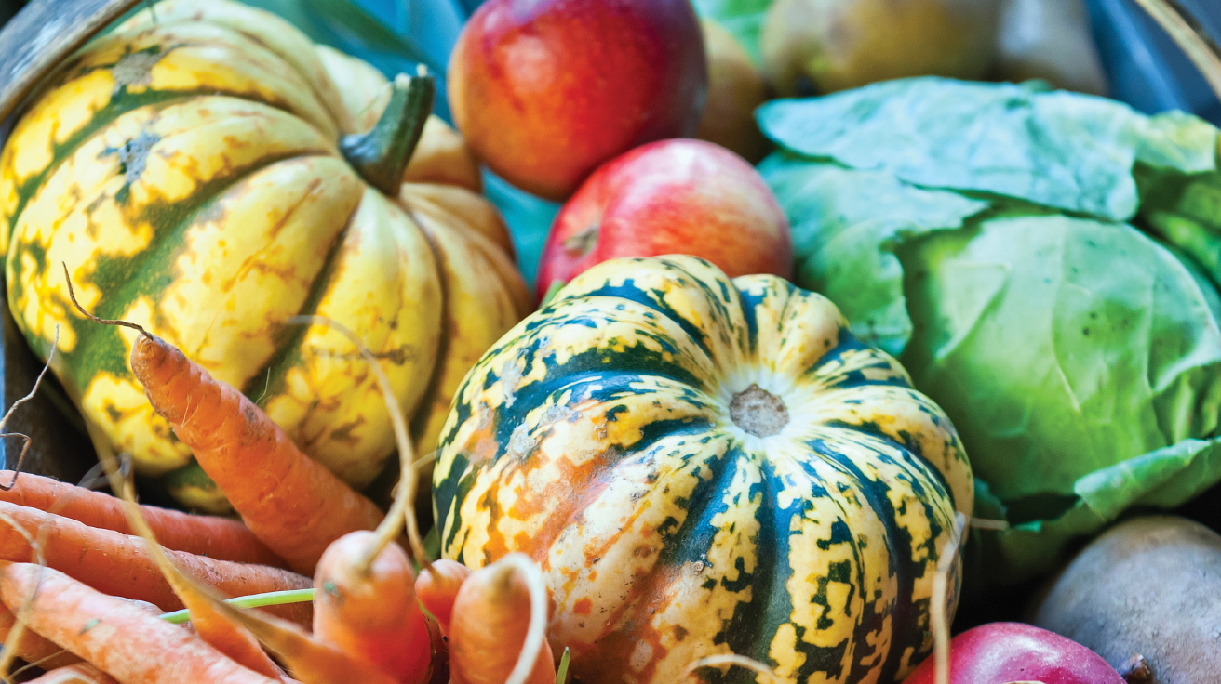

Empowering Indian Country through economic development and greater food access
Colby D. Duren, J.D., Director
Indigenous Food and Agriculture Initiative
University of Arkansas
Fayetteville, AR
cduren@uark.edu
www.indigenousfoodandag.com
@IFAIUark
@IndigenousFoodandAg
@foodsovereignty
WWW

