Slide 2
GAO’s Work on Energy and Economic Development on Tribal and Indian Lands

Slide 3
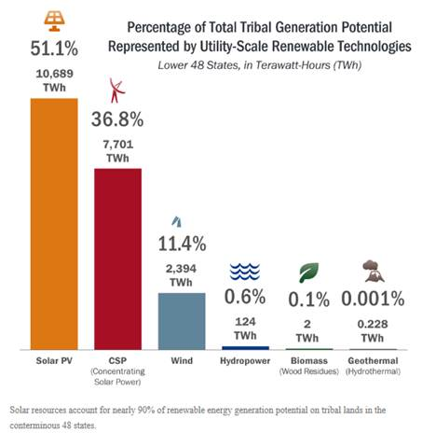
Renewable Energy Potential on Tribal and Indian Lands

Slide 4
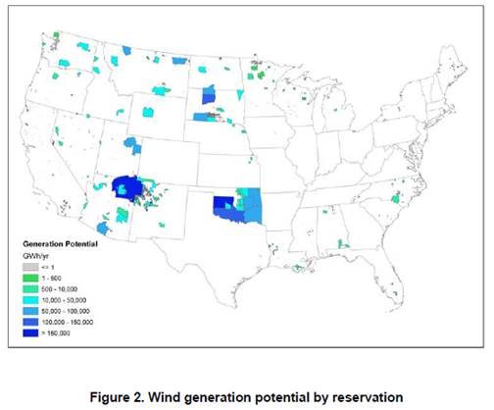
Wind Power Potential on Tribal and Indian Lands

Slide 5
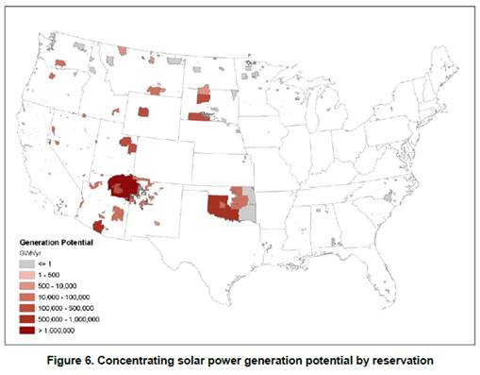
CSP Potential on Tribal and Indian Lands

Slide 6
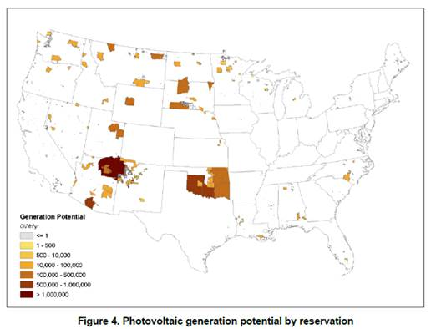
PV Potential on Tribal and Indian lands

Slide 7
Indian Energy: Poor management By BIA Has Hindered Development of energy on Indian Lands GAO-15-502
BIA does not have enough staff with the right skills in the right places to perform the tasks needed to assist tribes that choose to develop their energy resources.
BIA does not measure how long it takes to approve leases, issue permits, or develop communitization agreements. However these processes take far longer for BIA than for similar processes on federal, state, or private lands.
As a result, tribes and their members have missed huge opportunities to generate income from energy development and to create good jobs for tribal members.

Slide 8
Indian Programs: Interior Should Address factors Hindering Tribal Administration of Federal Programs GAO-19-87
In 2019, we found, among other things,
Inadequate Information Sharing By Interior
Delays in Disbursing Contract and Compact Funds
Lengthy Reviews of Proposed Tribal leasing Regulations
All of these factors are barriers to greater tribal self-governance.
Moreover, delayed or missed economic development is also a deterrent because self-governance tribes often must supplement federal funds when taking over administration of federal functions.

Slide 9
Programs that Serve Tribes and Their Members on GAO’s High Risk List
Indian Health Service
Bureau of Indian Education
BIA’s Administration of Energy and Economic Development Programs and Activities

Slide 10
High Risk Criteria and Federal Progress To-Date

Slide 11
Leadership Challenges at Interior and HHS

Slide 12
What Remains To Be Done?
Identify root causes of problems
Transform management to address these root causes
Demonstrate steady progress in improving outcomes of programs
Demonstrate a lasting commitment at the highest levels of management to ensure continued improvement

Slide 13
Recent and Coming Changes at GAO
Expanding Capacity To Evaluate Federal Programs Serving Tribes and Their Members
Plan to Form and Work with a Tribal Advisory Group
Created an Issue Area Devoted To Tribal issues
Better Coordination Across GAO Teams

Slide 14
Introducing My Colleagues at GAO and Taking Questions or Comments

