Slide 3


Slide 4

Stakeholder Engagement
Capturing and incorporating the voice of all stakeholders is vital to the success of the HHS // IHS HIT Modernization Project. The I/T/U community will have the opportunity to engage in the following ways:
Actively engage in Community of Practice
Participate in HIMSS Activities
Representation on Technical Advisory Group
Participate in Subject-specific Focus Sessions
Complete
Data Call Questionnaire
Participate in Site Visits
HHS // IHS HIT Modernization Project

Slide 7
Recommendation will be going directly to HHS Office of CTO and shared with IHS Executive Management and Stakeholder groups
Teams are actively working with Tribes and want to engage as many of these stakeholder groups possible for initiative-centric feedback
NIHB, DSTAC, TSGAC, and NCUIH have played a very helpful role in identifying and connecting the right tribal partners, which we value and hope for their continued support
Team is focused on Qualitive and Quantitative analysis with a priority of aligning the communities’ needs with Innovative solutions
HHS // IHS HIT Modernization Project

Slide 8
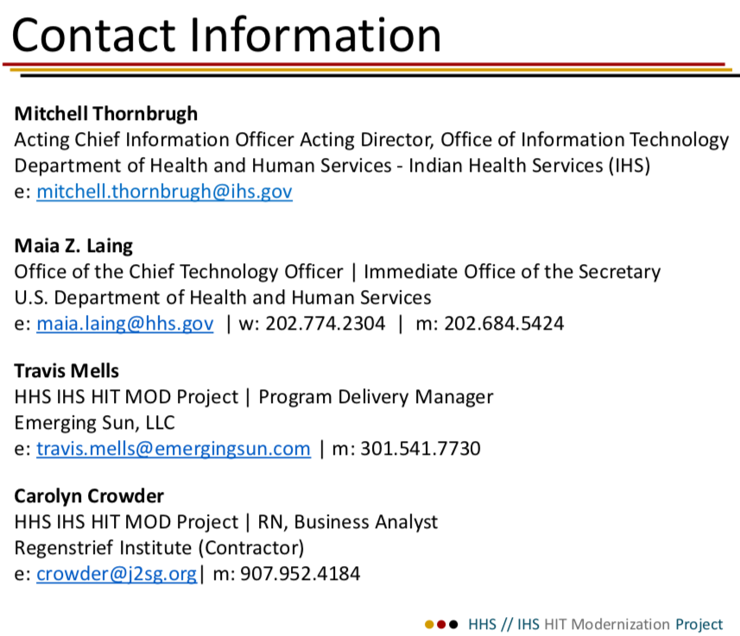
Project Group Email:
HITModernization@emergingsun.com
Mitchell Thornbrugh
Acting Chief Information Officer Acting Director, Office of Information Technology
Department of Health and Human Services - Indian Health Services (IHS)
e: mitchell.thornbrugh@ihs.gov
Maia Z. Laing
Office of the Chief Technology Officer | Immediate Office of the Secretary
U.S. Department of Health and Human Services
e: maia.laing@hhs.gov | w: 202.774.2304 | m: 202.684.5424
Travis Mells
HHS IHS HIT MOD Project | Program Delivery Manager
Emerging Sun, LLC
e: travis.mells@emergingsun.com | m: 301.541.7730
Carolyn Crowder
HHS IHS HIT MOD Project | Subject Matter Expert
Crown Consulting & Management
e: crowder@j2sg.org| m: 907.952.4184
Website
HHS OCTO Indian Health Service Health
Information Technology Modernization Initiative
https://www.ihs.gov/hit/
HHS // IHS HIT Modernization Project

