Slide 1
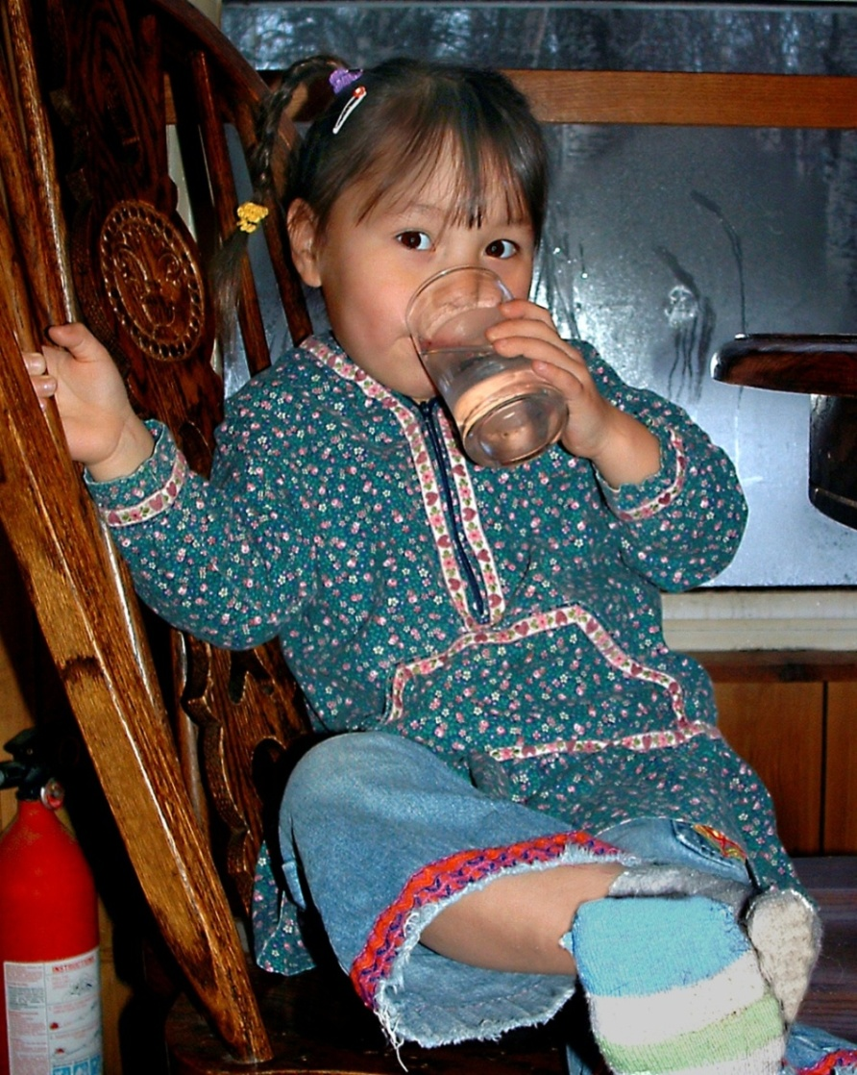
Impact and Opportunity:
Proposed Changes to the IHS Sanitation Deficiency System (SDS) Guideline
2019 Tribal Self Governance Consultation Conference
April 1, 2019
CAPT David Beveridge, PE
Director of Operations,
Environmental Health & Engineering ANTHC

Slide 2
Alaska Native Tribal Health Consortium
Created in 1998 with Congressional authorization
Provides statewide health services (incl. Sanitation Facilities Construction Program)
Supports all Alaska Tribal health organizations and communities

Slide 3
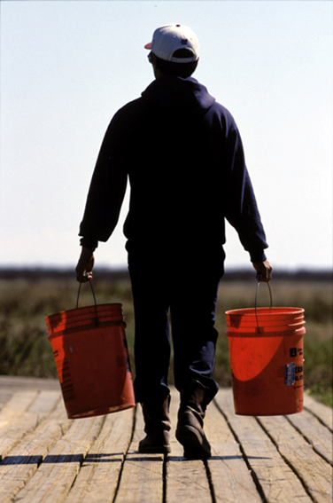
The Value of Rural Sanitation Investments
Infant Hospitalization Rates in Villages with <10% of Homes with Water Service* Compared with U.S. Infants**
Rate per 1,000 births
*YK Region, Alaska, 1999-2004 **All U.S., 1999-2001
Notes:
It is imperative to keep water and sewer systems operating
Homes revert back to honey-buckets and the risk of exposure to harmful pathogens increases

Slide 4
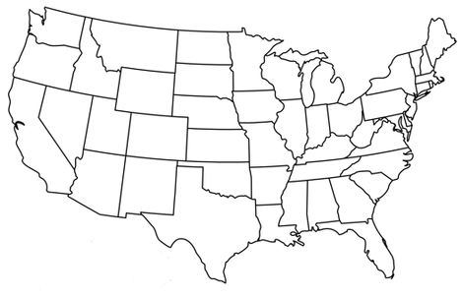
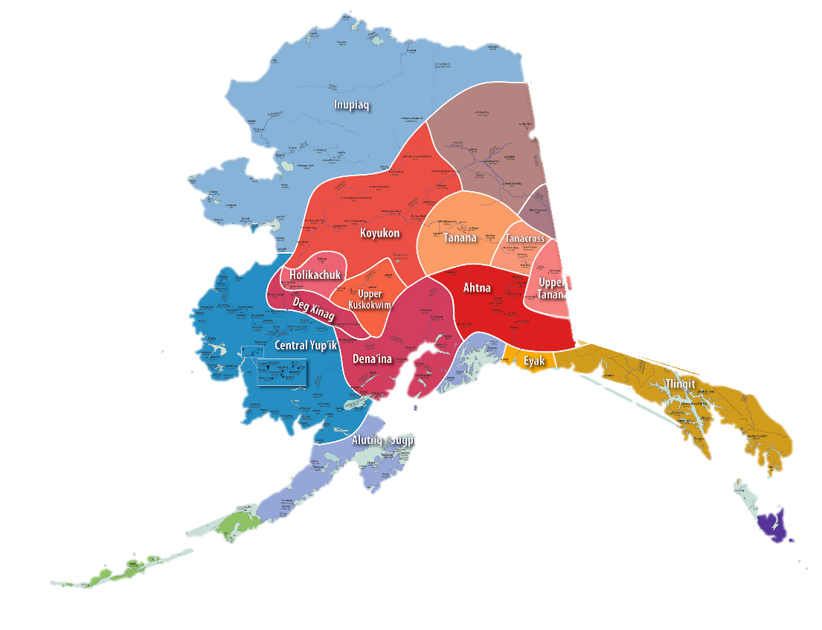
Many Nations – One Goal, Self Governance
Creating a data collection and scoring system that allows Tribes to address the unique challenges they face.
Consultation process for Tribes to provide comments on proposed SDS guideline.

Slide 5
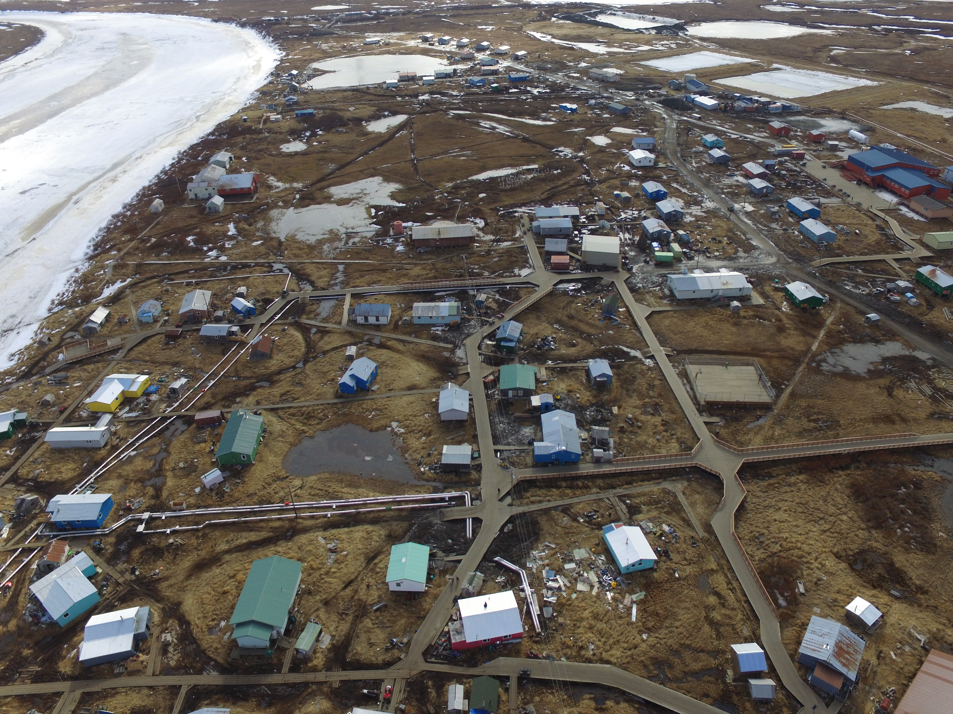
Alaska Experience with SDS - General
Unprecedented National
IHS SFC Funding FY18/FY19
180+ communities in SDS
ANTHC Maintains data
SDS List used for other funding
FY19 Funding (IHS & EPA)
44 Projects (24 require contributions)
39 Communities
90% Native Population
>95% Native Households
Eek – Pop 293, 99% Native
First Service Water and Sewer 2018

Slide 6
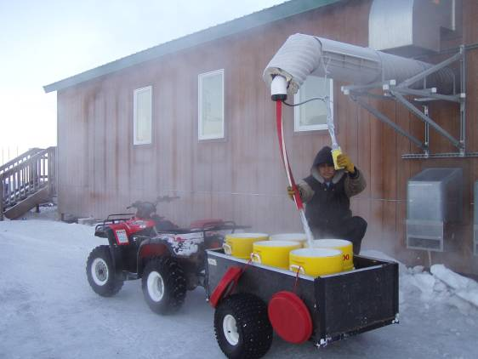
Alaska Experience with SDS – Contributions
Amounts vary based on usage
School may be only connection
Local ability to pay limited
Criteria (and willingness) of funding agency
Need time to secure
Consider non-cash, in-kind
Typical washeteria and watering point – Unserved

Slide 7
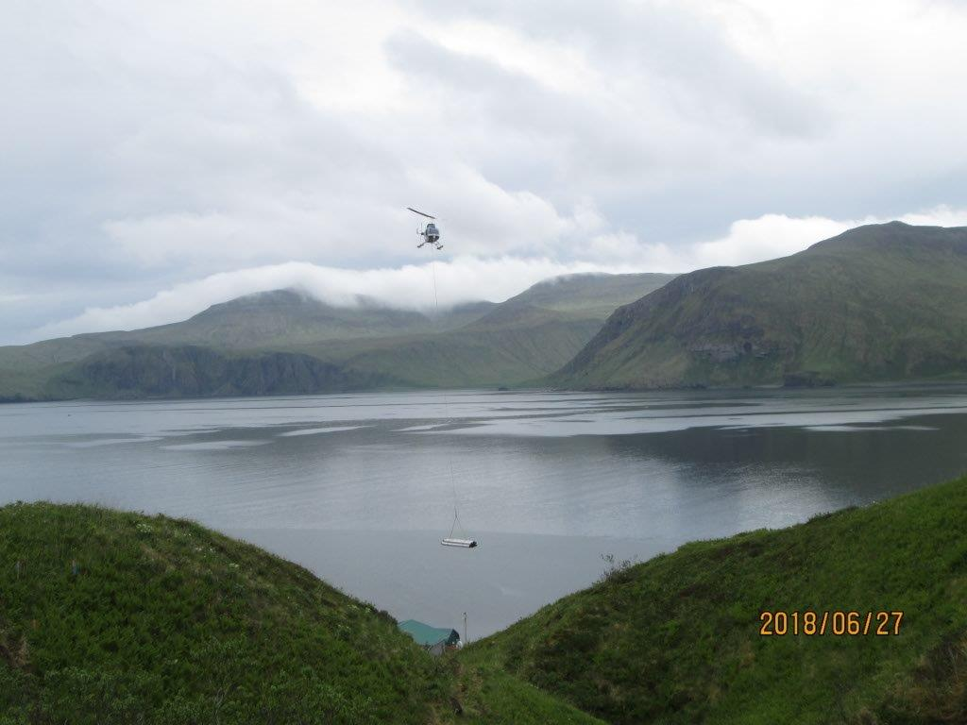
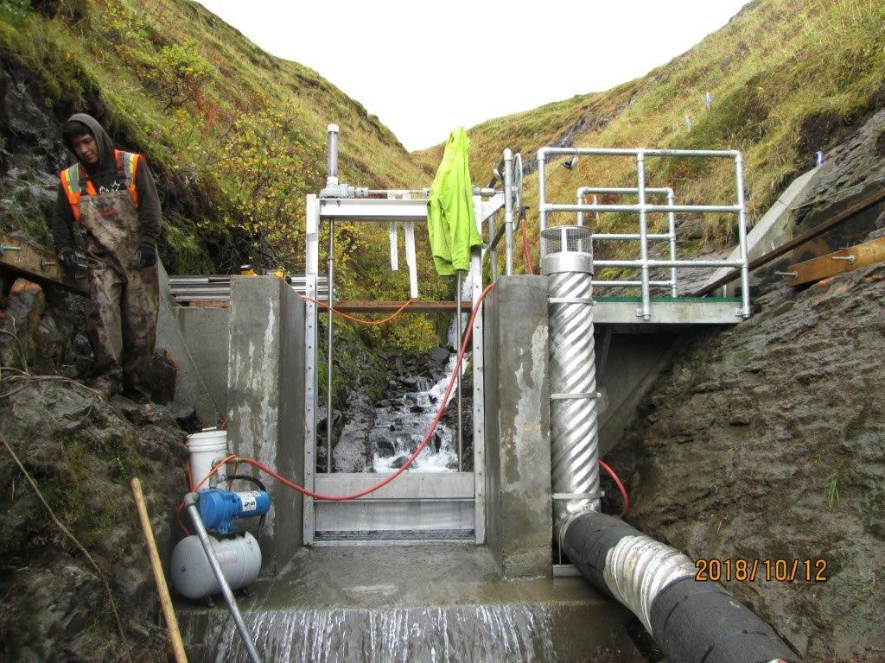
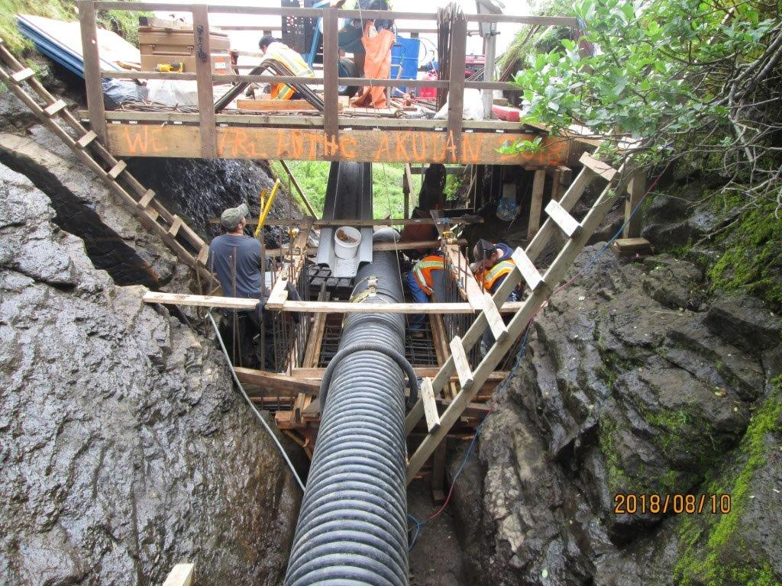
Alaska Experience with SDS – Allowable Unit Costs
Lower priority projects funded
Barrier for some first service
30 Unserved communities
Should be developed by Areas
Logistics
Actual costs
Other relevant systems
Akutan – Aleutian Chain 2018
New Intake & Transmission
Same allowable cost as Anchorage

Slide 8
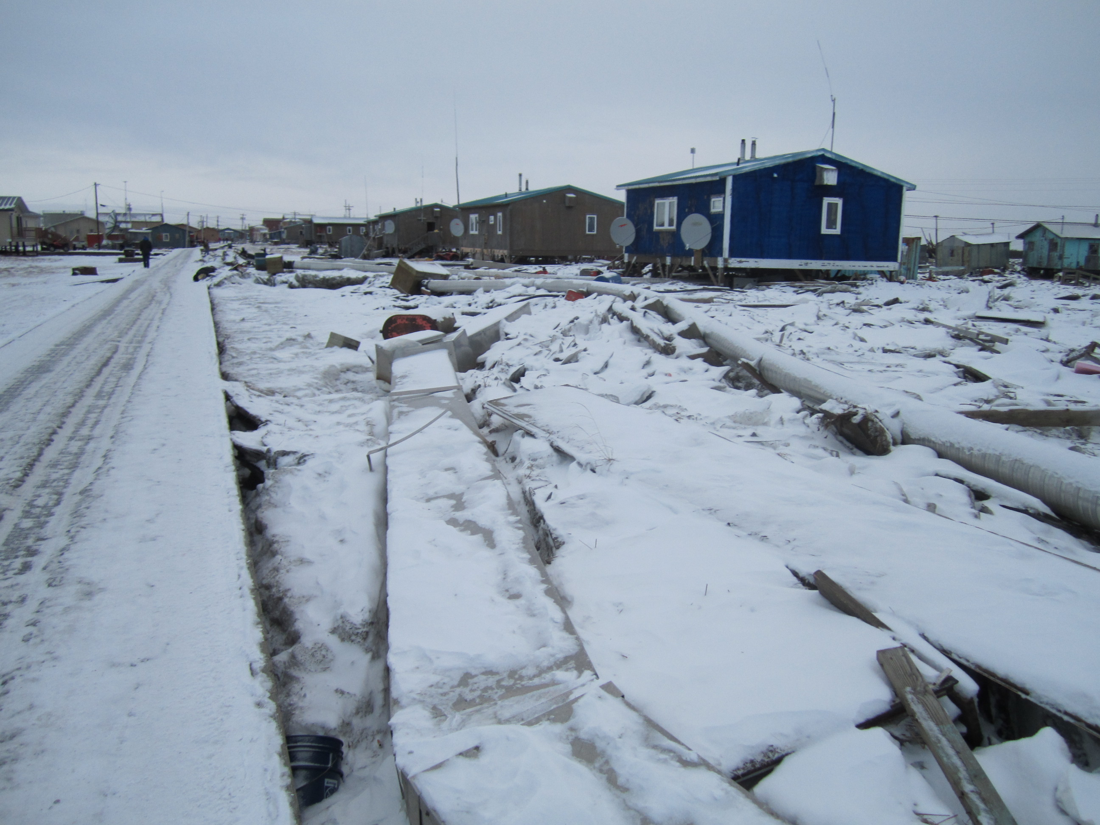
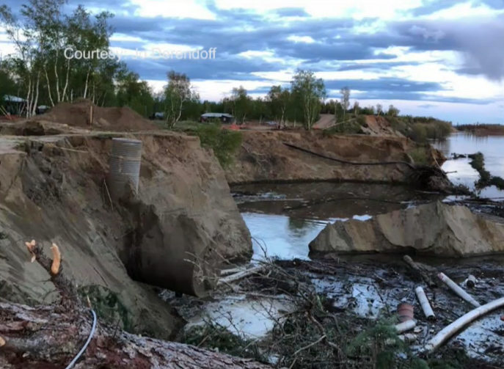
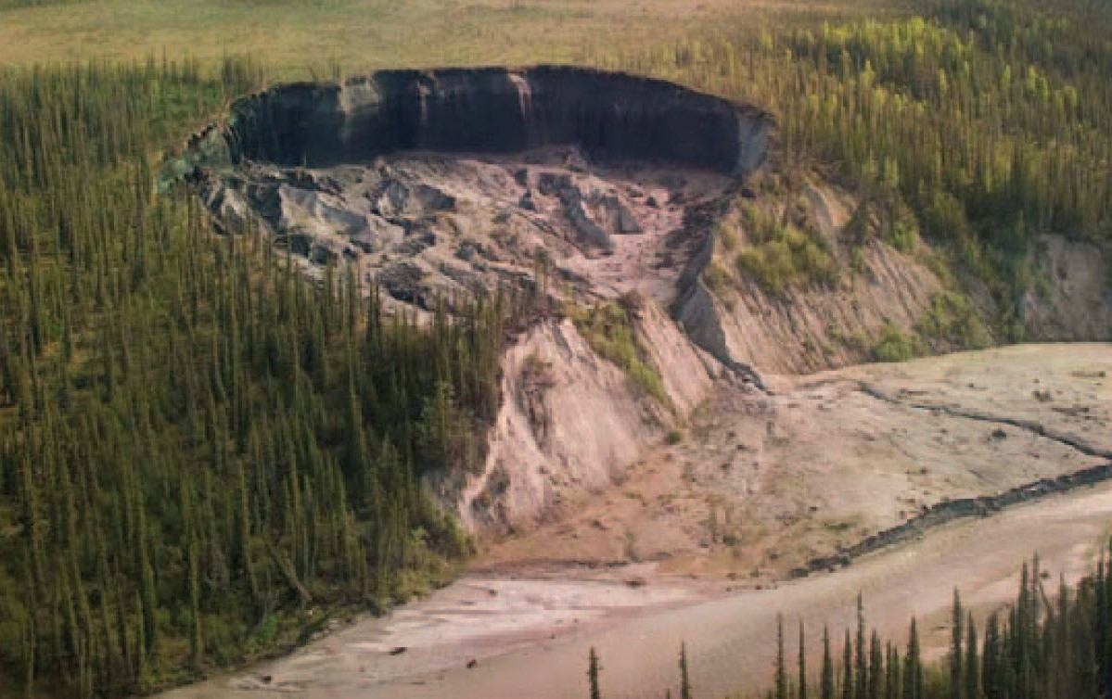
Alaska Experience with SDS – Existing Need Only
SDS - limited
Climate change
Water quality
Permafrost degradation
Erosion
Flooding (loss of sea ice)
Kotlik Storm Damage
Huslia Bank Erosion
Selawik River – Thermocarst
(Permafrost degradation)

Slide 9
Some things you can do
Engage with your IHS Staff on sanitation needs
Learn the funding rules – ask for training
Look for ways make contributions
Participate in project planning, design and construction
Participate on Tribal Advisory groups

Slide 10
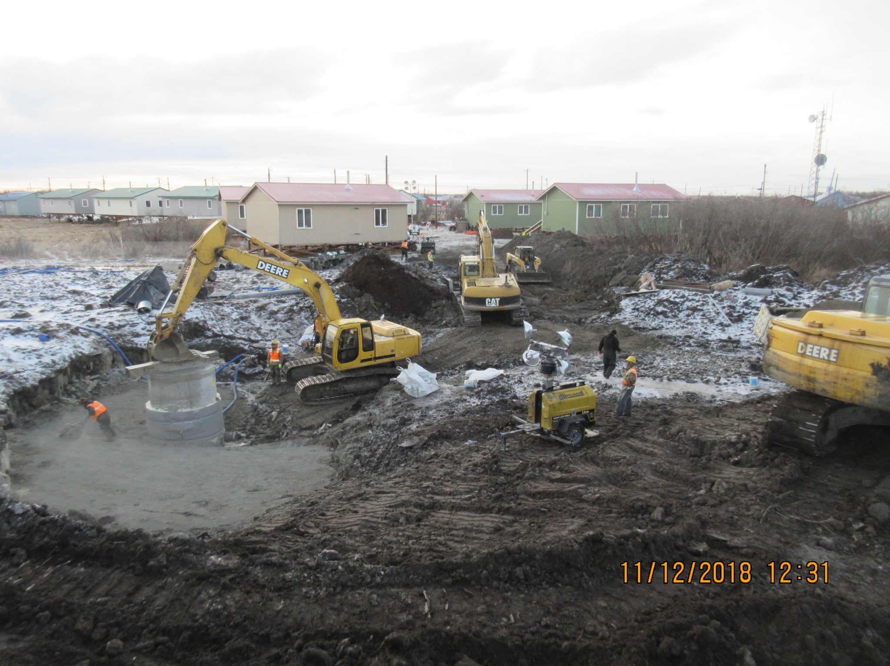
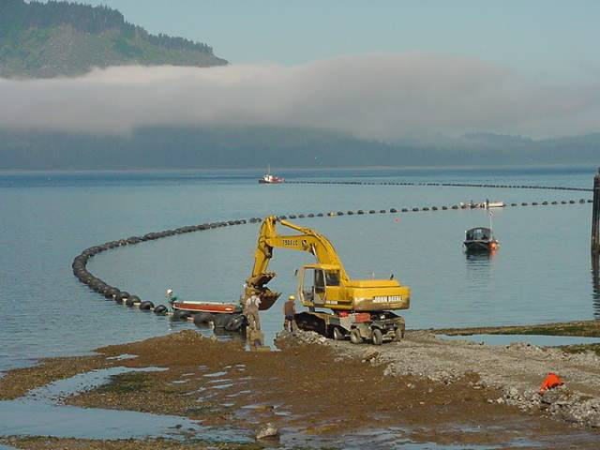
Thank You
Akiachak – First Service (Sewage Lift Station)
Hoonah – Replacement Wastewater Outfall

