Slide 1
IA Budget Update
August 29, 2023

Slide 2
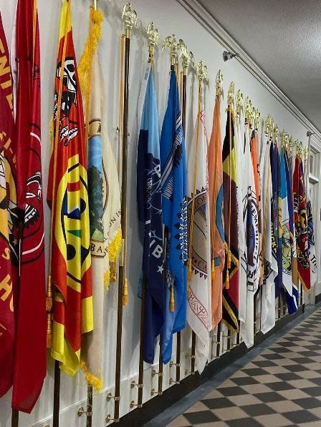

Agenda
FY 2024 Update
FY 2025 Schedule
Expiring Carryover

Slide 3

FY 2024 Appropriations Actions
House and Senate released 2024 proposed allocations
House Markup – Bill released July 12 full committee report released July 18
Senate Markup – Bill and full committee report released July 28

Slide 4
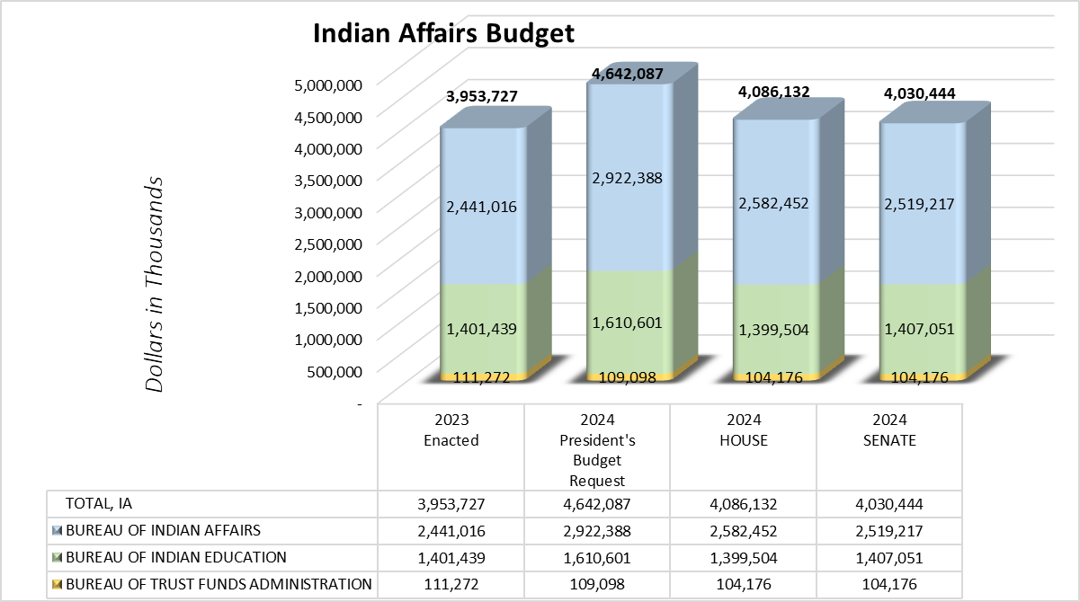
Indian Affairs Budget Overview
Considering the total reduction to the Interior and Environment Bill in the House Mark is $13.4B (-35%) and Senate is $1B (-3%) below Fiscal Year 2023, Indian Affairs came out relatively well.
BIA
  House +$141.4M above FY 2023
  Senate +$78.2M above FY 2023
BIE
  House -$1.9M below FY 2023
  Senate +$5.6M above FY 2023
BTFA is flat with FY 2023 after backing out OHA transfer
^{1/} 2022-23 Enacted reflects current CSC & 105(l) Actuals

Slide 5
FY 2024 Committee Markups
Tribal programs across Indian Affairs are collectively funded at:
HOUSE: $4.1B
  +$132.4K above FY 2023 Enacted level.
  -$555.9K below the President’s budget.
SENATE: $4.0B
  +$76.7K above FY 2023 Enacted level.
  -$611.6K below the President’s budget.
In addition to the BIA annual appropriations, funds provided in the Infrastructure Investment and Jobs Act for FY 2024 include:
$17M for Tribal Resilience and Adaptation
$26M for Community Relocation

Slide 6

Tribal Request vs PB Request vs Enacted
.

Slide 7

BIA Committee Mark Overview
Operation of Indian Programs
  House is $2.0B
    +$103.6M above FY 2023 Enacted.
    -$247.1M below the President’s budget.
    Includes +$7.1M OHA transfer
  Senate is $1.9B
    +27.6M above FY 2023 Enacted.
    -$323.1M below the President’s budget.

Slide 8
BIA Committee Mark Overview
BIA Construction
  House is level with FY 2023 Enacted.
  Senate is $154.8M
    +$1.5M above FY 2023 Enacted
    -$45.0M below the President’s budget.

Slide 9
BIA Committee Mark Overview
HOUSE
  All sub-activities and program elements presented in the budget request submitted to Congress are maintained at Enacted levels, as adjusted for the requested internal transfers, unless specifically addressed.
  Highlights –
+$38.8M for Law Enforcement programs.
+$23.7M for Tribal Courts (TPA)
+$11.0M for Road Maintenance to improve and maintain roads and bridges.
+$13.0M Climate Resilience for Coastal Tribal Communities.
+$2.0M increase to support housing units and applicants.
+$3.6M for Tribal Management Development Program general increase.
+$2.0M for Indian Business Incubator Program.
Notes:
Bullet 1 – CI&P 22.6m; Detention 15.7m; 500K Tribal Justice Support PL 280

Slide 10
BIA Committee Mark Overview
SENATE
  All programs and sub-activities included are continued at enacted levels
  Internal transfers are reflected
  Highlights –
    +$1.0M for Small Tribes Supplement.
    +$11.5M for Law Enforcement programs.
+$2.0M for Indian Child Family Violence Prevention activities.
+1.0M for ICWA grants to assist AI/AN sovereignty.
+$1.0M to support housing units and applicants.
+$1.8M RPI
+$614K for Tribal Management Development Program.
Notes:
LE includes $5M CI&P; $4M Detention; $1M Tribal Justice Sup; $1M MMIP
RPI $1M CRITFC Access Sites; $300K Pacific Salmon; $500K general for hunting fishing gathering rights,
TMDP-general increase

Slide 11
Bill Language Overview
HOUSE & SENATE both:
    Rejects the Administration’s proposal to reclassify Contract Support Costs and Payments for Tribal Leases as mandatory funding.
    Accept proposal to move the Office of Hearings and Appeals (OHA) under BIA.
    Do not provide funding for LWCF Tribal Land Acquisition.
    Reject request for funding to support the power system of the San Carlos Irrigation Project.
    Accept proposal for transfer authority to provide funds to the Office of the Secretary for trust, probate, and administrative functions.
HOUSE:
    Does not provide funding for Indian Land Consolidation.
SENATE includes:
    Transfer of Office of Subsistence Management out of FWS to Office of the Secretary.
Notes:
Bullet 1 – Senate report includes language that outlines that court decisions find that payments for contract support and tribal leases appear to create a type of budgetary entitlement not typically funded through discretionary appropriations. Reclassifying these programs as mandatory has been under discussion since the 2012 Decision.

Slide 12
BIE Committee Mark Overview
Operation of Indian Education Programs
  House is $1.131B
    -$1.9M below FY 2023 Enacted.
    -$62.8M below the President’s budget.
  Senate is $1.136B
    +3.2M above FY 2023 Enacted.
    -$57.7M below the President’s budget.
Education Construction
  House is level with FY 2023 Enacted.
  Senate is $270.3M
    +$2.4M above FY 2023 Enacted.
    -$145.9M below the President’s budget.

Slide 13
BIA Committee Mark Overview
  HOUSE Highlights –
    All lines at 2023 enacted level except $1.9M reduction to ISEP.
  SENATE Highlights –
    +$3.6M for ISEP.
    +$500K for ISEP Adjustments.
+$500K for Enhancements – Native Language
+$500K Student Transportation
-$555K Transfer of Juvenile Detention funding to Corrections
-$1M JOM
-$343K Scholarships & Adult Ed
+$1.4M Replacement School Construction
+$500K each to FI&R and Tribal College FI&R
Notes:
House leaves BIE lines flat with the exception of a $1.9M reduction to ISEP.

Slide 14
Bill Language Overview
HOUSE:
  Includes language limiting the number of schools and grade expansions.
SENATE:
  Does not include any language on number or expansion of schools.
  Directed reports
    JOM
    FERS-Salaries
    Native Language Programs
    Student attendance data and tracking

Slide 15
BTFA Committee Mark-Up Overview
  The House bill Appropriates funding under the Bureau of Trust Funds Administration heading, as requested; Senate does not.
  House and Senate fund BTFA at $104.2M, which is effectively FY 2023 Enacted less the transfer of OHA funding ($7.1M) to BIA.

Slide 16
FY 2025 Budget Formulation
Internal Indian Affairs’ budget proposals were developed using input from the Ranking Tool priorities, TIBC budget submission, School, Regional and CO input and Leadership priorities were submitted to DOI budget office.
DOI Passback was received on July 26, 2023 and initial OMB submission was provided to POB on August 28, 2023.
2025 budget submission due to OMB on Sept. 11, 2023
OMB sent a DTLL to announce a Tribal consultation on the Budget for Sept. 27, 2023, from 1-4 EST

Slide 17
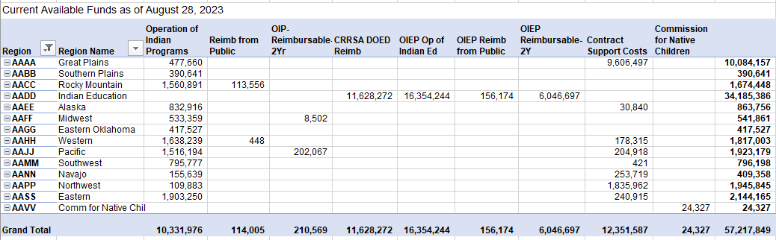
Carryover - Expiring
Expiring funds by Central Office Programs and Regional Offices - Regions

Slide 18
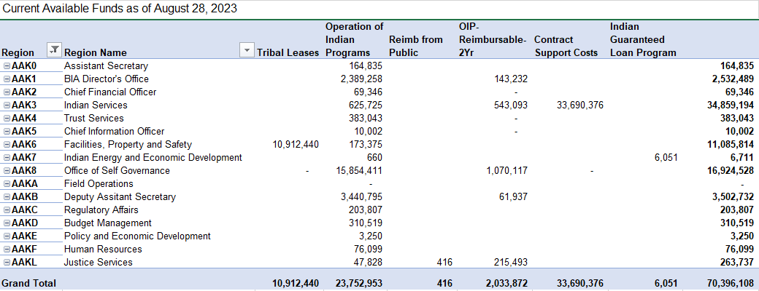
Carryover - Expiring
Expiring funds by Central Office Programs and Regional Offices – Programs

Slide 19
Questions?

Slide 20
THANK YOU!

