Slide 1
NCAI Budget Update
For the Self-Governance Advisory Committee
August 29, 2023
Introduction
Matthew Vogel
Policy Lead – Federal Budget & Appropriations
National Congress of American Indians

Slide 2
NCAI Budget Update
For the Self-Governance Advisory Committee
August 29, 2023
Agenda
Debt Limit Crisis
P.L. 118-5: Fiscal Responsibility Act of 2023
FY 2024 Regular Appropriations
FY 2023 Enacted vs. FY 2024 Outlook
Tribal Interior Budget Council Update
FY 2025 Tribal Budget Submission
Where is 2024 funding headed?
Congressional Next Steps

Slide 3
NCAI Budget Update
For the Self-Governance Advisory Committee
August 29, 2023
2023 Debt Limit Crisis
During the 2023 crisis, the federal debt reached its debt limit of $31.4 Trillion, placing the government at risk of defaulting on its obligations. As the default deadline approached, there were fears of severe consequences on the US economy, including credit rating downgrades and increased borrowing costs.
To avert a default, lawmakers eventually came to an agreement to raise the debt limit and passed P.L. 118-5: Fiscal Responsibility Act of 2023.
Notes:
January 19, 2023 the limit of $31.4 Trillion was reached and Treasury began using well-established “extraordinary measures” to borrow additional funds without breaching the debt ceiling.
When the debt limit is reached, the government must either reduce spending or raise the limit through legislation.
This uncertainty also impactes financial markets and investor confidence.
On June 3, President Biden signed into law the Fiscal Responsibility Act of 2023

Slide 4
NCAI Budget Update
For the Self-Governance Advisory Committee
August 29, 2023
P.L. 118-5: Fiscal Responsibility Act of 2023
Deliberations between President Biden and House Speaker Kevin McCarthy (R-CA) resulted in the passage of the Fiscal Responsibility Act (FRA). FRA temporarily suspends debt through January 1, 2025.
On January 2, 2025, the debt limit would be increased by the amount of obligations incurred up to that point. Congressional Budget Office (CBO) projects the law will reduce the federal deficit by about $1.5 trillion over 10 years.
The Act also includes:
Caps on Discretionary Funding
Rescission of Unobligated Funds
IHS Advanced Appropriations
Work Requirements
Other Provisions (Pay-as-you-go, federal student loans, energy related projects)

Slide 5
NCAI Budget Update
For the Self-Governance Advisory Committee
August 29, 2023
P.L. 118-5: Fiscal Responsibility Act of 2023
Caps on Discretionary Funding
Establishes for FY 2024 and FY 2025 statutory caps on defense and nondefense spending that would increase funding for defense and for veterans programs but reduced funding for other non defense programs and activities.
The agreement sets statutory caps on base discretionary spending for 2 years, FY 2024 and FY 2025 (as well as tentative levels for an additional four years through FY 2029), with separate caps set for defense and nondefense spending for those two years and spending levels that would rise by just 1% a year.
Notes:
-It also creates an incentive for Congress to enact all 12 appropriations bills this year. Section 102 would establish temporary caps on funding if a continuing resolution is in place on January 1 of 2024 or 2025. Caps on defense funding would be lower and caps on nondefense funding would be higher relative to the caps in section 101(a). Once full-year appropriations were enacted, the caps would revert to the limits that were in place on December 31 of that fiscal year (that is, the caps established in section 101(a), with adjustments). If a continuing resolution were still in place on April 30 of either 2024 or 2025, a final sequestration order would be issued according to the cap amounts in section 102.
FY24
Defense (-34.2 billion)
Non-Defense (-79.3 billion)
Total (-113.6 billion)
FY25
Defense (-57 billion)
Non-Defense (-98.6 billion)
Total (-155.6 billion)

Slide 6
NCAI Budget Update
For the Self-Governance Advisory Committee
August 29, 2023
P.L. 118-5: Fiscal Responsibility Act of 2023
Rescission of Unobligated Funds
Title I of division B would rescind funds that had been provided to 87 budget accounts during the 2020–2022 period as part of the federal response to the coronavirus pandemic and public health emergency.
CBO estimates that title would permanently rescind $27.1 billion in budget authority, reducing outlays by $11.0 billion over the 2023–2033 period.
Notes:
Unlike the House GOP debt limit bill (H.R. 2811) that would have rescinded $14.4 billion in clean energy and associated funding from last year's climate, health and tax law the FRA agreement includes no rescissions of clean energy funding from that law.
A majority of the reductions would come from the Public Health and Social Service Emergency Fund and from certain infrastructure and disaster relief programs.

Slide 7
NCAI Budget Update
For the Self-Governance Advisory Committee
August 29, 2023
P.L. 118-5: Fiscal Responsibility Act of 2023
Rescission of Unobligated Funds (cont.)
American Rescue Plan Act of 2021 – Public Law 117–2
Bureau of Indian Affairs
SEC. 66. The unobligated balances of amounts made available by section 11002(a) of Public Law 117–2 are hereby permanently rescinded.
PRESERVATION AND MAINTENANCE OF NATIVE AMERICAN LANGUAGES
“SEC 50. The unobligated balances of amounts made available by section 8169f0 of the Native American Programs Act of 1974 (42 U.S.C 2992d(f)), as added by section 11004 of Public Law 117-2, are hereby permanently rescinded.”
AMERICAN INDIAN, ALASKA NATIVE, AND NATIVE HAWAIIAN EDUCATION
SEC. 71. The unobligated balances of amounts made 19 available by section 11006 of Public Law 117–2 are hereby permanently rescinded.
Notes:
$1.7M of $900M was rescinded from BIA

Slide 8
NCAI Budget Update
For the Self-Governance Advisory Committee
August 29, 2023
P.L. 118-5: Fiscal Responsibility Act of 2023
Rescission of Unobligated Funds (cont.)
CARES Act – Public Law 116–136
Tenant-Based Rental Assistance
SEC. 25. The unobligated balances of amounts made available under the heading ‘‘Department of Housing and Urban Development—Public and Indian Housing—Tenant-Based Rental Assistance’’ in title XII of division B of Public Law 116–136 are hereby permanently rescinded.
HUD- Native American Programs
SEC. 26. The unobligated balances of amounts made available under the heading ‘‘Department of Housing and Urban Development—Public and Indian Housing—Native American Programs’’ in title XII of division B of Public Law 116–136 are hereby permanently rescinded.

Slide 9
NCAI Budget Update
For the Self-Governance Advisory Committee
August 29, 2023
P.L. 118-5: Fiscal Responsibility Act of 2023
IHS Advanced Appropriations
Sec. 123 (D)
(D) for the Department of Health and Human Services for the Indian Health Services and Indian Health Facilities accounts—
(i) for fiscal year 2025, in an amount that is not more than the amount provided
for fiscal year 2024 ($4.6 billion in FY 2024 advance appropriations)
Work Requirements
Division C of the bill would modify work requirements for SNAP and TANF. CBO estimates that those provisions would increase federal spending by about $2.1 billion over the 2023–2033 period, consisting of an increase of $2.1 billion for SNAP and a reduction of $5 million for TANF.
Notes:
Those estimates are informed by a 2022 CBO report that examined the effects of work requirements on enrollment and earnings for participants in means-tested programs.

Slide 10
NCAI Budget Update
For the Self-Governance Advisory Committee
August 29, 2023
P.L. 118-5: Fiscal Responsibility Act of 2023
Other Provisions
Pay-as-you-go
The executive branch is now required to follow administrative pay-as-you-go procedures before finalizing certain administrative actions.
Federal Student Loans
Terminate the current suspension of payments, interest accrual, and collections on defaulted loans in the student loan program 60 days after June 30, 2023
Energy Related Projects
The bill would amend provisions of current law that regulate permitting of certain proposed energy-related projects, require the Electric Reliability Organization (ERO) to study and report on the capability to transfer energy between utilities in neighboring regions, and require agencies to issue permits necessary to complete construction of the Mountain Valley Pipeline.
Notes:
Pay-as-you-go
Under those procedures, discretionary administrative actions that would increase direct spending by more than a certain threshold would be required to include additional proposed actions to fully offset the increase in direct spending.
Fed Student Loans
August 29, 2023 today marks the 60th day

Slide 11
NCAI Budget Update
For the Self-Governance Advisory Committee
August 29, 2023
Appropriations Spending Totals
How are the FY 2024 numbers looking?

Slide 12
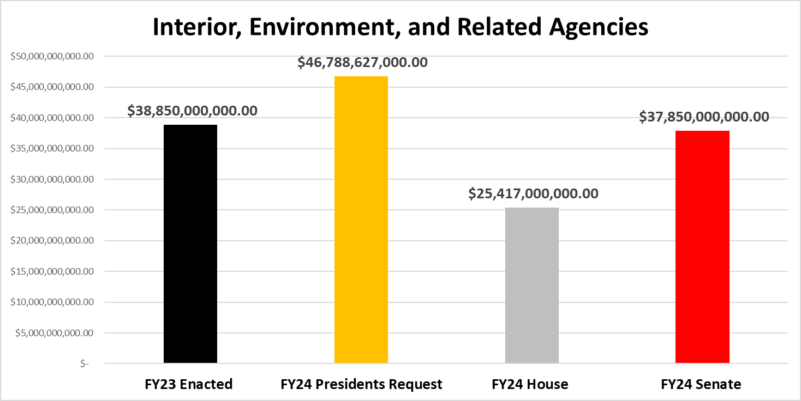
NCAI Budget Update
For the Self-Governance Advisory Committee
August 29, 2023
How are the Numbers Looking?
Notes:
FY24 House Mark is 34.6% below FY23 Enacted and 45.7% below Presidents Request
FY24 Senate Mark comes in at 2.6% below FY23 Enacted levels snf 19.2% below Presidents Request

Slide 13
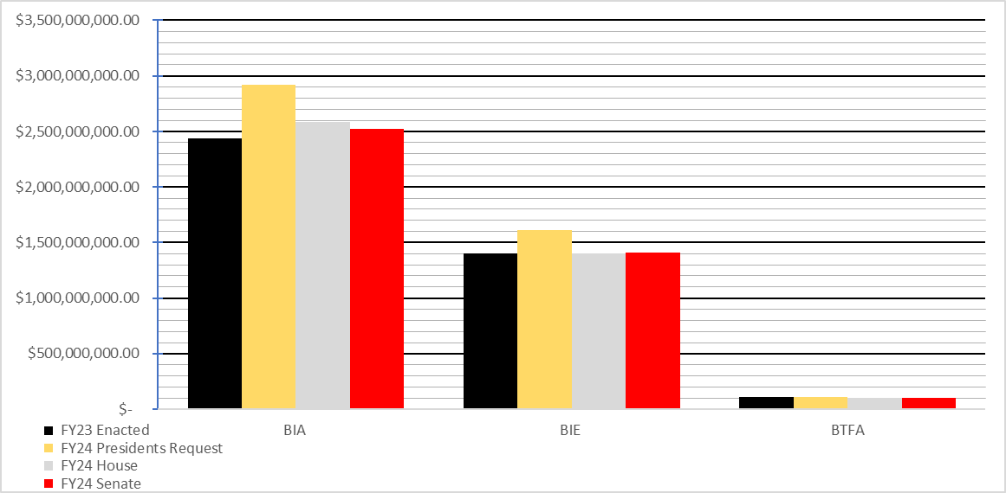
NCAI Budget Update
For the Self-Governance Advisory Committee
August 29, 2023
How are the Numbers Looking?
Notes:
BIA: House +$141.4M above FY 2023
Senate +$78.2M above FY 2023
BIE: House -$1.9M below FY 2023
Senate +$5.6M above FY 2023
BTFA: Flatline Funding

Slide 14
NCAI Budget Update
For the Self-Governance Advisory Committee
August 29, 2023
Committee Report General Provisions
Rejects the Administration’s proposal to reclassify Contract Support Costs and Payments for Tribal Leases as mandatory funding.
Accept proposal to move the Office of Hearings and Appeals (OHA) under BIA.
Do not provide funding for LWCF Tribal Land Acquisition.
Notes:
Unfortunately, neither the House nor Senate bill included reclassification of Contract Support Costs and 105(l) leases as mandatory spending, which is a long-time request of Tribal nations, and a provision included in last year’s Senate proposal.

Slide 15
NCAI Budget Update
For the Self-Governance Advisory Committee
August 29, 2023
How are the Numbers Looking?

Slide 16
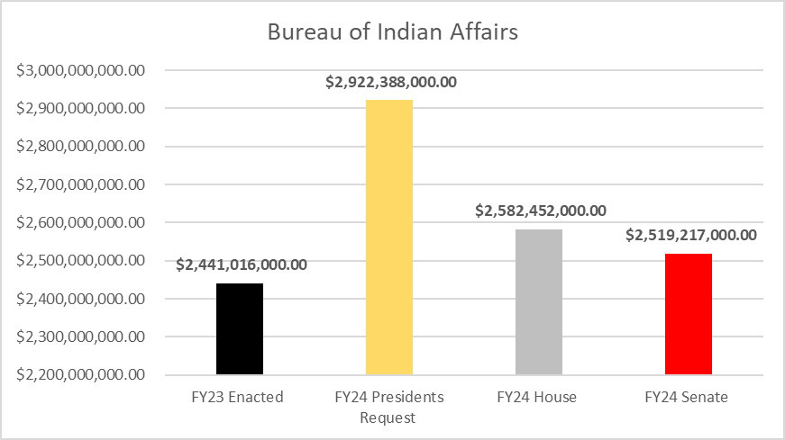
NCAI Budget Update
For the Self-Governance Advisory Committee
August 29, 2023
How are the Numbers Looking?
Notes:
House:
+$38.8M for Law Enforcement programs.
+$23.7M for Tribal Courts (TPA)
+$11.0M for Road Maintenance to improve and maintain roads and bridges.
+$13.0M Climate Resilience for Coastal Tribal Communities. to support vulnerable coastal Tribal communities and Alaska Native villages that experience severe weather-related conditions that jeopardize public safety and health.
+$2.0M increase to support housing units and applicants.
+$3.6M for Tribal Management Development Program general increase.
+$2.0M for Indian Business Incubator Program.
Senate:
+$1.0M for Small Tribes Supplement.
+$11.5M for Law Enforcement programs.
+$2.0M for Indian Child Family Violence Prevention activities.
+1.0M for ICWA grants to assist AI/AN sovereignty. Enacted to support ICWA grants to assist American Indians and Alaska Natives to assert their sovereignty under ICWA and to protect the rights of children in State welfare and judicial systems. The Committee also acknowledges the discrepancy of Alaska Native and American Indian children that are disproportionately represented in foster care systems and Tribes are the only entity in Children in Need of Assistance [CINA] cases not provided an attorney by the state. The Committee notes funds included shall be used to meet the ICWA’s mandate and attorney assistance in CINA cases.
+$1.0M to support housing units and applicants. Directs BIA to conduct an analysis of Alaska Natives’ eligibility for both Housing Program mortgage assistance grants and mortgages, as well as any barriers to affording new, energy-efficient homes in western Alaskan villages off the road system.
+$1.8M RPI
+$614K for Tribal Management Development Program.
Tiwahe.—The Committee expects funding to existing Tiwahe pilot programs to continue in the same amounts to the same recipients, including funding to support women and children’s shelters. The Bureau of Indian Affairs [BIA] is directed to submit a plan on how to expand the program to all Tribes incrementally along with a strategy on how to consider existing pilot programs during any expansion and be consistent with the final report and available funding. Further, as part of the expansion plan and strategy, the BIA is encouraged to explore the possibility of including all seven Virginia Tribes as a single consortium and who may be positioned to benefit as participants in future Tiwahe expansion plans.
Public Law 83–280 Needs.—The Committee notes that a number of States with large Indian populations have no law enforcement presence in Tribal communities and Alaska Native Villages despite skyrocketing crime rates. However, these Tribes are not eligible for certain Native justice funding simply because they are located in Public Law 280 States. Within 180 days of enactment of this act the Bureau is directed to conduct Tribal consultation on the budgetary needs of Tribal law enforcement, including wellness courts and other essential judicial needs for the tribes in these States, and report back to the Committee on the available Federal funding, within the Department of the Interior or elsewhere, for these tribes or outlining the barriers to the development of such funding.
the Committee notes the $7,000,000 provided in fiscal year 2023 for the Tribes that are eligible to receive public safety and justice funding but have not received funding in previous years will be incorporated into base funding for public safety and justice, following meaningful Tribal consultation to determine eligibility.

Slide 17
NCAI Budget Update
For the Self-Governance Advisory Committee
August 29, 2023
How are the Numbers Looking?

Slide 18
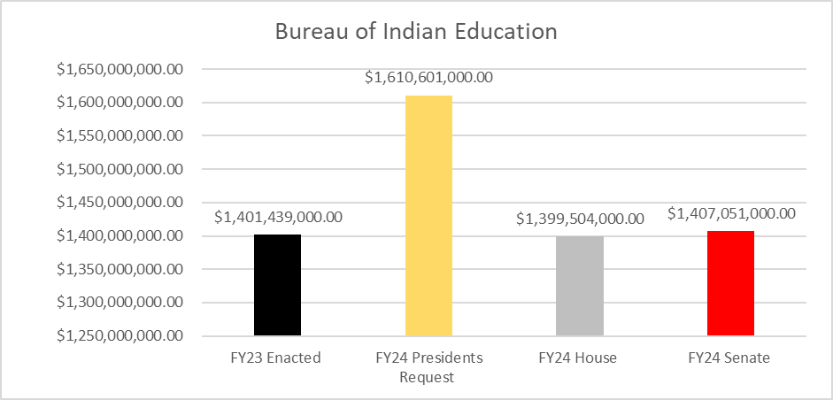
NCAI Budget Update
For the Self-Governance Advisory Committee
August 29, 2023
How are the Numbers Looking?
Notes:
House -$1.9M below FY 2023 (All lines at 2023 enacted level except $1.9M reduction to ISEP.)
Senate +$5.6M above FY 2023
SENATE Highlights –
+$3.6M for ISEP.
+$500K for ISEP Adjustments.
+$500K for Enhancements – Native Language The Committee understands the importance of preserving native languages for all Tribal communities. The Committee previously appropriated funds to the Bureau of Indian Education to build capacity for language immersion programs or to create new programs; however, those States that have federally recognized Tribes without Bureau-funded schools have been prevented from participating in this program, even though eligibility for these grants has included potential applicants beyond the Bureau of Indian Education school system. The Committee recommends no less than enacted in funding under this subactivity for language immersion grants. The Committee expects that eligibility will include any private nonprofit or Tribal organization in those States without Bureau-funded schools that are interested in further enhancing or creating native language immersion programs. The Committee supports the administration’s efforts.
+$500K Student Transportation
-$555K Transfer of Juvenile Detention funding to Corrections
-$1M JOM
-$343K Scholarships & Adult Ed
+$1.4M Replacement School Construction
+$500K each to FI&R and Tribal College FI&R - The Committee included directives under the Bureau of Indian Education-Operation of Indian Education Programs in previous years directing the Bureau to develop a methodology regarding the operating and infrastructure needs for Tribal colleges, but the Bureau has not yet complied and submitted a methodology. With the addition of mandatory money for deferred maintenance for these activities, the Committee again directs the Bureau to conduct an assessment of Tribal colleges facility needs and develop a distribution methodology to address these needs. The Committee also directs the Bureau to report back within 60 days of enactment of this act on how it conducts student counts at Tribal colleges and how funding is provided to address facilities operation, maintenance, and construction needs.

Slide 19
NCAI Budget Update
For the Self-Governance Advisory Committee
August 29, 2023
How are the Numbers Looking?
Notes:
Funding is Flatlined

Slide 20
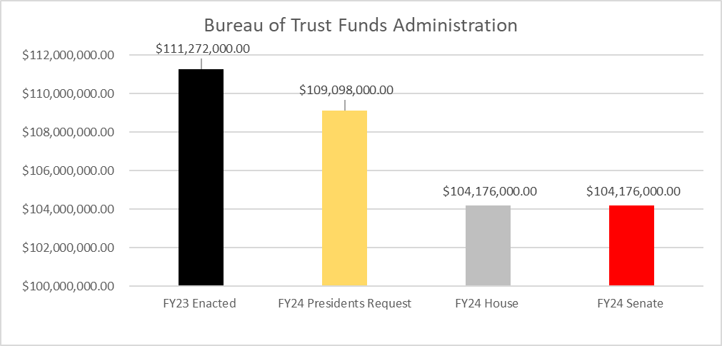
NCAI Budget Update
For the Self-Governance Advisory Committee
August 29, 2023
How are the Numbers Looking?
Notes:
Funding for BTFA is Flatlined
The budget also proposes to shift funding for the DOI Office of Hearings and Appeals Probate Hearings Division to BIA from the Bureau of Trust Funds Administration. This transfer will align OHA’s Probate Hearings Division function with BIA’s Probate Real Estate function, allowing DOI to more efficiently process probate cases to completion by improving coordination between BIA and OHA

Slide 21
NCAI Budget Update
For the Self-Governance Advisory Committee
August 29, 2023
Tribal Interior Budget Council
The Next Tribal/Interior Budget Council (TIBC) meeting
is scheduled for November 6-9, 2023. Meeting are back to 100% in-person.
Spring meetings for TIBC are tribal budget submission
meetings. This meeting will formulate an FY 2026
request for Indian Affairs programs.
The preferred program ranking tool process is on an
every-other-year schedule, and this is an “off” year.
TIBC data profile work is ongoing, with subcommittees
considering programs that address unique data
collection, privacy, or improvement concerns.

Slide 22
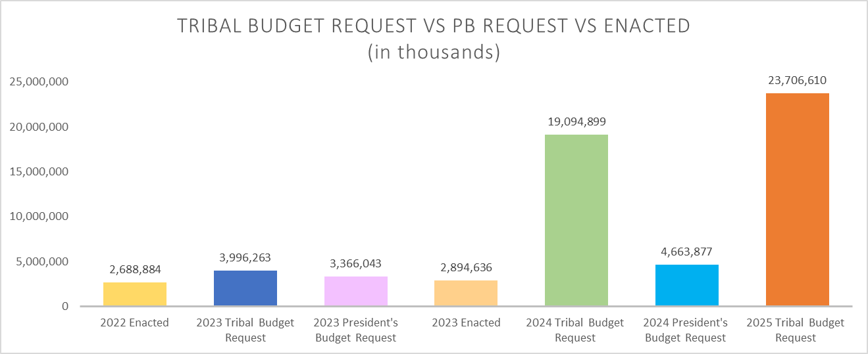
NCAI Budget Update
For the Self-Governance Advisory Committee
August 29, 2023
Tribal Interior Budget Council

Slide 23
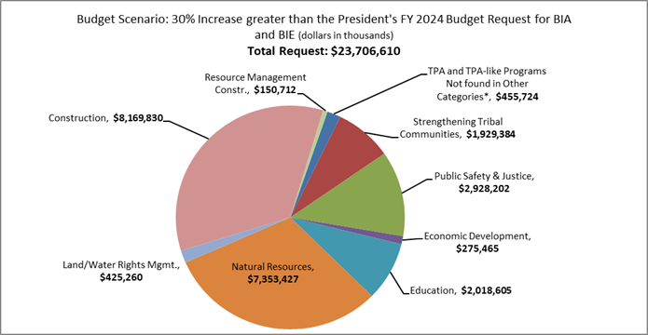
NCAI Budget Update
For the Self-Governance Advisory Committee
August 29, 2023
Tribal Interior Budget Council
Notes:
TIBC FY25 Tribal Budget Submission includes a total funding request of $23.7 billion dollars, this is a amount reflects a 30% Increase scenario of FY24 Presidents Budget, plus the Existing Cost Estimates provided by DOI and other Federal partners. In addition to the overall budget request TIBC Representatives have given nine programs a deliberative increase, and five suggested actions within the DOI-IA’s budget request to Congress

Slide 24
NCAI Budget Update
For the Self-Governance Advisory Committee
August 29, 2023
Tribal Interior Budget Council
Small Tribe Supplement ($29.5M) - amount needed to bring all tribes to $300k minimum payments using 2022 Base funding levels.
Law Enforcement ($1.3384B) - Tribal Law and Order (TLOA) Report.
Replacement School Construction ($6.2B) - based on replacing schools rated in poor condition that have not yet been funded at the average cost to build each school.
Road Maintenance ($400M) - based on deferred maintenance estimate
Notes:
Cost estimates in the full report, where provided, are a baseline amount; and do not truly reflect the full funding needs of every IA program. If full cost estimates, as identified by Tribal Nations and Federal partners were available, the overall budget request would be significantly greater in size. Notable cost estimates within the report include:

Slide 25
NCAI Budget Update
For the Self-Governance Advisory Committee
August 29, 2023
Tribal Interior Budget Council
Tiwahe Initiative- ($10M) Expand upon a Tribally supported program to include 10 new Tiwahe pilot tribes.
Law Enforcement Facilities Operations & Maintenance- ($6M) Increases for Law Enforcement Facilities other than Detention.
Alaska Native Subsistence Program- ($5M) Support and expand projects in the Federal Subsistence Management Program in implementing Title VIII of the Alaska National Interest Land Conservation Act.
Water Filtration Systems- ($1M) Installation of water filtration systems onto existing structures.
Land Acquisition- ($5M) Continue land acquisition efforts by acquiring land for landless and land limited Tribes.
Fire Protection- ($6.33M) Increase, enhance, and improve over 40 Tribal fire protection programs.
Tribal Data Management Capacity- ($3M) Support activities to strengthen and enhance Tribally owned data management and collection capacities. (Proposed Program)
Administrative Operations- ($10M) Address FTE vacancies, increase department bandwidth capacity, and improve the delivery of services through all three levels of Indian Affairs Programs. specific attention to Awarding Officials and Reality Officers. (Proposed Program)
Tribal Historic Preservation Office (THPO) - ($5M) Tribal Historic Preservation Offices which has been proposed to be relocated along with NPS funding levels under the BIA-OTS. (proposed program)
Notes:
The Tribal Representatives of TIBC are encouraged by Indian Affairs’ recent commitment to broadly measure the funded treaty and trust obligations of DOI. While this year’s FY 2025 Tribal Budget Submission only includes estimates for 29 programs (increase of 13 programs from FY24), the data presents a more comprehensive view of current Indian Affairs funding and the United States’ progress in fulfilling its obligations. When completed, this part of the effort will provide an estimate of the actual full funding needed with the necessary data and quantitative analysis/data to justify the related proposed budget that Tribal Representatives desire to put forward.

Slide 26
NCAI Budget Update
For the Self-Governance Advisory Committee
August 29, 2023
Tribal Interior Budget Council
Land Water and Conservation Fund (LWCF) - Request of a 10% Tribal set aside to address growing needs of Tribal Nations within the LWCF.
Payment in Lieu of Taxes (PILT) - The President’s FY 2024 Budget Request should include policy solutions and request funding to eliminate this discriminatory practice that excludes Tribal Governments in the PILT Program.
Mandatory Funding Status - Moving federal spending for IA obligations to mandatory spending will fix the unintended effects that mandatory obligations through discretionary spending, such as lapse in funding via continuing resolutions.
School Safety Resource Officers (SROs) - Funding directly to the BIE ISEP program allows transfer to OJS and include the funding for both “24/7” and “day” schools, for a more efficient and effective implementation of SRO’s. TIBC specifically called upon DOI to dedicate these funds to BIE.
Tribal Education Departments (TEDs) - Dedicate funding outside of BIE funded programs and establish a TED programs within Indian Affairs.

Slide 27
NCAI Budget Update
For the Self-Governance Advisory Committee
August 29, 2023
TIBC Meeting Materials
https://www.ncai.org/initiatives/tibc/tibc-documents

Slide 28
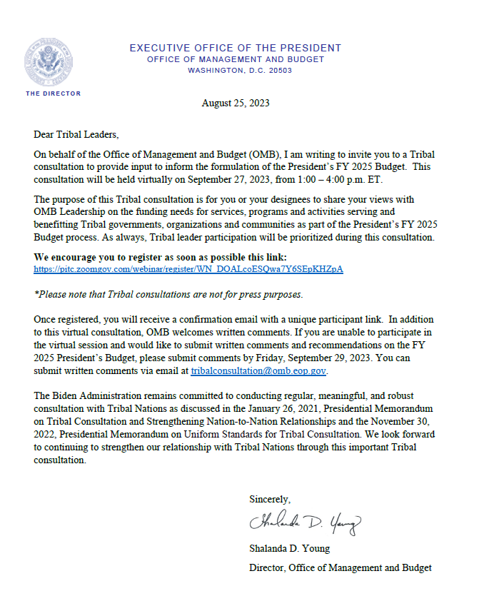

Slide 29
NCAI Budget Update
For the Self-Governance Advisory Committee
August 29, 2023
Upcoming OMB Consultation
Tribal consultation to provide input to inform the formulation of the President’s FY 2025 Budget. This consultation will be held virtually on September 27, 2023, from 1:00 – 4:00 p.m. ET.
Consultation Registration Link:
https://pitc.zoomgov.com/webinar/register/WN_DOALcoESQwa7Y6SEpKHZpA
If you are unable to participate in the virtual session and would like to submit written comments and recommendations on the FY 2025 President’s Budget, please submit comments by Friday, September 29, 2023. You can submit written comments via email at tribalconsultation@omb.eop.gov.

Slide 30
NCAI Budget Update
For the Self-Governance Advisory Committee
August 29, 2023
Congressional Outlook
So, where is FY 2024 funding headed next?

Slide 31
NCAI Budget Update
For the Self-Governance Advisory Committee
August 29, 2023
Where is FY 2024 Headed?
Possible Government Shutdown if Consensus is not reached.
Expect at least one Continuing Resolution between October 1, 2023 through January 1, 2024.
Budget Reconciliation before the end of the 2023 Calendar Year -December 31, 2023.
Discretionary spending levels would be reduced below current FY 2023 levels if FY 2024 bill is not enacted by January 1, 2024.
Notes:
The group of roughly three dozen Republican lawmakers have publicly said it would oppose any short-term stopgap unless leadership meets a slew of their demands. Without the support of its members the House would need a significant amount of bipartisan support to garner the amount of votes needed to pass any legislation.
House Speaker McCarthy and Senate Majority Leader Schumer have both agreed that some form of Stop-Gap funding AKA Continuing Resolution would make sense moving forward past the Sept. 30 deadline.
In a letter to House Speaker McCarthy - CBO Estimates Caps established in Sec.101 (a) and 102 of Fiscal Responsibility Act are:
Under section 101(a), the caps on base discretionary funding for 2024 would total $1.590 trillion ($886 billion for defense and $704 billion for nondefense funding The caps on base discretionary funding in 2025 would equal $1.606 trillion ($895 billion for defense and $711 billion for nondefense)
Budget Authority
FY24
Defense (+2.3 Billion)
Non-Defense (-112 Billion)
FY25
Defense (-11.6 Billion)
Nondefense (-124.3 Billion)
Section 102 would establish temporary caps on funding if a continuing resolution is in place on January 1 of 2024 or 2025. Caps on defense funding would be lower and caps on nondefense funding would be higher relative to the caps in section 101(a). If a continuing resolution were still in place on April 30 of either 2024 or 2025, a final sequestration order would be issued according to the cap amounts in section 102
FY24
Defense (-34.2 Billion)
Non-Defense (-79.3 Billion)
Total (-113.6 billion)
FY25
Defense (-57 Billion)
Non-Defense (-98.6 Billion)
Total (-155.6 Billion)

Slide 32
Matthew Vogel, Policy Lead – Federal Budget and Appropriations
mvogel@ncai.org

