Slide 1
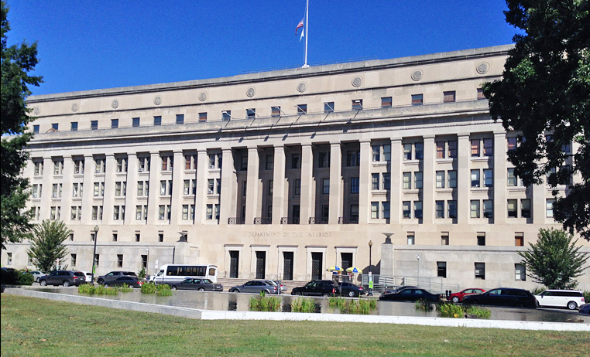
Office of Self Governance Update
August 29, 2023

Slide 2
OSG Personnel Changes
OSG is pleased to announce that Alexis Wagner has agreed to a detail assignment to OSG’s Northwest Field Office in Vancouver, WA. Alexis will help coordinate the awarding of Tribal Climate Resilience projects through OSG. As such, she may be in contact with self-governance tribes regarding funding agreement amendments. She is detailed from BIA’s Branch of Tribal Climate Resilience.

Slide 3
Sharee Freeman
Director
Tyvin Whittaker
Administrative Specialist
Vacant
Intern
Matt Kallappa
Manager – NWFO
Rufina Villicana
Financial Manager
Vickie Hanvey
Program Analyst/Compact Negotiator
Gordon Smith
Compact Negotiator
Cheryl Barnaby
Financial Specialist /Audits
Lance Fisher
Financial Specialist
Douglas Dan
Financial Specialist
Janelle Naranjo
Program Analyst/105(l) Leases
Maureen Marcellay
Program Support Assistant
Jacob Aguilar
Financial Specialist
CSC/Audits
Celeste Engles
Financial Specialist
Maggie Smith
Financial Specialist
Alexis Wagner
Analyst (Detailee)
Miles Reader
Financial Specialist

Slide 4
OSG Budget
Other Funding requested:
HQ Deputy Director - D.C.
Additional - SGCE – $150,000
Once Negotiated Rulemaking funding responsibilities are completed in 2024, salary funds will be available to hire an OSG Deputy.

Slide 5
Number of SG Tribes (288)* by Region FY 2023
Alaska – Tribes
35 Funding Agreements
10 Consortium Funding Agreements
Northwest – 27 Tribes
Pacific – 23 Tribes
Rocky Mountain – 1 Tribe
Western – 8 Tribes
Eastern – 2 Tribes
Eastern Oklahoma – 12 Tribes
Great Plains – 1 Tribe
Midwest – 13 Tribes
Southern Plains – 9 Tribes
Southwest – 6 Tribes
*Possible AK divorce adjustments

Slide 6
Fiscal Year 2023 OSG has:
138 Funding Agreements
11 Consortia
162 Tribes in Consortia
New Tribe for Fiscal Year 2023:
Spirit Lake Tribe (Great Plains Region)
New Tribes for Fiscal Year 2024:
Pawnee Nation of Oklahoma
Craig Tribal Association
Reno Sparks Indian Colony

Slide 7
Office of Self Governance – Finance (2022)
To date, OSG has received and obligated approximately $808,399,136 in FY 2022
funding to Self Governance Tribes

Slide 8
Office of Self Governance – Finance (2023)
To date, OSG has received approximately $757,640,334 in FY 2023 funding for Self Governance Tribes

Slide 9
Contract Support Cost (CSC)
FY 2019 – 2023 Update

Slide 10
Contract Support Email
OSG-CSC@bia.gov
Self Governance Tribes are requested to please email all correspondence and documentation regarding Self Governance Contract Support to this email address, including CSC Data.

Slide 11
Self Governance Negotiations
The OSG compact negotiation team has been focused on participation in the last year and a half on PROGESS Act Negotiated Rulemaking activities.
OSG is no longer in a cyclical process for negotiating Funding Agreements because:
Tribes have elected to wait on negotiations until PROGRESS Act Rulemaking is complete.
25 U.S.C. § 5363(p) – allows Tribes to maintain their prior Funding Agreement and receive funding without a negotiation.
Fiscal Year and Calendar Year Tribes are seeking to move forward with negotiations at various times of the year.

Slide 12
Self Governance ATOs
In response to Tribal concerns about the receipt of ATOs, a new Module for the Self Governance Database has been created and tested to speed the process of providing ATOs to Self Governance Tribes.
More to come…

Slide 13
ATO Information
If a Tribe is awaiting an ATO, please contact:
Doug Dan by email Douglas.Dan@bia.gov or
Maggie Smith by email at Maggie.Smith@bia.gov
Once contacted, a FBMS print screen and a SGDB print screen with information on the pending payments in ASAP can be provided. If funding is in ASAP, it is available for tribal drawdown.

Slide 14
The End

