Slide 1
Medicaid Unwinding Update for
Tribal Health Programs
April 17, 2024
Moderator: Cyndi Ferguson, Self-Governance Specialist, SENSE Incorporated
Elliott A. Milhollin
Hobbs, Straus, Dean & Walker, LLP
IHS Tribal Self-Governance Advisory Committee
Self-Governance Communication and Education

Slide 2
Medicaid Unwinding
During the Public Health Emergency, States got increase federal funding (FMAP) if they kept everyone on the Medicaid rolls without doing any eligibility redeterminations.
In the Consolidated Appropriations Act, 2023, Congress required States to begin making eligibility redeterminations again or lose the enhanced federal matching funds, and also phased out the enhanced federal match.
States were required to begin making eligibility redeterminations between Feb. 1 and April 1, 2023.

Slide 3
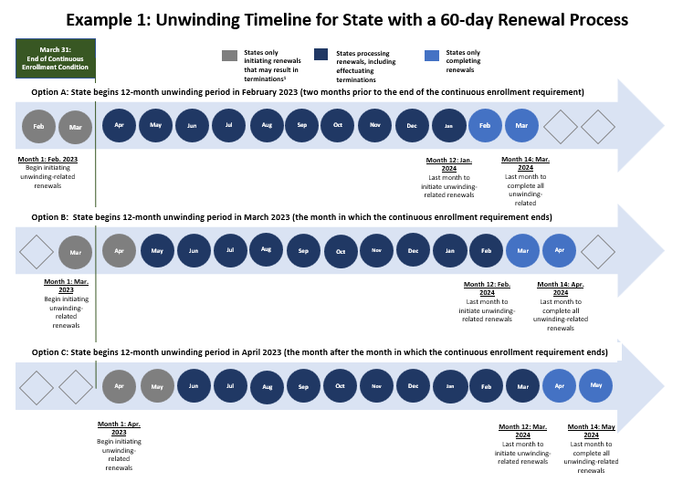
Example 1: Unwinding Timeline for State with a 60-day Renewal Process
Source: CMS

Slide 4
Eligibility Redetermination (42 CFR § 435.916)
Ex parte Renewal - eligibility redeterminations must start without requesting info from enrollee
Renewal form by letter mail, phone, text, and/or email – must only ask for new information.
Reasonable time frame and modalities to return form
Determine eligibility on all bases before terminating coverage
Provide 10 days advance notice and fair hearing rights prior to reduction or termination of coverage
Assess eligibility for and transfer to other health coverage programs, like Medicare, CHIP and the ACA Marketplace plans
Provide a reconsideration period of 90 days

Slide 5
Impact
As of April 4, 2024, the Kaiser Family Foundation (KFF) has found:
At least 19.6 million individuals have lost their coverage.
Disenrollment rates range from 12% in Maine to 57% in Utah. Other states with high disenrollment rates include Montana (55%), Oklahoma (55%), South Dakota (55%), Idaho (54%), and Alaska (44%).
Approximately 69% of disenrollments are for procedural reasons. States with the highest rates of procedural disenrollments included Nevada (93%), New Mexico (93%), Utah (92%), Washington (85%), Oklahoma (83%), and Oregon (79%).
At the beginning of unwinding, six states—including Oklahoma, Nebraska, Wyoming, and South Dakota—had very insufficient policies in place promoting continuity of coverage.
Procedural disenrollments refer to when individuals lose their coverage because they did not properly complete the renewal process, not because they have been deemed ineligible for Medicaid. This can happen for various reasons, such as when the State does not have updated contact information when an individual makes an error on their renewal form.

Slide 6
Key Concerns for Tribal Health Programs
According to a KFF survey fielded in March, 72 percent of Medicaid enrollees did not know that States are now allowed to terminate Medicaid coverage. Furthermore, nearly half of enrollees had never participated in renewal before. This leaves many unprepared for Medicaid renewal.
Tribal communities can face additional barriers to Medicaid renewal such as frequent address change, limited postal service, and inadequate broadband access.
To mitigate some of these challenges, tribal health programs can work with their States to ensure that all of their IHS beneficiary Medicaid enrollees are contacted and provide required information to stay on Medicaid or transfer to another type of coverage.

Slide 7
CMS Allows States to Share Data with Tribes
CMS SHO #22-001 says that States are “strongly encouraged to engage with other key stakeholders (e.g., providers, beneficiary advocacy groups) and with the Indian Health Service, Tribes and Tribal organizations, and urban Indian organizations (ITUs) located in your state on an ongoing basis.”
CMS SHO #23-002 says that States are strongly encouraged to “engage with the Indian Health Service (IHS), Tribes and Tribal organizations, and urban Indian organizations (collectively, ITU) to help with updated contact information for Tribal Medicaid beneficiaries, including sharing enrollment and renewal data with ITUs.”
CMS FAQs confirm that States may share beneficiary data with ITU providers.

Slide 8
Key CMS Unwinding Guidance
1/5/23 CMS CIB Key Dates Related to the Medicaid Continuous Enrollment Condition Provisions in the Consolidated Appropriations Act, 2023
1/27/23 CMS SHO #23-002
5/17/23 CMS FAQs for State Medicaid and CHIP agencies
12/18/23 CMS CIB Ensuring Eligible Children Maintain Medicaid and CHIP Coverage
3/15/24 CMS CIB Reminding States of Eligibility Redetermination Requirements
3/15/24 CMS Slide Deck on Eligibility Redetermination Requirements

Slide 9
Medicaid and CHIP Renewal Requirement Reminders
#1 Do not terminate Medicaid or CHIP coverage for an individual who has returned their renewal form or documentation requested by the state within the eligibility period, even if processing the renewal form and documents will need to occur after the eligibility period has ended.
#2 Do not terminate Medicaid coverage without first determining eligibility on all other bases.
#3 Do not require a new application from individuals who are eligible on the basis of Modified Adjusted Gross Income (MAGI) and who respond to a renewal request within 90 days after a procedural termination.
#4 Do not exclude an individual from ex parte renewal because wage data show that a household earner is working for an employer that is different from that reflected in the case record, if income remains below the applicable standard.
#5 Do not exclude individuals from an ex parte renewal in Medicaid solely because the state has aligned renewal dates with those for the Supplemental Nutrition Assistance Program (SNAP) or other human services benefit programs.
#6 Do not transition an individual to the Marketplace, or to an eligibility category with lesser benefits or increased premiums or cost sharing, based on an ex parte review, without first sending a renewal form and request for information.
#7 Do not terminate coverage, or take other adverse action, until after advance notice, including an explanation of fair hearing rights, is provided.
#8 Do not conduct ex parte renewals at the household level.
#9 Do not provide fewer than 30 days for the response to a renewal form for individuals whose eligibility is based on MAGI.
#10 Do not send renewal forms and other notices only in English, without providing language services, to households that have requested information in other languages or fail to ensure effective communication with individuals with disabilities.
Source: CMS

Slide 10
Unwinding Resources
CMS Unwinding Website
CMS AI/AN Unwinding Website
CMS March 2024 Bulletin to States Reminding them of Unwinding Requirements
CMS Slide Deck of Examples of What States May Not Do with Medicaid Renewals
CMS Unwinding Toolkit
NIHB Unwinding Toolkit
NCUIH Unwinding Toolkit for UIOs
TSGAC Unwinding Survey

