Slide 1
BIA Branch of Tribal Climate Resilience Awards Overview
April 18, 2024

Slide 2
Tribal Climate Resilience (TCR) Awards Overview
Program Purpose
FY 2023 Solicitation –Request for Proposals
What's New?
How to Apply
Helpful Resources and Partnerships
FAQs

Slide 3
Program Purpose

Slide 4
TCR Purpose
To support climate preparedness and resilience in for all Federally-recognized Tribal Nations and Alaska Native villages:
Technical assistance
Access to appropriate science
Educational and training opportunities
Regional network of liaisons
Regional Tribal Climate Resilience Coordinators
Financial assistance
Annual Awards Program
Bipartisan Infrastructure Law (BIL) and Inflation Reduction Act (IRA) funding for community-driven relocation and habitat restoration work

Slide 5
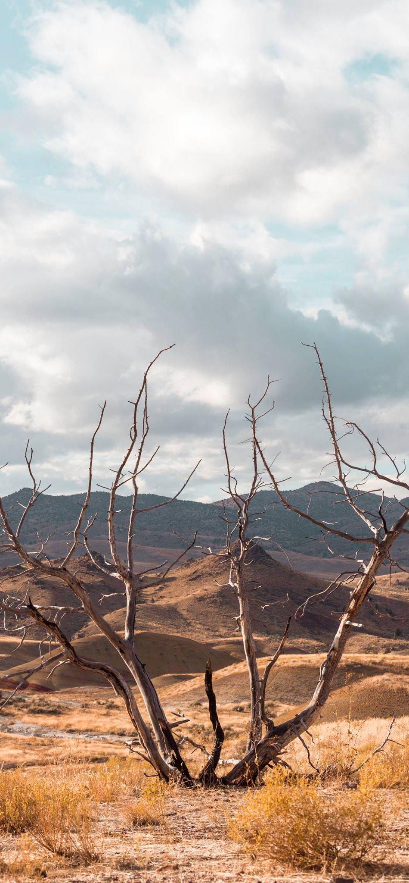
TCR Focus Area
Prioritization of issues such as:
Extreme events (e.g., flooding and erosion, extended drought, desertification, increased frequency and intensity of wildfire)
Toxic harmful algal blooms
Permafrost degradation
Ocean acidification
Storm surge
Sea level rise
And more...

Slide 6
Annual Awards Program Purpose
To provide funding for Federally-recognized Tribal Nations to achieve their climate adaptation, planning and implementation goals.
Planning and project design can minimize impacts, reducing the scale of emergencies, infrastructure damage, and threats to human health and well-being
Supports self-determination and sovereignty
Furthers inclusion of Indigenous Knowledge

Slide 7
FY 2023 Solicitation

Slide 8
FY 2023 Solicitation
Open to Federally-recognized Tribes and Tribal organizations that serve federally recognized Tribes as defined in 25 U.S.C. 5304(l)
Request for proposals open: July 19th – October 13th, 2023
Federal Register list of Federally-recognized tribes (2023): https://www.federalregister.gov/documents/2023/01/12/2023-00504/indian-entities-recognized-by-and-eligible-to-receive-services-from-the-united-states-bureau-of
Total Amount Available: ~$120 million
Other entities may participate as sub-awardees (the Tribe or Tribal organization must be the applicant and awardee)
Project timelines should be no more than two years

Slide 9
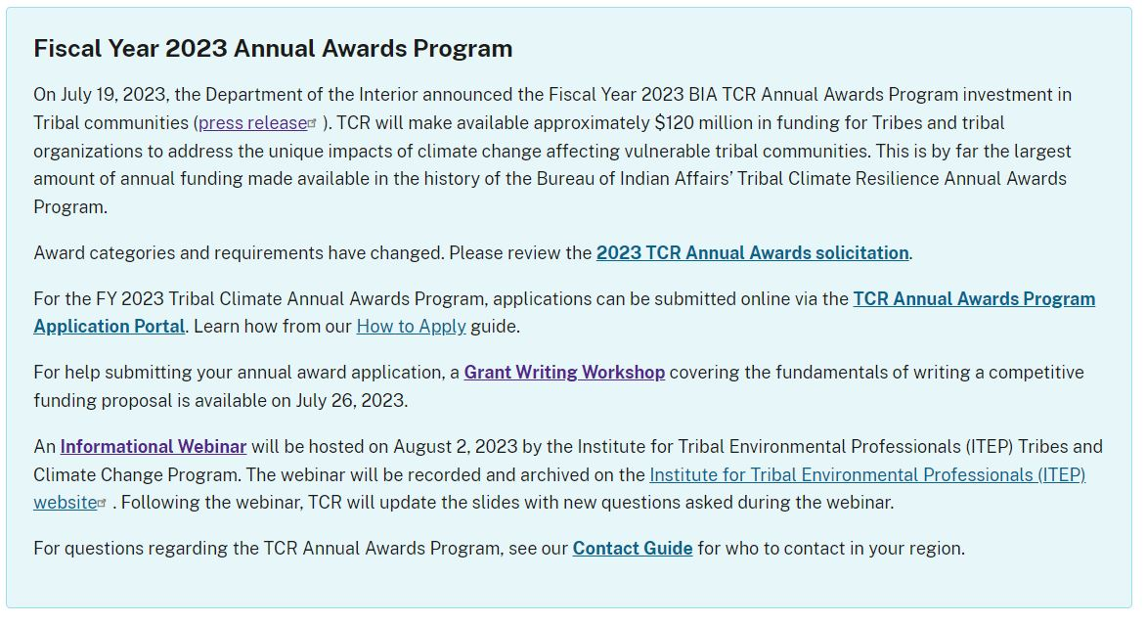
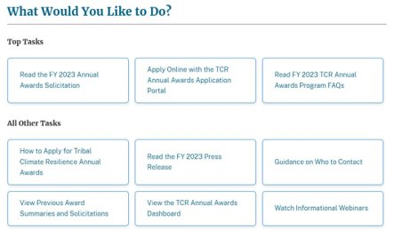
Where to Find More Information
TCR Annual Awards Program site page: www.bia.gov/service/tcr-annual-awards-program

Slide 10
2023 Categories of Funding
Climate Adaptation planning ($250,000 Max Per Award)
Climate adaptation implementation ($4,000,000 max per award)
Designed to support climate change considerations into:
Planning documents
Vulnerability assessments
Development of data analysis
Supplemental monitoring
Hosting of training and/or workshops focused on Tribal climate adaptation and resilience*
Internships and/or youth engagement
Travel to attend climate change-related training and/or events
May be considered either construction or non-construction activities and supports actions that are pre-identified in an existing Tribal plan such as:
Integrated resources management plans
Climate adaptation plans
Ecosystem restoration plans
Community-driven relocation, managed retreat, and/or protect-in-place plans
Example projects can be found at:
www.bia.gov/sites/default/files/dup/inline-files/award_summary_0.pdf

Slide 11
2023 Set-Asides
First Time Awardees
Habitat restoration and adaptation
Relocation, Managed Retreat, and Protect-In-Place (RMP) Coordinator
To perform a scoping needs assessment and develop a planning proposal in future funding cycles.
Designed to assure equity for Tribes at different places in their climate resilience and adaptation planning efforts
Tribes without dedicated staffing or climate programs at the beginning stages of program development are encouraged to apply.
Note: only Tribes who have not received a planning or implementation award in previous years are eligible for this set-aside.
Habitat Restoration of coastal ecosystems, including wetlands, marine systems, fire prone arid ecosystems, forest, any other critical ecosystems.
Emergency Restoration - Habitat and/or adaptation projects due to natural disaster.
Equity in Restoration Projects - May be used as cost share for Tribes to leverage other Federal agency-awarded habitat restoration and/or adaptation projects.
Designed to support Tribes that have limited technical staffing capacity to hire a full time RMP Coordinator.
Support and organize community involvement, coordinate with federal and non-federal partners, and develop community RMP plans and/or implementation actions.
Communities at the highest risk tiers will be considered.
Notes:
Coral

Slide 12
Application Content Requirements
A complete application must contain all four content requirements:
Cover Page Info
The cover page information can simply be entered into the e-form on the application portal.
Tribal Resolution or Cover Letter
When applying, either a signed cover letter or a Tribal resolution is required to summarize leadership support. If selected for funding, a Tribal resolution will ultimately be required.
Proposal
Describes the proposed project and associated activities. Six-page limit.
Budget Table and Narrative
Budget table and narrative must align and break down all costs associated with the project.

Slide 13
2020-2022 Awards Funding Categories
2020
Total Awards: 159
2021
Total Awards: 135
Total Amount: $13.8M
2022
Total Awards: 124
Total Amount: $45.3M
Total Amount: $14.4M

Slide 14
Helpful Resources
Notes:
C

Slide 15
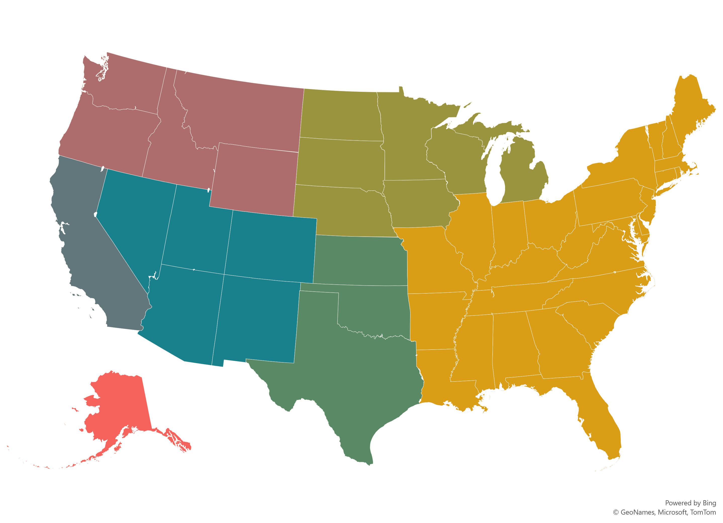
BIA TCR Regional Coordinators
Matthew Laramie
Northwest & Rocky Mountain Regions
Zachary Jorgenson
Great Plains & Midwest Regions
Shaina Tallas
Navajo, Southwest & Western Regions
Angela Waupochick
Eastern Region
Elisha Flores
Pacific Region
Jennifer Robinette
Vacant Position II
Alaska Region
Sheena Schemm
Southern Plains & Eastern Oklahoma Regions
List of regional contacts: https://www.bia.gov/service/climate-resource-directory#regional

Slide 16
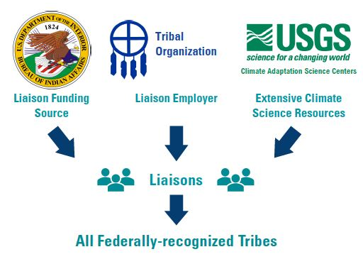
Regional Partners - Liaisons
Climate Adaptation Science Centers
Learn more at www.bia.gov/bia/ots/tcr/our-work-partnerships#tribal-climate-resilience-liaisons

Slide 17
Tribal Climate Resilience Liaison Network Tribal Liaisons
An updated version will be available soon to include Jake Palazzi (New Mexico) and Cynthia Naha (Senior Liaison, SW). Additional staffing changes may occur, please visit the directory at www.bia.gov/bia/ots/tcr/our-work-partnerships#tribal-climate-resilience-liaisons.

Slide 18
Who to Contact
BIA Regional Coordinators (federal)
Tribal Climate Resilience Liaisons (non-federal)
Reach out for questions about:
Whether a project would be appropriate for TCR funding
What Category of funding to apply for
Whether your Tribe or organization is eligible for a set-aside
How to apply & UEI/Sam.gov registration
Post award project changes
BIA-specific technical assistance, eligibility, and FAQs
Find your Regional Coordinator contacts: www.bia.gov/service/climate-resource-directory
Reach out for questions about:
Regional writing retreats, workshop events, or other gatherings
Grant writing tools, trainings, resources, consultants/organizations
Proposal review and tips
Find your Regional Liaison contacts: www.bia.gov/service/climate-resource-directory#regional-resilience-resources-andcontacts

Slide 19
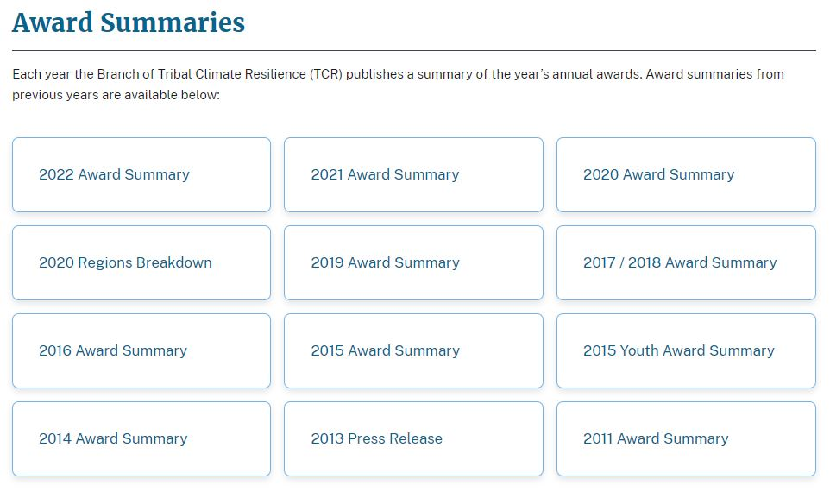
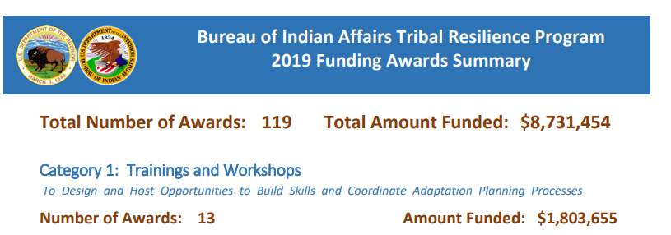
Don’t know where to start?

Slide 20
Additional Resources
BIA Branch of Tribal Climate Resilience Home Page: www.bia.gov/bia/ots/tribal-resilience-program
Tribal Resilience Resource Guide: https://biamaps.doi.gov/tribalresilience/resourceguide
NAU’s Institute for Tribal Environmental Professionals (ITEP) www7.nau.edu/itep/main/tcc/Resources/newsletters
UO’s Tribal Climate Change Guide: http://tribalclimateguide.uoregon.edu

Slide 21
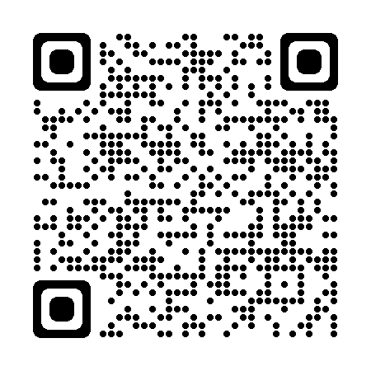
Thank you!
John Mosley
TCR Branch Chief
john.mosley@bia.gov
530-249-3889
TCR Contact: Resilience.Funding@bia.gov
Annual Awards Program: www.bia.gov/service/tcr-annual-awards-program

