Slide 1
Enhancing the Life of the Chickasaw Elder Through Enriched Living & Supportive Programs
April 17, 2024
Judy Goforth Parker

Slide 2
Goals & Objectives
Identify the programs available to support elder home maintenance.
Compare health and wellness programs designed to promote wellness and maximize independence at home.
Describe transitioning elders needs and support to foster optimum independence.
Discuss the opportunities to promote socialization and recognition among elders to remain active and independent.
Report on the holistic nature of elder services that includes mind, body and spirit within the Chickasaw Nation.

Slide 3
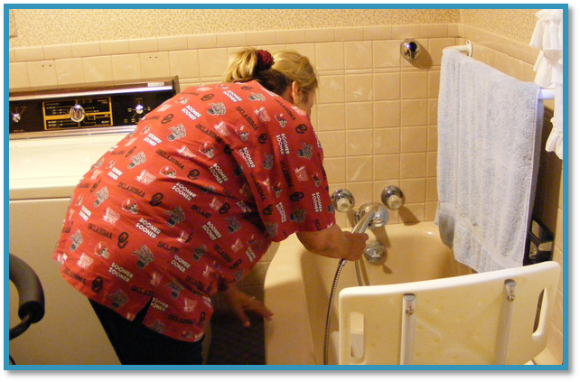
Identify the programs available to support Elder home maintenance.
Home Maintenance Program
Supplemental Lawn and Wood
Chore Service
Home Assessments
LIHEAP/Elder Energy Assistance Program
Handicap Accessibility Grant
Home Improvement Grant
Storm Shelters
Rental Assistance
Private Driveway Assistance
Notes:
This service provides minor home repairs for eligible Chickasaw elders.
Repairs may include:
Weatherization
Pest
Septic
Installation of handicapped ramps
Installation of handicapped grab bars
LIHEAP is available to Chickasaw citizens when federal funding is available.
Elder Energy - $300 provided twice a year – summer and winter
Elder Car Care is provided every November at each senior center.
Supplemental Lawn Mowing
The supplemental lawn mowing program provides supplemental lawn mowing services for eligible Chickasaw elders, 60 years of age or older, residing within the Chickasaw Nation boundaries. April through September
Supplemental Wood Program
The supplemental wood program provides supplementary wood for eligible Chickasaw elders, 60 years of age or older, who use a fireplace or wood stove to heat their home. Applicants must also reside within the Chickasaw Nation boundaries. This program provides one rick of wood per month (as needed) during winter months (November - March).
CHORE SERVICE
This program is to perform basic housekeeping services to the home of elders not able to perform these basic tasks themselves.
These basic services would also serve as injury and health prevention precautions.
Services are provided to elders while being able to stay within their own homes.
Services are scheduled based on a bi-weekly and monthly schedule, based on need.
The program can provide all cleaning supplies.
Basic services include sweeping, mopping, vacuuming, dusting, taking out trash, washing dishes, cleaning the kitchen and bathroom

Slide 4
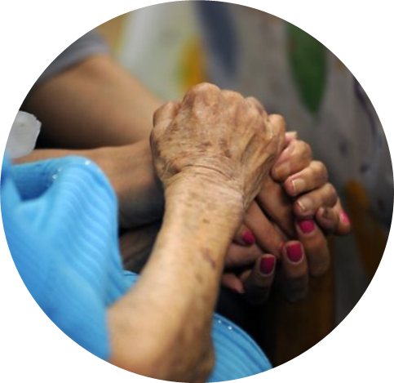
Compare Health and Wellness programs designed to promote wellness and maximize independence at home
Home visits
Virtual visits with a medical provider.
Public Health Nursing visits
- Seasonal vaccinations
- Provider-ordered vaccinations
Primary Care Case Manager support
- Coordinate home health and DME
needs
Notes:
Case Manager visits
Liaison between health departments, divisions, local agencies, service units, private medical providers
Care Coordination
Advocate for Chickasaw Patients
Educate Patients on available resources
Provide for citizens at large as well. Nationwide

Slide 5
Compare Health and Wellness programs designed to promote wellness and maximize independence at home.
Medication Assistance
Part D financial assistance
Patient coordination with drug assistance programs for medication not on formulary
OTC medications at senior centers and medication counseling services
Prescription mail and delivery of medications to home
Prescription Take-Back Program through Lighthorse
Medication Assistance Program
Notes:
Chickasaw Citizens >=60 years of age/available at Senior Sites
Non-Aspirin
Calcium
Cough Syrup
Multi-Vitamin
Artificial Tears
Docusate Sodium
(stool softener)
Konsyl D (fiber)
Liquid Antacid
Magnesium
Fish Oil
Vitamin C
Vitamin E
Anticoagulation
Monitor PT/INR for Anticoagulation Patients
Lipid Clinics
Hyperlipidemia counseling and medication services
Medication Refill Services
Mail order program
Delivery
Medication assistance Program
Specific non-formulary prescription medications are provided
Must be prescribed by CNHS physician
All ages
Must have a chart within the Chickasaw Nation Division of Health
Some restricted medications are not available
Provide Vitamin K
Prescription Mail Order program
Must be Chickasaw
No active chart within CNDH
Age 65 or older on Medicare Part D
Disabled and on Medicare Part D
Citizens may pre-enroll 90 days before Medicare Part D is effective
Covered prescriptions may be supplied by mail order pharmacy
During enrollment the prescription medication required will be identified and pre-authorized
Private Insurance drug coverage or Medicare Part D is required for adults eligible for the program
The Health Spending Account may be used to pay for monthly premiums
Patient will have no out-of-pocket expenses
NON COVERED MEDS
Anti – rejection drugs
Chemotherapy
Controlled substances
Investigational drugs
IV medications/devices to administer
Over the counter medications
Performance enhancing drugs and short-term use drugs

Slide 6
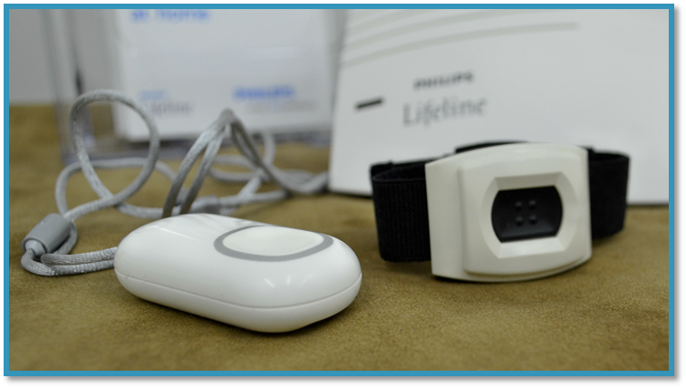
Compare Health and Wellness programs designed to promote wellness and maximize independence at home.
Tribal Health & Medical Equipment programs
DME program
MAPs-Medical Assistance Program-in boundaries
financial services to cover up to $5,000/year for medical expenses
Health Spending Account-Services At Large
Itiapela (Medical Alert Program)
Eyeglass Program
Hearing Aid Program
Notes:
Health Spending
Will reimburse each participant up too $200.00 each
month for covered services including:
Medicare part B and D premiums
Vision insurance premiums/deductibles
Dental insurance premiums/deductibles
Medical insurance premiums/deductibles
Doctor’s visits co-pays
Preventive Care
Prescription Medicine
Eyeglasses
Eligible for one pair of eye glasses or contacts every two years, up to $150.00
Provides members with assistance in purchasing glasses at Oklahoma Optical
Hearing Aids
Provides one pair of hearing aids every three years
Most repairs covered by warranty
Patient can purchase additional aids at cost (canal or digital aids)
Replacement ear molds for behind-the-ear aids are available every six months
Itiapela Medical Alert Program
Pays the initial costs and monthly fees for 24-hour medical alert services for qualified Chickasaw elders, 60 years of age or older that live within Chickasaw Nation boundaries.

Slide 7
Compare Health and Wellness programs designed to promote wellness and maximize independence at home.
Transportation
Transport patients to medical appointments
Wisdom Walkers Program
Nutrition Programs
Food Distribution Program
Senior Farmers Market Nutrition Program Summer Program
Winter Fruits and Vegetable Benefits
Get Fresh! (SNAP Nutrition Education) provides fun nutrition education to elders
Notes:
Wisdom Walkers Program: This is an elder wellness program designed to get elders active and keep them active. Exercise classes are held regularly at the Chickasaw Nation Senior Centers. Program includes many fitness activities, such as Tai Chi, line dancing, chair exercises, water aerobics, golfing, fishing, bowling and Nintendo Wii sports tournaments. Centers have access to treadmills and other exercise equipment, in-house or at local wellness center(s).
(Food Distribution Program on Indian Reservations – alternative to SNAP for Native Americans within a tribal boundary) assists elders in these ways:

Slide 8
Explain transitioning Elders needs and support to foster optimum independence.
Chickasaw Elder Independent Living Apartments (CEILA)
Eight one bedroom apartments for low income American Indian Elders and spouse. Therse are in the Ardmore OK campus
Assisted living
Provides up to $2500 for citizens to live in a state licensed assisted-living facility nationwide
Citizens can live in their own community

Slide 9
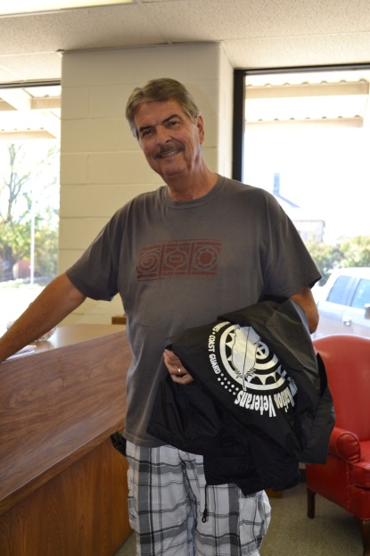
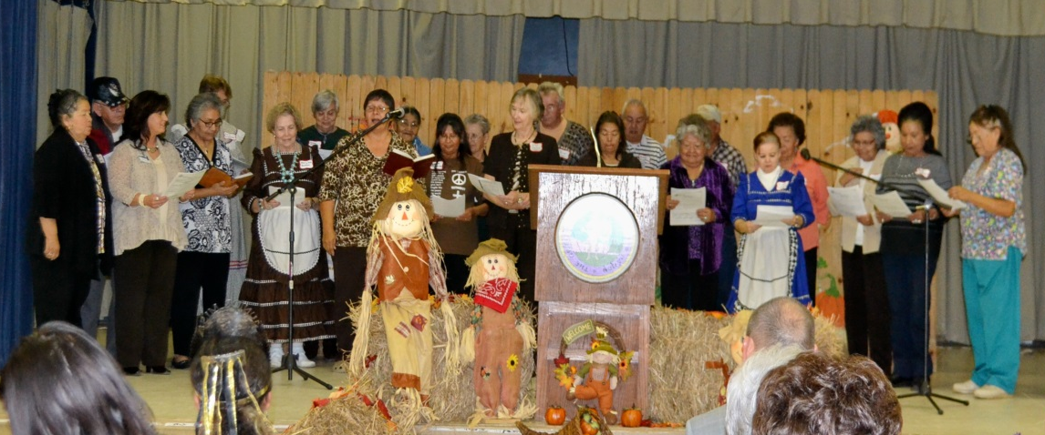
Discuss the opportunities to promote socialization and recognition among Elders to remain active and independent.
Veteran Recognition and Support
Senior Centers
Trips and Events
Community Garden Project
Social Marketing Campaign
Notes:
Veteran Recognition and Support
This is a nation-wide program for eligible Chickasaw elder veteran citizens to receive a jacket of recognition for their military service to our country.
Documentation is required to verify military service.
Annual Elder Veterans Trip to Washington D.C.
This is a nation-wide program for eligible Chickasaw elder veteran citizens to receive a jacket of recognition for their military service to our country.
Documentation is required to verify military service.
Senior Centers
The senior nutrition program helps to improve nutritional status by providing a breakfast and lunch five days per week at 11 centers. Menus have been reviewed and approved by Chickasaw Nation Registered Dietitians.
Activities at the centers include exercise, speakers on topics of importance to seniors, crafts, dominoes, cards, bingo, birthday parties and fundraisers. Day and overnight trips are taken by the elders. Holidays are celebrated with lunch and programs for all centers. These activities help reduce isolation through social interaction and visitation.
We provide breakfast and lunch at 11 centers, and lunch at 1 center in Okalhoma City
Chickasaw Elders Conference
Day Trips, Overnight Trips,
Chickasaw Elders Thanksgiving Luncheon & Christmas Bazaar
Chickasaw Elders Christmas Party
Valentine Coronation
Halloween Party
Easter Party
4th of July Celebration
Wisdom Walkers Exercise Program

Slide 10
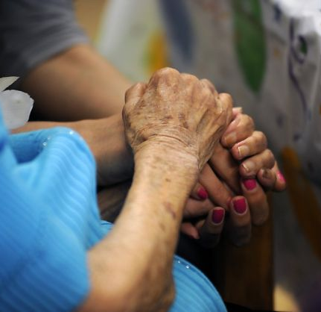
Report on the holistic nature of Elder Services that includes Mind, Body and Spirit within the Chickasaw Nation.
Elderly Specialists
Community Health Representatives
Central figure to coordinate and connect elders to all services
Interaction in the home and often the motivator when needed
Touch point and fill the gap when needed.
Native American Caregiver Program
Native American Caregiver Program- provides five areas of service for caregiver including respite care
Burial Assistance
Financial assistance for Elders
Notes:
Elderly Specialists
Elderly specialists make visits to clients in their homes to assess the Native American elders’ needs
Visits are determined by referrals submitted to Senior Services.
Elderly specialists are able to help link the elder with services and resources, in and outside of the Chickasaw Nation.
Elderly specialists assist elders in completing applications for other services, such as housing repairs, burial, veterans, etc.
Elderly specialists work to coordinate services with Community Health Representatives (CHRs), State Department of Human Services representatives and other agencies that are beneficial to the elder.
CHR
Make home visits to Native American homes. – in-nation and OKC
Develop a relationship of trust, and caring.
Check vital signs and explain the normal values
Check medications to see that they are in good supply and taking them as prescribed.
Offer Health Education on various topics as well as gathering information requested by the client from Health Providers at our clinics, hospital and other reliable sources. (such as the American Heart Association)
Refer clients to resources available as well as assist them with applications.
Arrange medical visits, and arrange transportation as needed.
Transport to medical facilities in the event that they need physical assistance that transportation services cannot give such as visual impairment, mobility impairment or mental impairment.
Document each visit on a CHR Patient Care Component (PCC) and enter the PCC information into the Resource Patient Management System (RPMS) so that physician can access health measurements in a home setting.
Native American Caregiver Program (Respite Care)
This is a federal program funded through the Administration on Aging, Title VI-C program to assist families who are caring for an older relative with a chronic illness or disability and to help provide support services for family caregivers and/or grandparents or older individuals who are relative caregivers.
This program provides five areas of service for the caregiver:
Information
Assistance
Counseling, Training, Support Group
Respite
Supplemental Services
Burial Assistance
The burial supplement assistance program is for Chickasaw Nation citizens.
The Chickasaw Nation Social Services division will pay $2,500 toward the FINAL balance of the Chickasaw elder’s burial expense.
The payment will be made directly to the funeral home.
This assistance pays last, after all other avenues of payment are exhausted, including, but not limited to: pre-needs insurance (pre-paid burial policy), social security and/or burial assistance through other Chickasaw Nation offices/programs.
Application must be received within 60 days of funeral service.

Slide 11
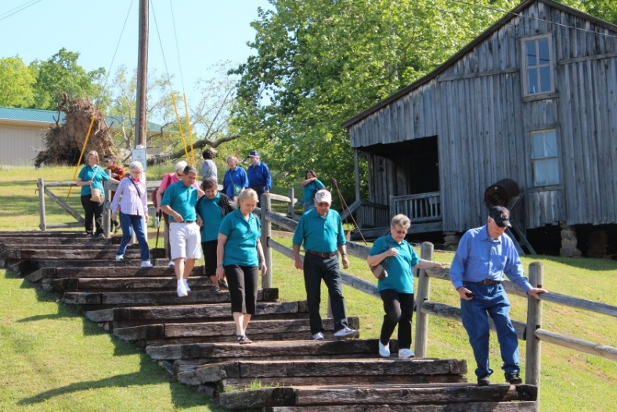
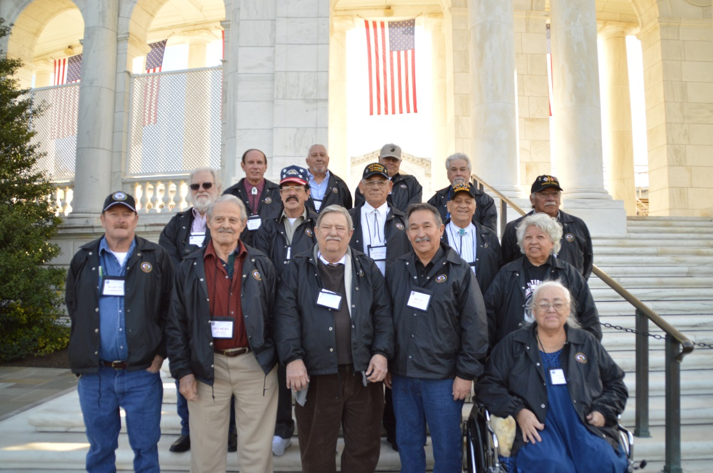
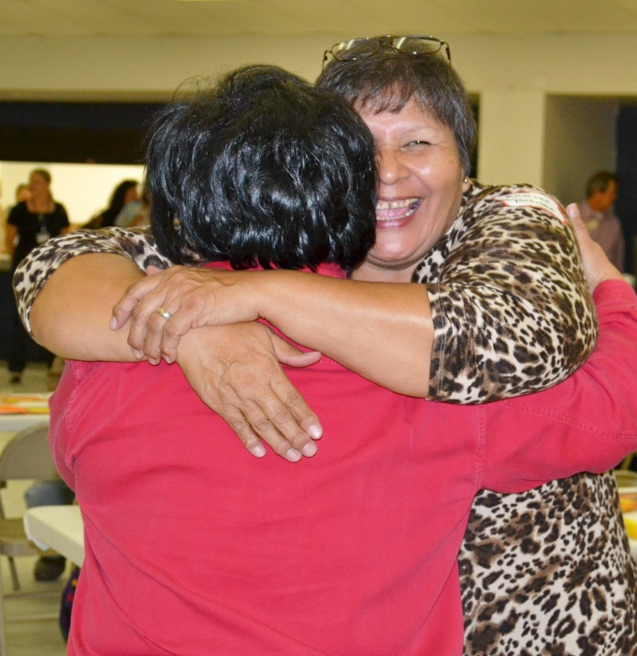
Summary
Mind-Activity & Engagement
Body-Health and Wellness
Spirit-Resilience & Independence

Slide 12
Chickasaw Nation Contributors
Karen Cook, Executive Officer, Aging, Aging Division
Stacy Wesberry, Director of Senior Centers and Information, Aging Division
Carrie Law, Under Secretary of Operations, Department of Health
Amy Wampler, Services at Large Case Manager, Division of Tribal Health
Stephanie Luna, Elder Care Case Manager, Division of Tribal Health

