Slide 1
TRIBAL SHARES FUNDAMENTALS
PUBLIC LAW 93 - 638 , INDIAN SELF DETERMINATION AND EDUCATION ASSISTANCE ACT ( ISDEAA)
Carla Mayo
DEPUTY DIRECTOR OF IHS OFFICE OF TRIBAL SELF- GOVERNANCE (OTSG)
Tribal Shares Fundamentals

Slide 2
History of IHS Tribal Shares
1994
IHS negotiated first 14 Self- Governance Agreements
Joint Allocation Methodology Workgroup (JAMW) formed
1991
Feasibility study of Self- Governance Demonstration Project
2002
Last public edition of IHS HQ PSFA Manual
1997
1st Published IHS HQ PSFA Manual
1992
Self-Governance Authority extended to IHS
1995
JAMW Final Report issued
IHS DTLL on Tribal Shares
2000
Title V Amd. created permanent IHS Tribal Self- Governance Program

Slide 3
Activities IHS carries out
Associated funds
Key Concepts
Programs, Services, Functions, and Activities (PSFAs)
Associated
Tribal Share
Means programs, services, functions, and activities (or portions thereof) that IHS carries out that an Indian Tribe may elect to carry out through a contract or compact
Means the associated portion of funds used by IHS to carry out the PSFAs to be contracted
Inherent Federal Function
Associated
Residual
Means those governmental functions that only IHS must perform that cannot legally be delegated to Tribes
Means associated portion of funds used by IHS to carry out remaining inherent Federal functions when all other PSFAs are contracted

Slide 4
Inherent Federal Function Examples– A few examples of inherent federal functions may include: •Personnel management –appointment, oversight, control, and direction of Federal employees •Accounts payable –control and determinations in accordance with Federal appropriations law •Financial management –oversight and control of Federal financial transactions and records •Budget & planning –budget formulation, execution, and alignment with agency program goals

Slide 5
Inherent Federal Functions Examples– •Property oversight –control of acquisition, use and disposition of US property •Monitoring & evaluation –control over reviews, inspections, compliance policies for agency authorized programs, etc. •Contracting –control and oversight over all agency pre-award and post-award contract functions •Program policy –control and oversight for agency administrative and program policies •Legal counsel and legislative affairs –legal advice and related services https://www.acquisition.gov/far/part-7#FAR_Subpart_7_5

Slide 6
ISDEAA –
Permits Transfer from IHS to Tribes

Slide 7
Diabetes -- S.D.P.I.
Contract Support Costs
I.H.S. Scholarships, Loans
Urban I.H.P.
PSFA: activities and associated funds are available to contract
No
No
Inherent Federal Functions: are not legally contractible and associated funds are not available (a very small fraction of IHS funds)
Clinical & Preventive Health Services
Facil- ities
Other Categories:
additional laws govern how Tribes
participate
Yes
Yes
Additional laws also apply
Figures are suggestive of the proportions of the IHS budget.
Transferrable Categories of PSFA

Slide 8
Extent of Self-Determination Contracts – Current and Hypothetical
½ IHS Operated
½ Tribal Operated
Inherently Govern- mental
NOW
Potentially Contractible PSFA
Contracted PSFA
100% Tribal Operated
FUTURE
Contracted PSFA
“Residual”
ISDEAA anticipates that direct Federal spending will decrease commensurately as functions are transferred to Tribes
*Illustration only, bar scale is hypothetical

Slide 9
PSFAs & Tribal Shares
PSFAs and associated funds are available from all 3 levels of the IHS. Location and dispersion does not affect amounts available for
contract.
IHS-wide (HQ) Shares
Portion benefiting each Tribe
Area Level Shares
Portion benefiting each Tribe
Local Level Shares
Portion benefiting each Tribe

Slide 10
“Transferred” vs. “Retained”
Associated Shares
Funds associated with A, B, and C are transferred to the contract
PSFAs
A
B
C
. . .
Tribe elects to contract or compact
A, B, C
$
Transferred
Associated funds are retained by IHS to perform X, Y, Z
$
Leaves X, Y, Z for IHS to perform
Shares retained for other Tribes
X
Y
Z
Retained

Slide 11
FUNDING FORMULAS

Slide 12
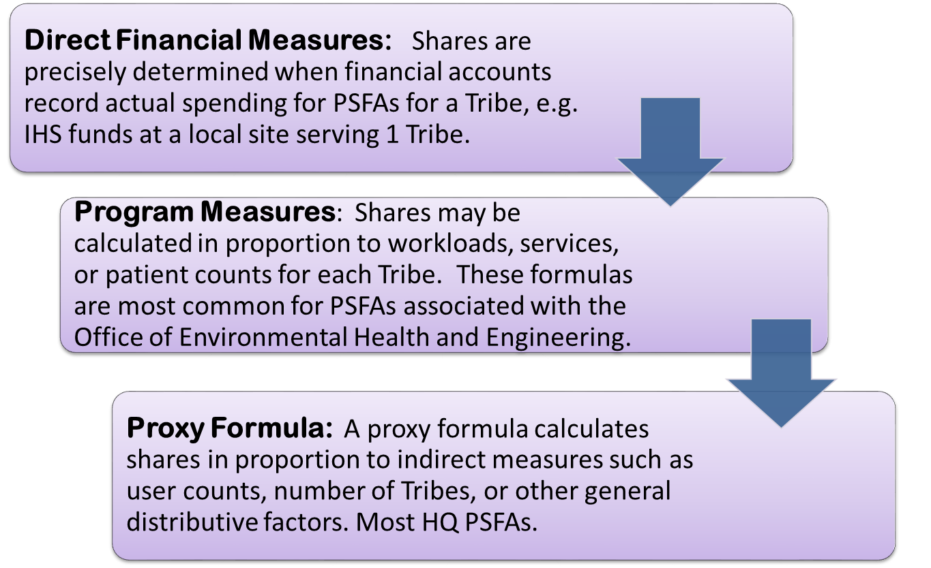
How Are Tribal Shares Determined?

Slide 13
Direct Financial Measure Example: 1 IHS Site Serving Only 1 Tribe
When financial accounts record IHS expenditures for a program serving only 1 Tribe, the process to identify that Tribe’s shares is straightforward. The entire amount may be labeled “shares” and 100% are available when the Tribe contracts the program.
Budget of the local IHS site to be contracted
100% of the site budget is available to that Tribe
Shares ($) for the Tribe
=
Only 1 Tribe is served there

Slide 14
Program Measure Formula Example: Fiscal Intermediary (FI) PSFA (IHS-wide)
The FI processes claims for IHS operated Purchased/Referred Care (PRC) programs. The FI is paid a fee per claim processed. A Tribe can contract for this function. Shares associated with the PRC FI are proportional to the claims workload.
FI Fee Contract Amount $
# Claims for the particular Tribe
Shares ($) for the Tribe
Average Cost Per Claim
($ / #)
x
=
Total # Claims Processed by the FI

Slide 15
Proxy Formula Example:
Tribal Size Adjustment Formula
Most of HQ PSFAs collectively benefit more than 574 Tribes.
The TSA formula calculates a dollar benefit for all Tribes in proportion to Tribal user counts.
TSA Formula
92% of TSA $ is calculated per user for all Tribes
Aggregate funds for ~ 50 HQ PSFAs
Portions for all
Tribes
8% if < 2,500 users

Slide 16
Shares are determined when a PSFA is initially contracted. The amount is recurring thereafter.
Subsequent negotiations occur before annual appropriations are known. Shares are ESTIMATED and
adjusted when the appropriation is enacted.
Protections for Tribal Shares
Recurring shares for contracted PSFAs are protected from reductions except for limited reasons stated in ISDEAA.
Funds may be added to a contract for special projects or limited time periods but are non- recurring.

Slide 17
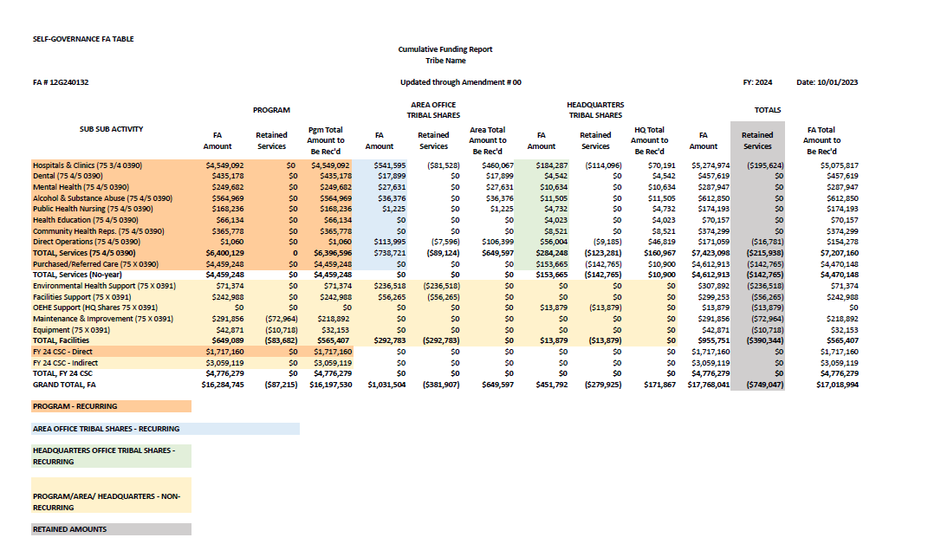
Self-Governance Funding Agreement Table

Slide 18
IHS Funding Opportunities -
Funding opportunities available:
Three Planning Cooperative Agreements in the amount of $180K (each)
Three Negotiation Cooperative Agreements in the amount of $84K (each)
Application deadline June 12, 2024
For more details please go to https://www.ihs.gov/dgm/funding/

Slide 19
Questions – Office of Tribal Self-Governance : http://www.ihs.gov/SelfGovernance Contact Information : Carla Mayo – Carla.Mayo@ihs.gov

