Slide 1
MISSION Act Section 403 Pilot Program on Graduate Medical Education and Residency (PPGMER) Tribal Self Governance Conference April 17, 2024
John M. Byrne, DO
Senior Advisor
Office of Academic Affiliations
Veterans Health Administration

Slide 2
Outline
Graduate Medical Education in VA
Section 403
Rulemaking Process
Proposed Rule
Two Models for Pilot Program
Specific Requirements
Request for Proposals
Reporting Requirements

Slide 3
Medical Education Pathway
College
Pre-Medical Education
(4 years)
Medical School
MD/DO degree awarded
(4 years)
Residency (GME*)
(3-7 years)
Sub-specialty training (GME*)
(1-3 years)
Practicing Physician
*GME = Graduate Medical Education

Slide 4
Graduate Medical Education (GME) in VA
GME Training Programs
Administered by Sponsoring Institutions
Accredited by the Accreditation Council for Graduate Medical Education (ACGME)
ACGME sets requirements for institutional and program accreditation
Sponsoring Institutions

Slide 5
ACGME Accreditation
Institutional (Sponsoring Institution) Requirements
Common Program Requirements
Specialty Program Requirements

Slide 6
Graduate Medical Education in VA
“To Educate for VA and the Nation”
VA Medical Facilities
Do not hold the accreditation of GME programs
Establish affiliation agreements with ACGME sponsoring institutions
Provide faculty supervision and learning environments
Reimburse affiliated sponsoring institutions for resident rotations at VA, taking care of veteran patients

Slide 7
Federal GME Funding

Slide 8
VA GME Funding Process
GME Sponsoring Institution
VA Facility Reimburses GME Sponsor
VA Facility
Affiliation Agreement
Disbursement Agreement
Hires and Pays Residents
Residents Rotate to VA Facility

Slide 9
GME Oversight Responsibilities
Trainee Allocation
Finances
Affiliations
Support and Education
Policies and Guidance
Notes:
By 1946 after World War II, the nation was reaching a crisis in caring for returning war wounded.
Affiliations were created such that VA could utilize medical school faculty and trainees for care in VA
Title 38 was also created at this same time to exempt physicians from civil service hiring rules
January 3, 1946, Public Law 79-293 provided statutory authorization for the VA to affiliate with the nation’s medical schools.
Policy Memorandum No. 2 (Veterans Administration Policy Memorandum No. 2 1946) ushered in the agency’s long-standing and productive collaborative relationship with U.S. schools and universities.
Provided the framework upon which all the subsequent expansion of academic affiliations was based
Expansion of relationships with educational institutions continued aggressively in the 1960s and 1970s.
Many new VAMCs were deliberately co-located close to their medical school affiliates.
Teague-Cranston Act Passed (1972), creating 5 medical schools specifically associated with VA.

Slide 10
Outline
Graduate Medical Education in VA
Section 403 Summary
Rulemaking Process
Proposed Rule
Two Models for Pilot Program
Specific Requirements
Request for Proposals
Reporting Requirements

Slide 11
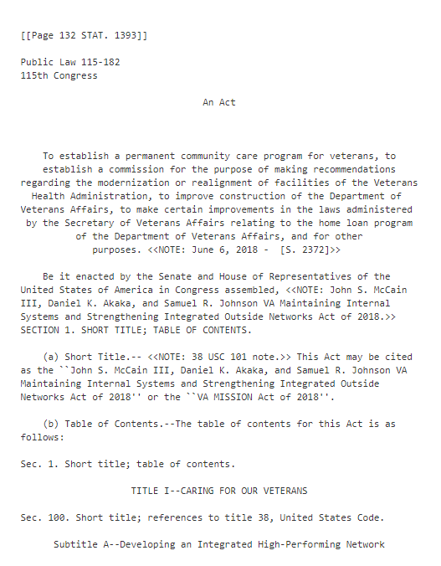
MISSION Act of 2018 – Sec. 403
VA Maintaining Internal Systems and Strengthening Integrated Outside Networks (MISSION) Act Section 403

Slide 12
MISSION Act - Section 403
Authorizes VA to:
Pilot program
Include no fewer than 100 resident physicians at covered facilities
Operated by Indian tribe or tribal organization
Indian Health Service
Federally-Qualified Health Centers
Department of Defense
Reimbursement of costs
Initiative ends August 7, 2031

Slide 13
Outline
Graduate Medical Education in VA
Section 403 Summary
Rulemaking Process
Proposed Rule
Two Models for Pilot Program
Specific Requirements
Request for Proposals
Reporting Requirements

Slide 14
PPGMER: Development of Regulations
AUTHORIZING LEGISLATION PASSED
PILOT PROGRAM RFP PROCESS
AGENCY PUBLISHES FINAL RULE
AGENCY RECEIVES COMMENTS
AGENCY PUBLISHES PROPOSED RULE
PUBLIC COMMENT
AGENCY DEVELOPS PROPOSED RULE
Federal Rulemaking
Notes:
Complexities involved in the development of regulations
Two new authorities
Payment for resident time (salary & benefits) for delivering non-Veteran care in non-VA facilities
Reimbursement of startup costs for new residency programs at non-VA facilities
Multiple factors in site selection
Multiple governmental/non-governmental stakeholders
Complex regulatory process due to health care, procurement, personnel, tort and contract law issues

Slide 15
Paperwork Reduction Act (PRA) Clearance
PPGMER Congressional Reporting = “information collection request (ICR)”
OMB approval for ICR required → PRA Clearance Process
Federal Register Notice with 60-day public comment period
Follow-up Federal Register Notice with 30-day public comment
OMB reviews ICR
Once approved, a 3-year PRA Clearance is granted
PRA Clearance Process

Slide 16
Outline
Graduate Medical Education in VA
Section 403 Summary
Rulemaking Process
Proposed Rule
Two Models for Pilot Program
Specific Requirements
Request for Proposals
Reporting Requirements

Slide 17
Priorities for Placement of Residents
Covered facilities
Operated by Indian Health Service
Operated by Indian tribe or tribal organization
Located in communities in the same areas as VA facilities designated by VA as underserved (Section 401 PL 115-182)

Slide 18
Pilot Program GME and Residency (PPGMER)
Two New VA Authorities
Reimbursement for resident time (salary & benefits) for delivering non-Veteran care in non-VA facilities
Reimbursement of startup costs for new residency programs at non-VA facilities

Slide 19
Two Pilot Models: VA Reimbursement
Model A
Costs of resident stipends + benefits only
Costs of new GME programs and resident stipends + benefits
Model B

Slide 20
VA Reimburses GME Sponsor
VA reimburses GME sponsor for salary and benefits of residents rotating to covered facilities
Model A
US Dept. of Veterans Affairs
Affiliated GME Sponsor
Residents rotate to covered facility
Hires and pays residents
Covered facility

Slide 21
VA Reimburses Covered Facility GME Sponsor
VA reimburses covered facility GME sponsor for new program startup costs
+
salary and benefits of residents
Model B
US Dept. of Veterans Affairs
Covered facility sponsors new GME program
Faculty & residents from new GME program at covered facility

Slide 22
PPGMER Model B New Residency Programs
Program Requirements
Reimbursement authorized for new residency programs that have
Initial ACGME accreditation or
Continued ACGME accreditation without outcomes and have not graduated an inaugural class

Slide 23
Model B Reimbursement Potential New GME Program Startup Costs
Authorized Costs | Description
Curriculum Development | Needs analysis, didactics, materials, equipment, consultant fees, and instructional design
Faculty Recruitment and Retention | Advertising for faculty positions, incentives (relocation and loan repayment)
Accreditation Costs | Administrative fees for initial ACGME accreditation
Faculty Salary | Only proportionate cost of faculty for PPGMER
Resident Education Expenses | Medical equipment, training, NRMP, software fees

Slide 24
PPGMER Funding
Not a grant program
Reimbursement of costs
VA will issue and evaluate responses to a Request for Proposal (RFP)
Determine the covered facilities where residents may be placed
Determine the costs to be reimbursed

Slide 25
Outline
Graduate Medical Education in VA
Section 403 Summary
Rulemaking Process
Proposed Rule
Two Models for Pilot Program
Specific Requirements
Request for Proposals
Reporting Requirements

Slide 26
Regulations Development to a Request for Proposals
We are here
AUTHORIZING LEGISLATION PASSED
AGENCY PUBLISHES FINAL RULE
AGENCY RECIEVES COMMENTS
AGENCY PUBLISHES PROPOSED RULE
PUBLIC COMMENT
AGENCY DEVELOPS PROPOSED RULE
PILOT PROGRAM RFP PROCESS

Slide 27
RFP Process
VA issues a Request for Proposal (RFP) Model A Summer 2024
VA reviews RFPs
VA selects 403-covered facilities
VA and GME Sponsors enter contracts, agreements
or other arrangements
Resident Placement in Covered Facilities
RFP submitted to OAA

Slide 28
Model A and Model B Timeline
Summer 2024
RFP Release
December 2024
Award Decisions
July 2025
AY 25-26
Resident Rotations
Fall 2024
Applications Due
Model A
Stakeholder Communications and Model B Planning Phase
July 2025
RFP Model A-Round 2
(if required)
RFP Model B- Planned release
Notes:
Top line Model A

Slide 29
Outline
Graduate Medical Education in VA
Section 403 Summary
Rulemaking Process
Proposed Rule
Two Models for Pilot Program
Specific Requirements
Request for Proposals
Reporting Requirements

Slide 30
PPGMER Required Data Reporting
Number of Veterans receiving care from residents
Number of resident positions at each covered facility
Number of clinical appointments for Veterans
Medical specialties pursued by the residents
Resident time
Program costs
Number of residents hired by VA
Internal VA Use Only

Slide 31
Questions?

