Slide 1
Self Governance Basics at DOI
2024 Self-Governance Conference

Slide 2
Foundational Self-Governance (SG) Legislation
1921 – Snyder Act
BIA…shall direct, supervise, and expend moneys…for the benefit, care, and assistance of the Indians throughout the United States for...purposes…(as stated)
1934 – Johnson O’Malley Act
Authorized the DOI Secretary to enter into contracts with any State… for the education, medical attention, agricultural assistance, and social welfare, including relief of distress, of Indians in such State…

Slide 3
Foundational SG Legislation
2
P.L. 93-638 - Indian Self-Determination and
Education Assistance Act (ISDEAA), as amended
Timeline:
1975 - ISDEAA
1987 - Arizona Republic “Fraud in Indian Country”
1988 - Tribal Self-Governance Demonstration Project DOI
1992 - Demonstration Project extended to IHS
1994 - Self Governance as permanent option for DOI
2000 - Self Governance as permanent option for IHS
2020 - Amendments to Title IV (PROGRESS Act)
Notes:
P.L. 93-638, as amended
1975 ISDEA; passed by President Nixon
During the late 80’s, 12 years after the passage of ISDEA, Tribal leaders continued to be frustrated with federal bureaucracy
1987 Arizona Republic “Fraud in Indian Country”; a series of articles alleged serious waste and mismanagement in the federal system.
1988 Tribal Self-Governance Demonstration Project DOI- authorized initial participation of 30 tribes.
1992 Demonstration Project extended to IHS
1994 Authorization of SG as permanent option for DOI
2000 Authorization of SG as permanent option for IHS
SG has been a tribal initiative.

Slide 4
Foundational SG Legislation
ISDEAA
Title I - Indian Self-Determination Act
Title II - Indian Education Programs
Title III - Tribal Self-Governance Demonstration Act (repealed)
Title IV - Department of Interior –
Tribal Self Governance Act (1994)
PROGRESS Act (2020)
Title V - Indian Health Service (IHS) Programs
Title VI - Other HHS

Slide 5
Foundational SG Legislation
ISDEAA for DOI
Title I – Directs the respective Secretaries of DOI and HHS, upon request, to enter into self-determination contracts
Title III – Tribal Self Governance Demonstration Project (1988) directed the DOI Secretary to conduct the Tribal Self Governance Project (superseded by Title IV in 1994)
Title IV – Tribal Self Governance Act (1994)/PROGRESS Act (2020) directs the DOI Secretary to establish and carry out the Tribal Self Governance program
Notes:
10 Tribes selected initially, 7 compacted in 1991, couple more in subsequent years, one declined altogether. 10 additional tribes in each 1992 and 1993, total 27 demonstration project tribes.

Slide 6
Tribal Self Governance in DOI
Is designed to provide Tribal Governments with control and decision-making authority over the Federal financial resources provided for the benefit of their people
Fosters the shaping of a new partnership between Indian Tribes and the United States in their government-to-government relationships
Provides, administratively, the opportunity for Tribal Governments to exercise their sovereignty with minimal Federal intrusion and involvement

Slide 7
Tribal Self Governance in DOI
Returns decision-making authority and management responsibilities to Tribes and their governing bodies
Is about change through the transfer of federal funding available for programs, services, functions, and activities to control
Supports Tribal accountability to their own people for resource management, service delivery and development

Slide 8
PROGRESS Act: Some Major Changes
"Practical Reforms & Other Goals to Reinforce the Effectiveness of Self Governance & Self Determination for Indian Tribes" (PROGRESS) Act, Pub. L. No. 116-180 signed into law on October 21, 2020.
Amends Title IV to be similar to Indian Health Service (IHS) Title V.
Creates opportunity for administrative efficiencies by enabling tribes to operate under similar statutory frameworks.

Slide 9
25 CFR Part 1000 Tribal Self Governance – Final Rule
Effected January 16, 2001 (under revision)
A sample of what Self-Governance Regulations address
Application Process and Selection Criteria
FAs for BIA Programs
FAs for non-BIA Programs
Compacts
Negotiation Process for FAs
FAs for Non-BIA Programs
Revised regulations targeted for late fall/early winter 2024

Slide 10
Service Options
Tribes have the option to:
Receive services directly from the BIA,
Operate services under P.L. 93-638
Title I – Contract/Grant/Cooperative Agreement
Title IV – Compact and Funding Agreement
A combination of the three options above

Slide 11
Eligibility Criteria
To be eligible, a tribe must:
Complete the planning phase*
Provide a tribal resolution or other official action by the governing body
For the 3 years preceding the application, demonstrate financial stability and financial management capability…(continued on next slide)

Slide 12
Financial Stability and
Management Capability
“…by having no uncorrected significant and material audit exceptions in the required annual audit of its self-determination or self-governance agreements with any Federal agency.”

Slide 13
*Planning Phase
The Planning Phase must:
Be conducted to the satisfaction of the Indian Tribe
Include:
Legal research
Budgetary research
Internal Tribal government:
Planning
Training
Organizational preparation

Slide 14
Self Governance Compacts
Applicable to all DOI bureaus/offices
Specifies and affirms the general terms of the Gov-to-Gov relationship between the Tribe and the Secretary
Negotiated once, generally valid until it’s amended or rescinded by the parties

Slide 15
Funding Agreement (FA)
Legally binding and mutually enforceable written agreements negotiated and entered into between a self-governance Tribe/Consortium and the BIA or non-BIA agency.

Slide 16
Funding Agreements (FAs)
Specify the programs that are included
Specify the applicable funding:
Retained by DOI/BIA for “inherently federal functions” identified as “residuals”
To be transferred to the Tribe/Consortium
Retained by DOI/BIA to carry out functions that the Tribe/Consortium could have assumed but elected to leave with the DOI/BIA (“Retained Tribal Share”)
Remain in effect until a subsequent FA is executed
Notes:
Example of programs left with the BIA or services bought-back: Agency perform CDIB with $ left with BIA; Tribe performs the portion of Real Estate Services for tribal lands, BIA performs the portion of Real Estate Services for individual Indian allotments.

Slide 17
Tribal Participation in SG at DOI
Total Federally Recognized Tribes
287 Tribes served through SG Funding Agreements
141 Funding Agreements
11 Consortia (162 Tribes in consortia)
New into self-governance for 2024:
Puyallup Tribe of Indians (Washington)
Ahtna, Inc. (Alaska)
1 application pending

Slide 18
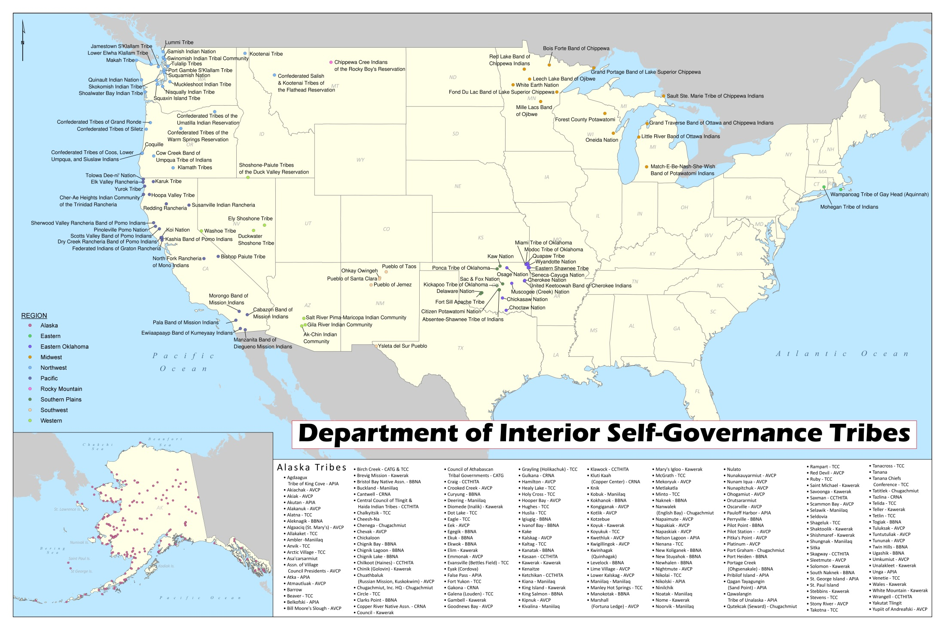
Created by: Brittni Kilborn, GIS Analyst II , BIA - Office of Trust Services and
Michaela Stroup-Madrid, Self-Governance Intern, DOI - Office of Self-Governance, Northwest Field Office

Slide 23
Open discussion

