Slide 1
Sitka Tribe of Alaska’s Experience Negotiating
with NPS
Topic of Presentation
December 12th 2022
Lisa Gassman, Chief Executive Officer
April 2024

Slide 2
Presentation will Cover:
History of our efforts – issues we faced
01
02
03
04
Highlights of some of our successes
Current Status/Plan
Lessons learned

Slide 3
History of Efforts
2004 Tribal Council put management of Totem Park on the STA Strategic Plan
Staff had an NPS box that passed from Dept to Dept, not quite sure how to make that happen.
Another GM raised the potential of STA Compacting at a SG conf in 2012-2013 timeframe, NPS responded negatively – how dare a Tribe try to take over anything at NPS!
Summer 2016 – Lisa Gassman returned as GM to STA, this item was not completed, began work on it
Letter submitted September 2016 in response to federal register notice
Issues experienced from outset (nonworking fax, phone for NPS)
Response by NPS received indicating a team would be identified and further info would follow
Issue: That didn’t happen

Slide 4
NCAI Resolution Oct 2016
STA requested assistance from NCAI in bringing to the attention of Congress that no Tribe had been successful in entering into an Annual Funding Agreement outside of BIA/IHS despite 20 years passing since the ISDEAA had been passed.
Resolution | NCAI
Lists all of the parks near a Tribe that may have “a special geographic, historic or cultural relationship to Federally Recognized Tribes”
We requested Congress request the Secretary of Interior to analyze attempts to compact and report back on barriers to compacting with NPS

Slide 5
Primary Issues we faced over multiple years
1. NPS not wanting to co-manage with a Tribe – they would rather do a grant agreement or cooperative agreement. Once we decided we wanted to use our compact to have an AFA with NPS we became the enemy.
When a cooperative agreement was used, full indirect would be provided – no question. Once it became an AFA, all of the sudden they didn’t get indirect funding so couldn’t give it to us. They refused to pay indirect or CSC.
Lack of respect for Tribes by certain individuals within the Alaska Region
Belief by NPS that we couldn’t handle the job – comments like we are building the airplane while flying it, just take a little not a lot.
2. No clear definition of what is inherently federal and NPS asserting all top positions within the various programs were inherently federal leaving STA with no ability to manage the programs.

Slide 6
History of Efforts
FY18 Negotiations
STA requested several divisions within SNHP
Interpretation, Cultural Resources, Natural Resources and Maintenance
Issues experienced:
No documents available to utilize – NPS has done cooperative agreements and with Tribes, attempted to treat compacting through SG as a grant, not a government-to- government agreement
GM modeled AFA and Budget off of BIA documents
Inherently federal positions asserted by NPS
NPS unwilling to provide full indirect funding
Notes:
NPS stated all upper positions within the divisions performed “inherently federal functions and therefore were not compactible”
To get an agreement in place, we agreed to accept only limited positions within Interpretation. That was a 6-month agreement (4/1/18-9/30/18)
We haven’t been able to get NPS in the Alaska Region to budge regarding their position on what is inherently federal

Slide 7
History of Efforts
FY19 Negotiations
Did Status Quo of FY18 to get an agreement in place and combat assertion that NPS needed money back for additional federal positions, was able to slip in another seasonal position.
DC Staffers offered to participate in negotiations – this upset federal staff, said we should have told them in advance of negotiation meeting.
Despite another Park in East Coast being turned over to a County government and no inherently federal issues being raised there, Alaska region still won’t budge.
ZERO indirect provided – despite prior year providing some, and full indirect in cooperative agreements NPS has taken flawed legal position they don’t get it so cannot give it

Slide 8
History of Efforts
FY20 Negotiations
Requested status quo of FY19 to get an agreement in place
Approached the Congressional delegation throughout but particularly in this year’s negotiations to keep them in loop
NPS then reviewed the documents for several months, we submitted all by 7/2/19.
September 9, 2019, NPS sent a letter stating they would not agree to extend the FY19 agreement or to enter another agreement but would be happy to explore a cooperative agreement.
A subsequent notice received on 9/24/19 indicating we needed to remove our staff and all Tribal items from the Park by 9/30/19. The Tribe was being kicked off land that was historically belonged to the Kiks.ádi clan. We were also asked after we moved if we could confirm that we didn’t take anything that belonged to the Park. This attitude epitomizes the mistrust NPS leadership at the park has for the Tribe.

Slide 9
History of Efforts
FY21 Negotiations
NPS refused to negotiate an FY21 agreement with STA that had been submitted 5/19/2020 relying on 25 CFR §1000.
Local Superintendent stated she would be more than willing to discuss “partnering opportunities under other mechanisms, such as a cooperative agreement.”
Co-Management was a dirty word to NPS and the local park leadership shared a couple of times with the STA General Manager that the Tribe was just a “hiring service” for them.

Slide 10
History of Efforts
FY22 Negotiations
STA submitted our request to enter into an AFA very early so they didn’t have a technicality to fall back on.
Park Superintendent dictated who from STA could participate (on our side). She refused to allow anyone other than the Chairman and myself. She didn’t like our Tribal Attorney or the person who had served as the Operations Lead for the Tribe, that familiarized himself with all laws, policies, applicable to NPS and the local park.
We eventually ended negotiations with her because it was apparent it was a waste of time. They had reduced positions they were willing to give up from 7 to 3 and were demanding workplans etc. We did the workplans, it really was the reduction in positions and moving from SG to being their hiring service that made us ultimately pull back.
We did not submit requests for FY23 or FY24.

Slide 11
Current Status
STA somewhat stepped away from seriously trying to do an AFA with NPS beginning in 2020 (during COVID in particular).
We received a large influx of federal funding to address the pandemic and had to shift our focus to that.
Also, we realized as we attempted to negotiate with the current local NPS leadership for FY21 and FY22 AFA requests that until we get NPS to respect the Tribe and understand SG, we would not want to subject our staff to having to be at the Park.

Slide 12
Current Status
We have had our Director of Transportation and Community Development focused on serving on the Progress Act negotiated rulemaking team – we believe without language to move agencies outside BIA/IHS from being “optional” participants in ISDEAA there will be little to no movement on getting NPS to change their culture and embrace Self-Governance – and believe in having a co-management with Tribe’s relationship.
Our current plan/ask of our Congressional delegation is two-fold.
Get the money NPS owes us from the 2019 AFA, despite them signing it, they still to date haven’t paid all of it.
“Landback” – take the Sitka National Historical Park out of the park system and give that land back to Sitka Tribe of Alaska. This is more along the lines of the original vision of our Elders when this was put in our Strategic Plan in 2004 and with the current administration stating this isn’t off the table, we want to try to make this happen.

Slide 13
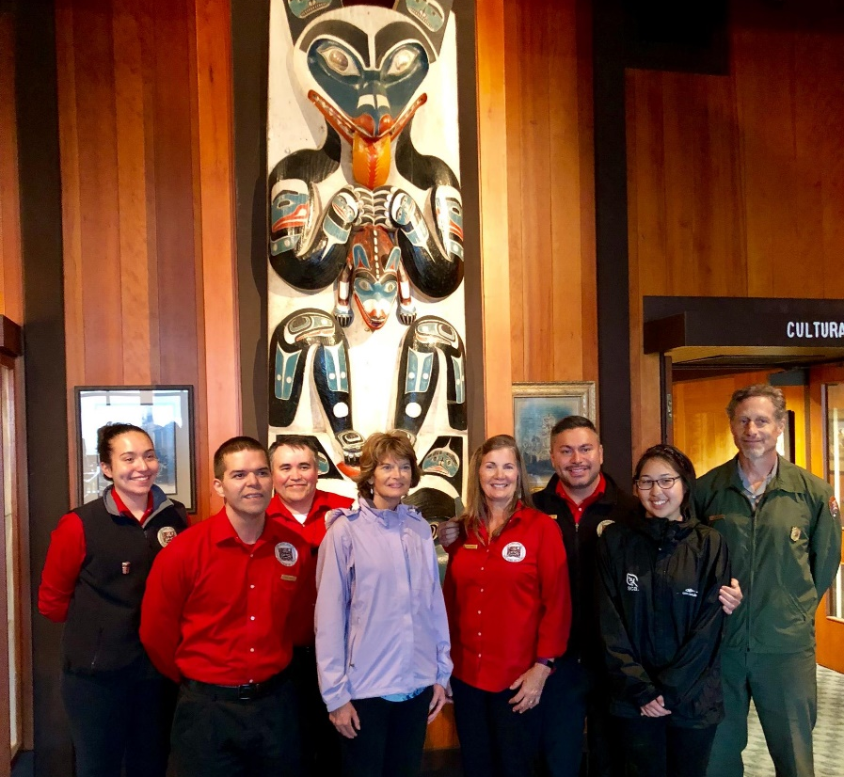
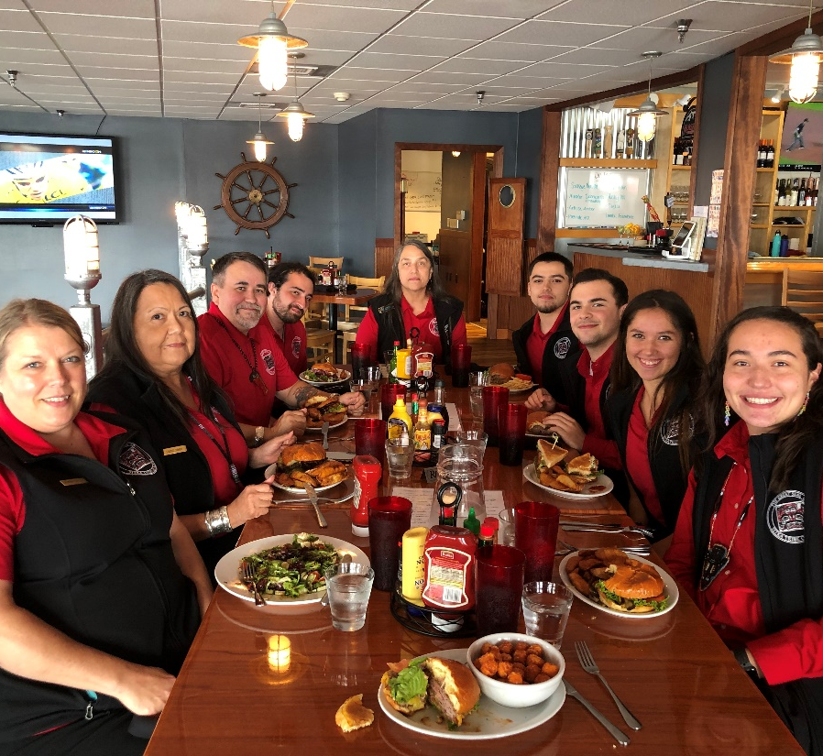
Park Employees 2018 and 2019
2018 – Taking opportunity to introduce Senator Murkowski to STA staff at Sitka National Historical Park.
2019 – Mid-season dinner hosted by STA to show our employees we appreciated them being on the front lines

Slide 14
Successes from 2018-2019
STA was able to tell our story during the Summer of 2018 and 2019
Visitors who have been there before noticed a difference it is our youth, our people.
We saw the highest customer satisfaction ratings in NPS surveys of visitors when we were there telling our story.

Slide 15
Our people telling our story
14 Miles: The Land of Our Grandparents on Vimeo

Slide 16
Lessons Learned/Advice for other Tribes
1. You will face obstacles, don’t give up be persistent – shout out to Gerry Hope, STA Transportation Director.
2. NPS has no concept of what true Self-Governance means
3. Don’t let NPS get you to use documents that are like grant agreements/cooperative agreements
4. Be willing to be the leader in your state – make it happen for Tribes in your area
5. Be prepared to have the Tribe support some of the cost while you battle NPS to fully fund indirect
6. Keep your congressional delegation informed of issues, call on them to help
7. Support the frontline staff that are facing a potentially unfriendly NPS staff who don’t want to see change

Slide 17
Contact Information
Lisa Gassman, Chief Executive Officer
Sitka Tribe of Alaska
204 Siginaka Way, Suite 300
Sitka, AK 99835
(907) 747-7380 (direct line)
lisa.gassman@sitkatribe-nsn.gov
Please contact me and I would be happy to share our documents with you related to our Annual Funding Agreement/ Reprogramming Request with NPS or if you have any questions.

