Slide 1
CHAP: The Road to Implementation
Tribal Self-Governance Conference
CHAP Panel Discussion
April 15, 2024

Slide 2
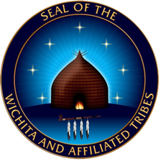

Slide 3
Desired Outcomes
Provide an overview of the Community Health Aide Program and status of expansion activities.
Engage in discussion with the panelists on their unique perspectives and experiences through CHAP expansion.
Increase advocacy and awareness of the benefit of CHAP for tribal communities.

Slide 4
CHAP Panelists Moderator: Nicklaus Lewis, Councilman, Lummi Nation, Chair, Northwest Portland Area Indian Health Board, Vice Chair, National Indian Health Board
Terri Parton, President, Wichita and Affiliated Tribes
M. Angela Thompson, MTAG, CEO, Leader, LLC, Consultants for Wichita and Affiliated Tribes, Oklahoma
Katie Ferguson, Special Projects Officer, Cherokee Nation Health Services
Christina Friedt, MJ, Tribal Community Health Provider Senior Program Director, Northwest Portland Area Indian Health Board
Julie Seward, RDH MEd-CHAP Program Manager at Southern Plains Tribal Health Board
Dr. Loretta Christensen, MD, Chief Medical Officer, IHS Headquarters
Dr. Christopher Jarvis, MD, OCPS Director, IHS Headquarters

Slide 5
CHAP Video: Aerial View of Practice and Promise
https://www.youtube.com/watch?v=lLyGcBA_DWU

Slide 6
Panelists: Snapshot of CHAP in Your Area

Slide 7
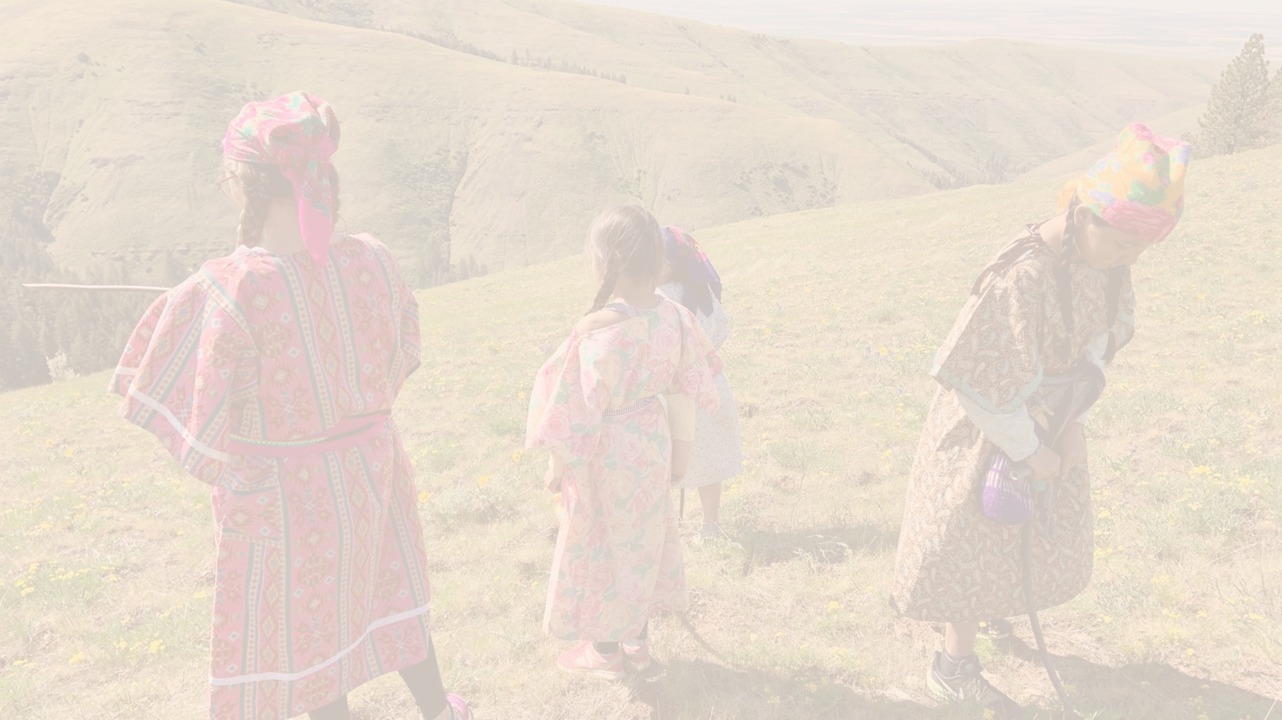
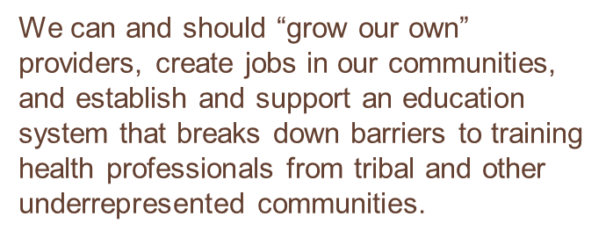
Addressing structural racism and strengthening Tribal sovereignty in all levels of the work
Proven history of safe, quality care in Alaska for over 60 years
Uniquely developed for Tribes using the Alaska model
Tribes can tailor their programs to fit their needs
Increases AI/AN local workforce and creates career paths
Providers are home grown and culturally knowledgeable
Competency based, skilled providers who increase access to care
Extend the reach of services into hard to access areas
CHAIRMAN CLADOOSBY,
SWINOMISH TRIBE
WHY
CHAP MATTERS
Notes:
Christina

Slide 8
Tribes in Portland Area developing CHAP and/or utilizing CHAP Providers
Tribes with Education Programs partnerships in operation or development
Coeur d’Alene Tribe (ID)
Confederated Tribes of the Umatilla Indian Reservation (OR)
Lummi Nation (WA)*
Shoshone-Bannock Tribes (ID)*
Swinomish Indian Tribal Community (WA)*
Yakama Nation (WA)
* Tribes developing or utilizing CHAP providers
Colville Confederated Tribes (WA)
Confederated Tribes of Coos Lower Umpqua, and Siuslaw Indians (OR)
Coquille Tribe (OR)
Cowlitz (WA)
Jamestown S’Klallam Tribe (WA)
Klamath Tribes (OR)
Lower Elwha Klallam Tribe (WA)
Makah Tribe (WA)
Nooksack (WA)
Port Gamble S’Klallam Tribe (WA)
Shoshone-Bannock Tribe (ID)
Tulalip Tribe (WA)
Yakama Nation (WA)
Tribes Outside of the Portland Area with students in CHAP education Programs
Sault Ste. Marie Tribe of Chippewa Indians
Wichita and Affiliated Tribes Kiowa Navajo
Assiniboine Sioux Crow
White Mountain Apache
Notes:
Other tribes are still in the exploration phase. Training of providers can be expensive

Slide 9
Summary of the components of CHAP within the Portland Area
Community outreach and engagement
Tribal leadership
Tribal Health Programs
Advocacy (federal, state, tribal)
ECHO
Student and Supervising provider support
Support for students through the education program
Support for providers as they integrate a new provider type into their health programs
Regulatory Infrastructure
Federal/State advocacy
Working with states on integration of CHAP providers into Medicaid programs
CHAP TAG
Certification Boards
Standards and Procedures
Academic Review Committees
Administrative Support
Clinic Implementation Support
Support for tribal administrators as they integrate the program into their health organizations
Education Programs
Development and ongoing support of education programs
Curriculum Development
Health Aide Manuals
Partnerships with education institutions
Providers
Community Health Aides
Dental Health Aides
Behavioral Health Aides
Community Health Representative Programs as gateways to CHAP careers
Implementation Funding
Grants, grant administration
Long-term Program Sustainability
Federal/State Advocacy for funding
State Medicaid Program Collaboration
State Medicaid Billing Infrastructure
Area Office Collaboration
Notes:
Each one of these bullet points is a major body of work – this is just a summary of the categories of work that NPAIHB, the Area Tribes, and PAIHS are engaged in.
Examples of Clinical Implementation Support
Providing sample Job Descriptions
Supervising Provider technical assistance
Tribal Health Org policy and Procedures
Credentialing and Privileging
NPI numbers

Slide 10
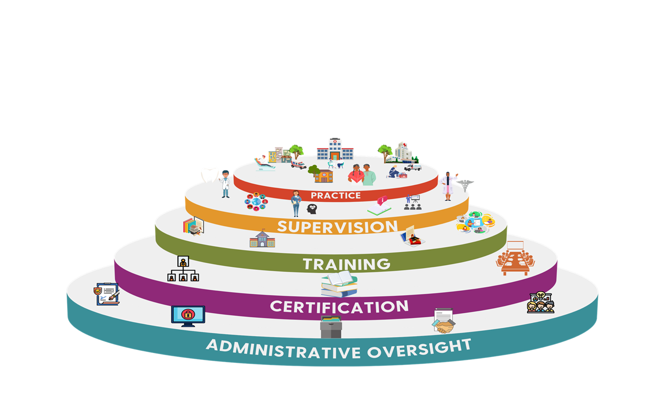

Slide 11
Panel Discussion and Audience Q&A

