Slide 1
Working with the FCC
Bambi Kraus, Chief
Office of Native Affairs and Policy
Consumer and Governmental Affairs Bureau
Federal Communications Commission

Slide 2
Agenda
What is the FCC’s Mission?
What is the FCC’s Governance and Structure?
How Does the FCC Fulfill its Mission?
Key FCC Bureaus and Offices
What is Federal Rulemaking?
FCC Rulemaking – Why and How
How the FCC Seeks Public Comment
Why Should Tribal Nations File Comments?
Types of Filings
What to Include in Comments?
How to File?
Strategies for Tracking FCC’s Work

Slide 3
What is the FCC’s Mission?
The Federal Communications Commission is an independent agency overseen by Congress
Responsible for implementing and enforcing America’s communications law and regulations
Regulates interstate and international communications by wire and radio in all 50 states, the District of Columbia, and U.S. territories
Covers wireline and wireless communications, broadcast TV and radio, as well as satellite, and cable TV

Slide 4
FCC’s Governance and Structure
Five Commissioners
President selects one Commissioner to be Chair
Divided into Bureaus and Offices
7 Bureaus: e.g., Consumer and Governmental Affairs (includes ONAP), Media, Wireless, and Enforcement
10 Offices: e.g., General Counsel, Legislative Affairs, Managing Director, Engineering and Technology

Slide 5
How Does the FCC Fulfill its Mission?
The FCC establishes and enforces rules based on the substantive areas outlined in the Communications Act, as amended, to:
Promote competition, innovation and investment in broadband services and facilities
Support the nation's economy by ensuring an appropriate competitive framework for the unfolding of the communications revolution
Encourage the highest and best use of spectrum domestically and internationally
Revise media regulations so that new technologies flourish alongside diversity and localism
Provide leadership in strengthening the defense of the nation's communications infrastructure

Slide 6
Key FCC Bureaus and Offices
Consumer and Governmental Affairs Bureau (CGB)
Office of Native Affairs and Policy (ONAP); Affordable Connectivity Program (ACP) outreach and outreach grant programs
Wireline Competition Bureau (WCB)
Universal Service Fund (USF); ACP regulatory issues
Wireless Telecommunications Bureau (WTB)
Spectrum Access; Spectrum Licensing; Historic Preservation issues
Media Bureau, Tribal Radio Priority
Public Safety: FirstNet, Emergency Alert System, 911
Enforcement Bureau - investigates and enforces the provisions of the Communications Act, and the FCC’s rules

Slide 7
What is Federal Rulemaking?
Rulemaking is a process for developing and issuing rules. The rulemaking process can lead to the issuance of a new rule, an amendment to an existing rule, or the repeal of an existing rule
In the rulemaking process, all Federal agencies must adhere to the Administrative Procedure Act (APA), which sets forth basic requirements for notice and comment rulemaking, including:
A minimum length of time agencies must provide for public notice and comment (usually at least 30 days)
FCC also has its own FCC-specific rules for rulemaking procedures.
Notes:
Public notice and comment is a critical piece of the rulemaking process!

Slide 8
FCC Rulemaking – Why and How
The FCC follows the Administrative Procedure Act (APA) when developing and issuing rules and makes rules for three main reasons:
Congress requires the FCC to make a rule
The FCC identifies a problem (e.g., an industry behavior that adversely affects consumers) or a need to clarify existing rules)
A person or organization files a Petition for Rulemaking asking the FCC to make or change a rule

Slide 9
How the FCC Seeks Public Comment
The FCC considers policies (and may adopt rules) by asking for public comment through these types of notices:
Notice of Inquiry (NOI) – asks questions about issues; no rules proposed
Notice of Proposed Rulemaking (NPRM) – specific questions and proposals for final rules
Further Notice of Proposed Rulemaking (FNPRM) – specific questions and proposals for modifying or adopting additional rules
Public Notice (PN) – used to announce certain actions; also used to seek comment or data on more limited issues (more like an NOI; no rules are proposed)

Slide 10
Why Should Tribal Nations File Comments?
FCC’s notice and comment rulemaking process
Rules Must be Based on Record Evidence
Public Comments Strengthen the Process
Provides Transparency
Provides Different Perspectives
Tribal comments are important
Help shape policies and rules
Provide Tribal perspectives
Helps preserve appeal rights

Slide 11
Type of Filings
Public Comments
Two rounds: Initial & Reply
Comment deadlines announced in different ways (e.g., in actual notice, by Fed Reg publication)
Tip: Sign up for ONAP’s email list to stay informed
Letter format or more structured
Ex Parte Letters
“Permit-but-disclose” anytime during open proceeding including after comment period (up until Sunshine Period for open meeting)
Submit any handouts and/or summary of discussions from meetings with FCC staff
File within two business days
Becomes part of decision record
Notes:
Tribal College Libraries: In addition to this, we are also receiving feedback on how service to the public should be verified (IMLS Grants, Tribal Government, State Central Library Agency)? What restrictions should be put in place (open to the public for a set number of hours, permit public to request materials, prevent other facilities from using services)?
Simplifying the E-Rate Process and Forms: In particular, we are seeking feedback on how the forms or processes for the program can simplified. We are also seeking comment on who the competitive bidding exemption should apply to (Tribal libraries, Tribal entities, all libraries)? What services and equipment should the exemption apply to (C1 and C2, C2 equipment)? At what price should purchases be exempt from competitive bidding (e.g., $3,600, $5,000, $10,000)?
E-Rate cost-allocation rules: We have received comments that cost-allocation rules could be clarified or more guidance could be provided on when cost-allocations are required. For example, should we consider providing guidance on when cost-allocation is not required if the primary use of the E-Rate funded services or equipment is for eligible purposes and other use is ancillary and does not add to the cost of the library’s services? We are also seeking information on what kind of entities may share space with Tribal libraries and more information on how Tribal libraries operate within the shared space. Can you describe any multiuse buildings with libraries that you are aware of (e.g. Chapter Houses or Tribal Government buildings), so that we can think through how to provide more guidance?
Increase C2 discount rate/funding floor: We are seeking more information about the costs for providing services and equipment to Tribal libraries and whether an increase in the amount of the discount available would encourage more Tribal libraires to participate in the E-Rate program. We are also asking if the current minimum C2 funding floor should be raised and what it should be increased to.
Adding Tribal Representative to USAC’s Board of Directors: Would this help to encourage Tribal entities to participate in the E-Rate program if there was greater Tribal leadership and oversight at USAC, the administrator for the Universal Service Fund, and the universal service programs, including the E-Rate program?
Adopt a definition of Tribal and what should that definition be: Possible categories to be included in the definition: An entity is Tribal for purposes of E-Rate funding if it is a school operated by or receiving funding from the Bureau of Indian Education (BIE), or if it is a school or library operated by a Tribal Nation. Are there Tribal libraries on Tribal lands that are not operated by a Tribal Nation? Are Tribal libraries “operated by” Tribal Nations? Is “Tribal Nation” inclusive enough to include all 574 federally-recognized Tribes? Is there another definition of Tribal that the Commission should consider instead?
Seeing it written this way, 70% does seem low for usage, especially at a school, unless we are only talking about cabling. Should we rephrase this to be more general, like "primarily" used for library use?

Slide 12
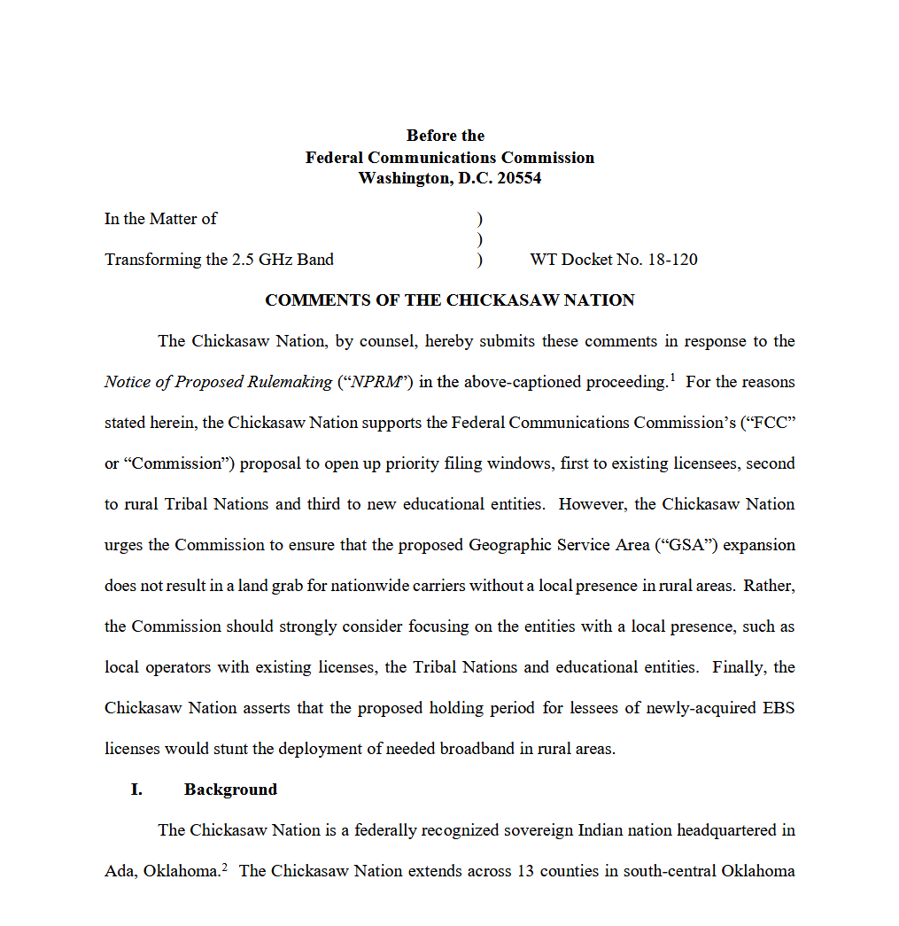
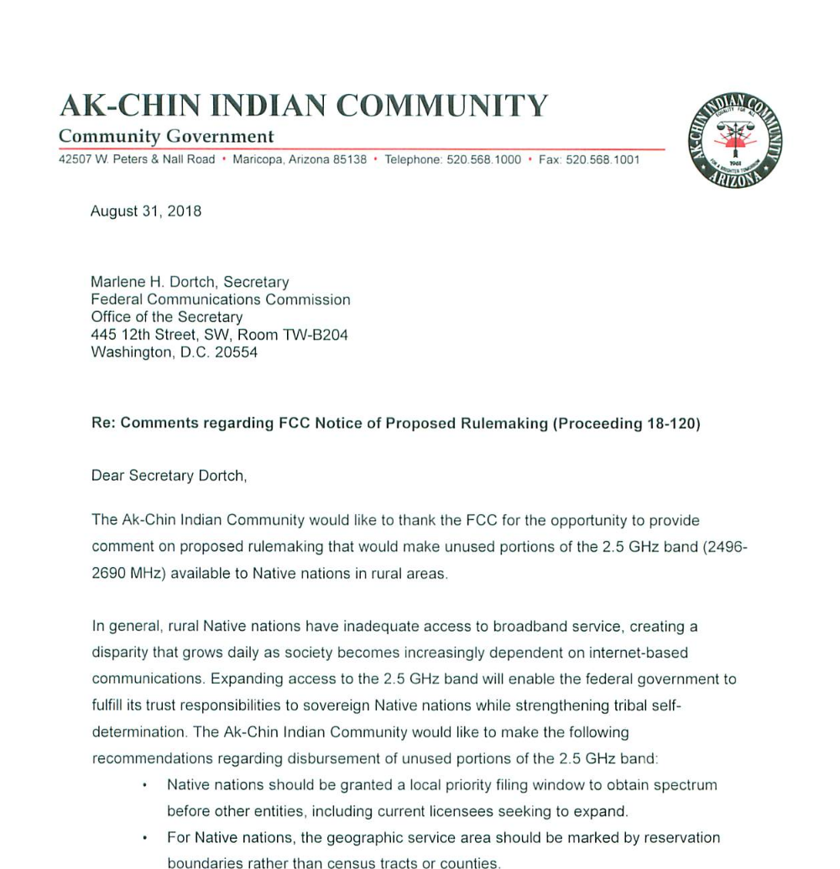
Types of Filings continued Examples: Structured Comment Letter Style Comment `

Slide 13
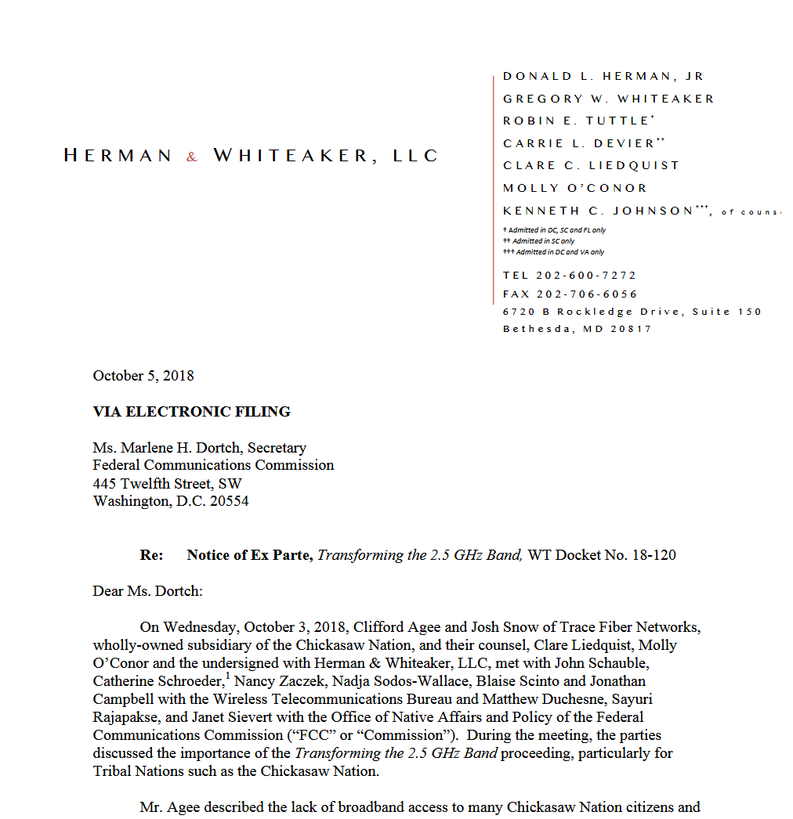
Types of Filings continued Example: Ex parte letter

Slide 14
What to Include in Comments?
Include anything you want the FCC to rely on in its decision-making process
Specific examples, evidence, and data are helpful
Illustrative stories demonstrating the real-world impacts
Confidential treatment is possible
Initial comments respond to the NOI/NPRM/FNPRM
Reply comments respond to initial comments
Ex parte filings supplement the record OR must detail non-public meetings or presentations

Slide 15
What to Include in Comments? continued
List and file in all relevant docket numbers
From the first page of NOI/NPRM/FNPRM
Also online at https://www.fcc.gov/ecfs/browse-popular-proceedings
ONAP can help

Slide 16
How to File?
FCC’s Electronic Comment Filing System (ECFS):
https://www.fcc.gov/ecfs/filings
Paper filings are still possible
Must include signed original comment and four copies
More details here: https://www.fcc.gov/consumers/guides/how-comment#paper
Public access for all filings.
All public filings are searchable & can be downloaded through ECFS

Slide 17
How to File? continued

Slide 18
How to File? continued

Slide 19
How to File? continued

Slide 20
How to File? continued

Slide 21
Strategies for Tracking FCC’s Work
Sign up for ONAP blasts by sending email request to Native@fcc.gov
Watch for new proceedings on the FCC’s main page or Bureau pages
Sign up for FCC’s Daily Digest (https://www.fcc.gov/proceedings-actions/daily-digest)
Set up an RSS Feed (https://www.fcc.gov/ecfs/help/rss)
Attend FCC’s monthly open meetings, which can be livestreamed, (https://www.fcc.gov/document/fcc-announces-tentative-agenda-november-open-meeting-9)
Notes:
Tribal College Libraries: In addition to this, we are also receiving feedback on how service to the public should be verified (IMLS Grants, Tribal Government, State Central Library Agency)? What restrictions should be put in place (open to the public for a set number of hours, permit public to request materials, prevent other facilities from using services)?
Simplifying the E-Rate Process and Forms: In particular, we are seeking feedback on how the forms or processes for the program can simplified. We are also seeking comment on who the competitive bidding exemption should apply to (Tribal libraries, Tribal entities, all libraries)? What services and equipment should the exemption apply to (C1 and C2, C2 equipment)? At what price should purchases be exempt from competitive bidding (e.g., $3,600, $5,000, $10,000)?
E-Rate cost-allocation rules: We have received comments that cost-allocation rules could be clarified or more guidance could be provided on when cost-allocations are required. For example, should we consider providing guidance on when cost-allocation is not required if the primary use of the E-Rate funded services or equipment is for eligible purposes and other use is ancillary and does not add to the cost of the library’s services? We are also seeking information on what kind of entities may share space with Tribal libraries and more information on how Tribal libraries operate within the shared space. Can you describe any multiuse buildings with libraries that you are aware of (e.g. Chapter Houses or Tribal Government buildings), so that we can think through how to provide more guidance?
Increase C2 discount rate/funding floor: We are seeking more information about the costs for providing services and equipment to Tribal libraries and whether an increase in the amount of the discount available would encourage more Tribal libraires to participate in the E-Rate program. We are also asking if the current minimum C2 funding floor should be raised and what it should be increased to.
Adding Tribal Representative to USAC’s Board of Directors: Would this help to encourage Tribal entities to participate in the E-Rate program if there was greater Tribal leadership and oversight at USAC, the administrator for the Universal Service Fund, and the universal service programs, including the E-Rate program?
Adopt a definition of Tribal and what should that definition be: Possible categories to be included in the definition: An entity is Tribal for purposes of E-Rate funding if it is a school operated by or receiving funding from the Bureau of Indian Education (BIE), or if it is a school or library operated by a Tribal Nation. Are there Tribal libraries on Tribal lands that are not operated by a Tribal Nation? Are Tribal libraries “operated by” Tribal Nations? Is “Tribal Nation” inclusive enough to include all 574 federally-recognized Tribes? Is there another definition of Tribal that the Commission should consider instead?
Seeing it written this way, 70% does seem low for usage, especially at a school, unless we are only talking about cabling. Should we rephrase this to be more general, like "primarily" used for library use?

Slide 22
Still Have Questions?
Contact ONAP Staff:
Bambi Kraus, Chief, Bambi.Kraus@fcc.gov
Lloyd Collier, Attorney Advisor, Lloyd.Collier@fcc.gov
Michelle Branigan, Attorney Advisor, Michelle.Branigan@fcc.gov
Denise Rosado, Attorney Advisor, Denise.Rosado@fcc.gov
Kenneth Akini, Attorney Advisor, Kenneth.Akini@fcc.gov
Email ONAP’s general mailbox: Native@fcc.gov

Slide 23
Questions?

