Slide 1
Indian Health Service Budget Update
July 23, 2024
JILLIAN CURTIS, CHIEF FINANCIAL OFFICER
TRIBAL SELF-GOV ADVISORY CMTE MTG

Slide 2
FY 2025 Appropriations Update

Slide 3
FY 2025 President’s Budget
The FY 2025 President’s Budget aims to address the longstanding underinvestment in IHS through a two-pronged approach.
In FY 2025, the budget includes $8.2 billion for IHS, including $8.0 billion in discretionary funding, and $260 million in proposed mandatory funding.
Starting in FY 2026, the budget requests a mandatory funding formula for the next 9 years, culminating in a total funding level of $42 billion in FY 2034, and exempts the IHS from sequestration.

Slide 4
FY 2025 House Bill
In FY 2025, the House Bill provides $8.6 billion in discretionary funding for the IHS, which is +$1.6 million above FY 2024 enacted.
The Bill includes:
Services: $5.3 billion in discretionary funding;
Facilities: $851 million in discretionary funding;
Contract Support Costs: $2 billion indefinite discretionary funding; and
Payments for Tribal Leases: $400 million indefinite discretionary funding.
Not included in the House Mark, but in the FY 2025 President’s Budget:
Special Diabetes Program for Indians: $260 million in mandatory funding, increased to +$270 million through FY 2026.

Slide 5
FY 2025 House Bill (Cont.)
Some major highlights of the Bill include:
Staffing of Newly Constructed Facilities: Fully funds +$91 million
Current Services: Fully funds increases for pay costs, medical and non-medical inflation and populations growth +$345 million;
Contract Support Costs: Maintains indefinite discretionary appropriations and includes an increase of +$985 million for a total of $2 billion; and
Payments for Tribal Leases: Maintains indefinite discretionary appropriations and includes an increase of +$251 million for a total of $2 billion.

Slide 6
FY 2025 House Bill (Cont.)
Other highlights of the Bill include:
Other Notable Increases: +$10 million for the Tribal Epidemiology Centers for a total of $44 million, +$8 million for Indian Health Professions for a total of $89 million, and +$7 million for dental health for a total of $283 million.
Additional Smaller Increases: emergency generators (+$5 million), Produce Prescription Pilot Program (+$4 million), staffing quarters (+$3 million), the Behavioral Health Pilot Program (+$2 million), and maternal health (+$1 million).

Slide 7
FY 2025 House Bill (Cont.)
Although the House bill provides a significant increase above FY 2024 enacted over all, it also includes a critical reduction.
Electronic Health Record : -$115 million for the Electronic Health Record modernization project, leaving a total of $75 million in FY 2025.
At this funding level, the IHS would have to dramatically scale back this effort, and would not be able to support Tribal and urban partners.

Slide 8
FY 2025 House Bill (Cont.)
The House bill does not restore FY 2024 funding reductions to facilities programs.
Health Care Facilities Construction: A total of $183 million, which continues the -$75 million reduction from the FY 2024 appropriation.
Sanitation Facilities Construction: A total of $124 million, which continues the -$78 million reduction from the FY 2024 appropriation.

Slide 9
FY 2025 House Bill (Cont.)
The bill continues to provide advance appropriations for the IHS, including a total of $6 billion for FY 2026 that will become available on October 1, 2025.
The House bill expands advance appropriations to the Indian Health Care Improvement Fund, Electronic Health Record, and Health Care and Sanitation Facilities Construction.
The bill does not provide advance appropriations for Contract Support Costs or Section 105(l) Leases.

Slide 10
FY 2025 Next Steps
While the House bill provides a significant increase for the IHS in FY 2025, that increase is achieved by making significant reductions to other Agencies in the Interior appropriation.
The Senate is unlikely to accept reductions of that magnitude within the Interior appropriation.
The Senate Mark-up is scheduled for July 25.

Slide 11
Impact of CSC SCOTUS Decision

Slide 12
Becerra v. San Carlos Apache Tribe (Cont.)
Cost impacts for new CSC proposals will show up as early as FY 2025.
Under the current indefinite discretionary appropriation for CSC, those increases will score in the Interior Appropriation.
The impact of funding CSC increases within the Fiscal Responsibility Act caps in FY 2024 already resulted in funding reductions to critical facilities programs and EHR modernization.
In FY 2025, direct health services and critical priorities could be at significant risk.

Slide 13
Becerra v. San Carlos Apache Tribe (Cont.)
If Congress has to reduce funding for IHS Services or Facilities activities to pay for CSC increases in FY 2025 and beyond, that would reduce funding that goes to ISDEAA Tribes, Direct Service Tribes, and Urban Indian Organizations.
Direct Services Tribes would be uniquely impacted because they will not share in the increased CSC funding like ISDEAA Tribes will.
This could result in a widening gap between ISDEAA and Direct Service Tribes.

Slide 14
San Carlos Apache v. Becerra (Cont.)
The FY 2022 – FY 2025 President’s Budgets propose to reclassify CSC (and Section 105(l) Leases) to mandatory funding.
Reclassification to mandatory funding would mitigate the risks of funding reductions to discretionary funding for Services and Facilities activities as CSC and 105(l) costs continue to grow.
Funding would still be indefinite and fully fund actual CSC ands 105(l) costs.

Slide 15
Unobligated Balances Update

Slide 16
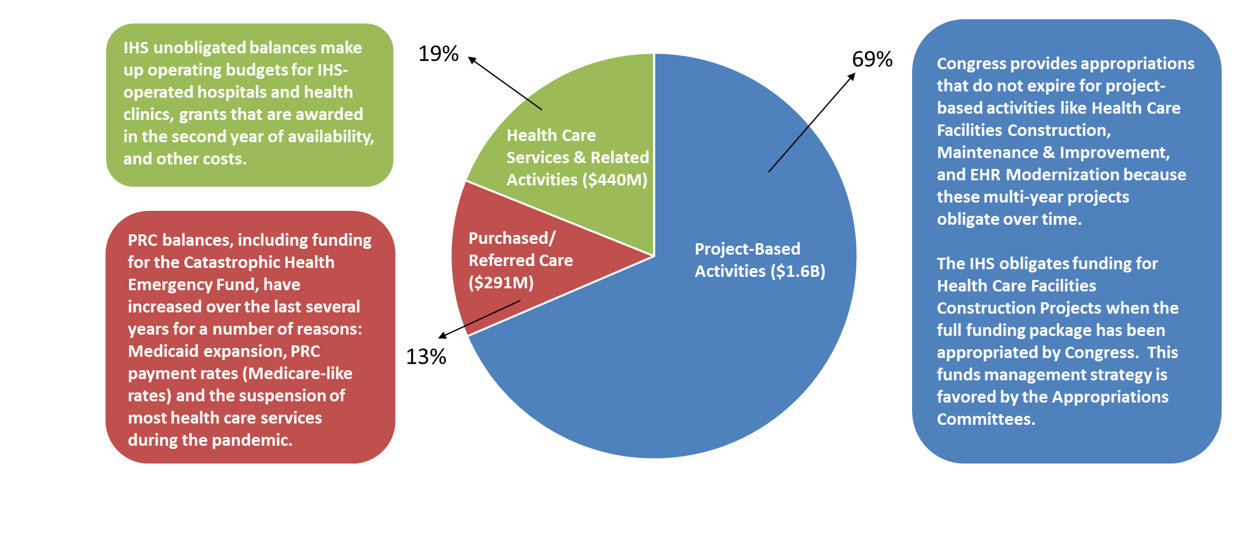
Prior Year Unobligated Balances ($2.3 billion)

Slide 17
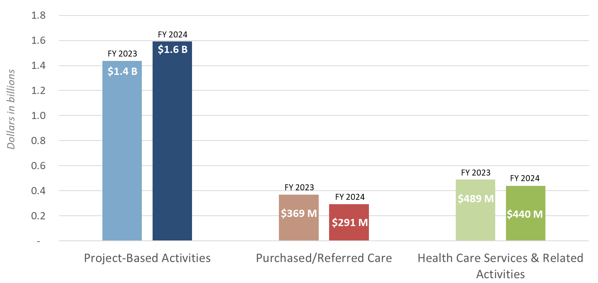
Prior Year Unobligated Balances Comparison: July 2023 to July 2024
Approx. 20% Reduction in PRC Balances

