Slide 1

ASAP Payment Justification Update
Self-Governance Advisory Committee (SGAC) Meeting
December 9, 2025
Presented by:
Office of Chief Financial Officer (OCFO)
Indian Affairs, Department of the Interior (IA/DOI)

Slide 2
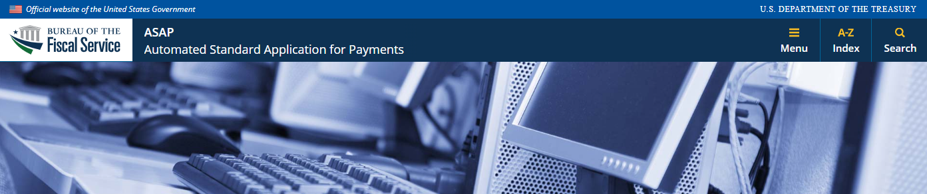
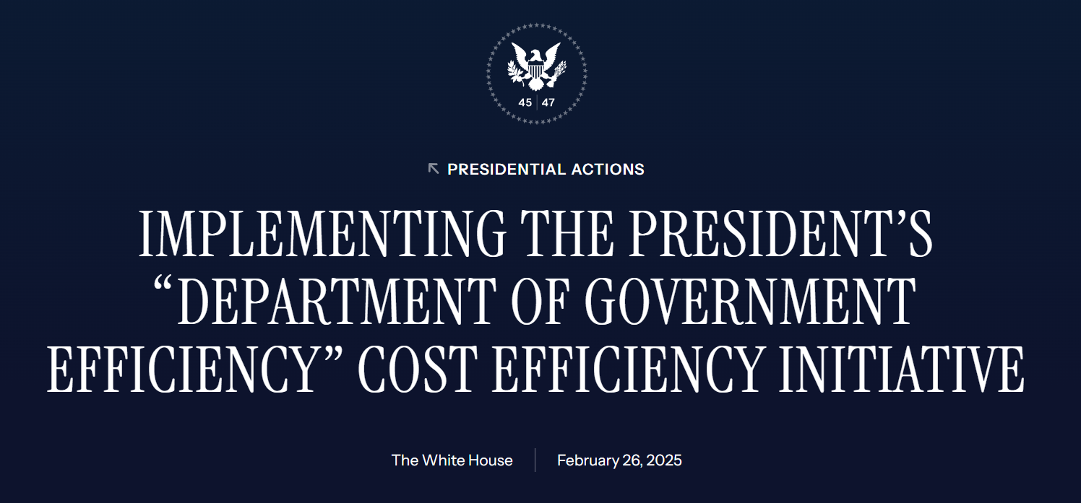
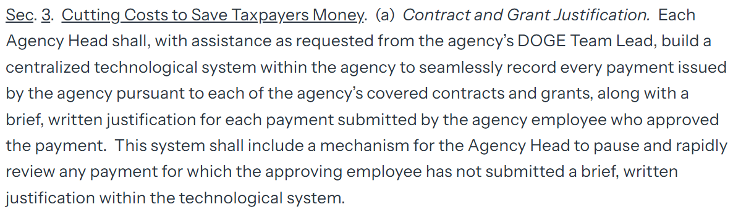

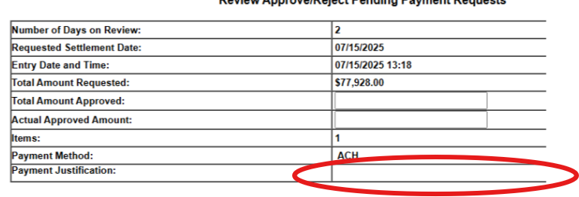
Payment Justification Update
DOI-IA Tribal recipients are not required to provide the payment justification
IA worked with the Treasury Tribal Affairs Office and BFS and implemented the following solutions:
“ISDEAA Payment”
Permanent Exemption – October 1, 2025.
DOI-IA tribal recipients can simply leave the field blank.
Additional ASAP Assistance
IA OCFO
Vendor_Mailbox@bia.gov

Slide 3

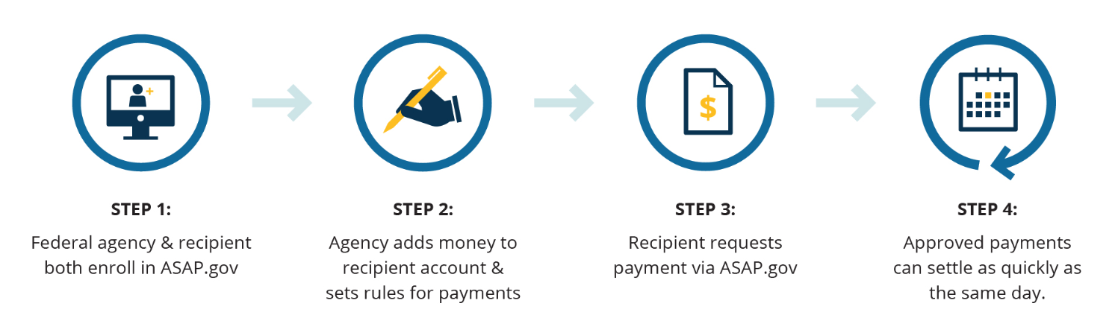




DOI –IA ASAP Process
ASAP - Treasury electronic payment system to quickly and securely transfer funds to federal recipients.
ASAP - DOI requirement recipient payment system.
ASAP - offers the most flexibility to Tribes on determine when and how much to drawdown to support tribal programs.
ASAP - promotes the coordination between the IA Awarding Officials and Tribes on ensuring financial management and accountability.
IA Awarding Official Obligates in IA system and money is available in ASAP
Tribe drawdown against the money in ASAP
ACH
Fedwire
Processed by BFS
IA OCFO is working with OSG and other IA offices on reviewing the ISDEAA award and payment process flow for enhancement.

Slide 4

Q & A
Jason Bruno
Jason.bruno@bia.gov
Director
Office of Self-Governance, Indian Affairs, DOI
Karen (Qing) Francis qing.francis@bia.gov
Deputy Chief Financial Officer
Office of Chief Financial Officer (OCFO), Indian Affairs, DOI

