Slide 1
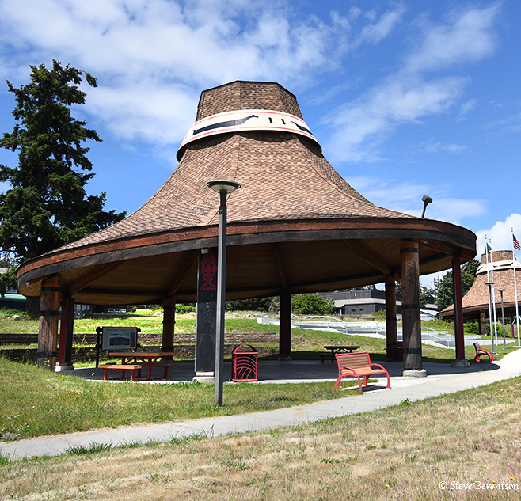

A Case Study: Swinomish Tribal Sovereignty in action to implement Dental Health Aide Therapists (DHATs)
Senator Brian Wilbur
Sarah Sullivan, Health Policy Director
Swinomish Indian Tribal Community
TSGAC Webinar 9.28.2023

Slide 2

Overview
Dental Health Aide Therapists (DHATs)/Dental Therapists.
Adding a Dental Therapist to the Swinomish Dental Team to meet the needs of the community.
Political Road to Tribal Sovereignty implementing Dental Therapists.
Swinomish Dental Licensing Regulatory Framework.
Successful Impacts of Dental Therapists at Swinomish.
2017 Washington Tribal Dental Therapist Bill.
Washington Medicaid Reimbursement for Dental Therapists.
Expansion of Dental Therapists beyond the Reservation.
Swinomish and Skagit Valley College dəxʷx̌ayəbus Dental Therapy Education Program.
Remaining Needs.

Slide 3
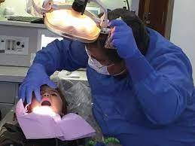
A Native Solution to Oral Health Disparities Among Native Americans
American Indians and Alaska Natives face a disproportionate burden of oral health disease compared to any population in the US:
  Early childhood untreated tooth decay for AI/ANs is 3 times higher than the US average.
  AI/AN adults are more likely to have severe periodontal disease, missing teeth, and to report poor oral health.
  In 2009 the IHS spent $99 per person on dental care compared to $272 per person nationwide.
  In 2014, more than 2.4 million Native Americans lived in counties with dental care shortages.
  The typical IHS Provider/Dentist availability is 2,800 patients per provider compared to 1,500 per Provider/Dentist for the general US population.
Barriers to the Oral Health Workforce in Indian Country include burnout, limited staffing, and lack of AI/AN representation in the workforce.

Slide 4
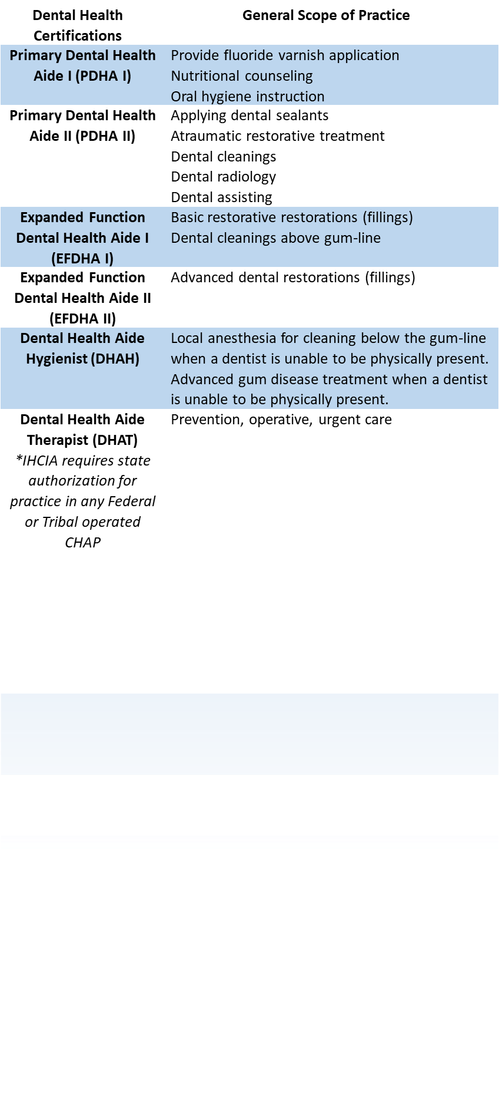
Dental Health Aide Therapists (DHATs)/Dental Therapists
DHA/Ts are primary oral health professionals that provide preventative, basic restorative care and uncomplicated extractions under the supervision of a state licensed dentist (DDS).
Trained to perform about 50 of > 500 different procedures that a dentist typically provides.
Allows the supervising provider to focus their practice at the top of their scope.
Must renew certification every 2 years.
Under the Indian Health Care Improvement Act (IHCIA) for DHAT services on tribal land outside of Alaska the following requirements must be met:
  “the use of dental health aide therapist services or midlevel dental health provider services is authorized under State law.” 25 U.S.C. § 1616l(d)(3)(A).

Slide 5
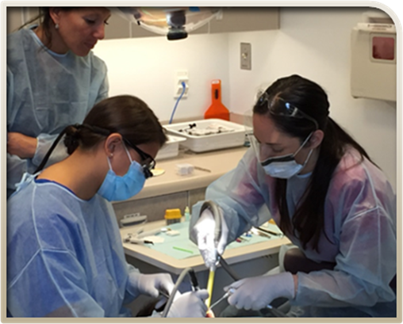
Analysis of Adding a Dental Therapist to the Swinomish Dental Clinic
Procedural review for FY 2012, 2013 and 2014 for Swinomish showed that over 50% of procedures and services could have been provided by a trained dental therapist under the Alaska model
Analysis showed that the same procedures could have been covered with 50% personnel cost savings by replacing dentist time with dental therapist time.
Analysis showed that dentist time could have been significantly reoriented to more complex dentist-only procedures (i.e. prosthodontic, advanced restorative and surgical procedures).
Dental therapists are a Native solution to the unmet oral healthcare needs in Native communities. They provide culturally appropriate care to the patients and communities they serve, and they free up dentists’ time for the most complex conditions and procedures.

Slide 6
Political Road to Self-Governance Implementation of
Dental Therapists
Swinomish worked for 5 years with Northwest Portland Area Indian Health Board (NPAIHB) and a coalition of community advocates, public health organizations, and dental professionals to pass a bill in the Washington Legislature authorizing dental therapists to practice in Washington to meet the requirement of the Indian Health Care Improvement Act (IHCIA) language.
Before 2016, no bill got out of the House or Senate Committees in Washington State, blocked by legislators working on behalf of the Washington State Dental Association.
Swinomish determined it has the power and obligation to address oral health systems change by exercising its Tribal Sovereignty. Swinomish entered into an Agreement with the Alaska Native Tribal Health Consortium to provide training to 2 Swinomish members.

Slide 7
Swinomish Dental Licensing Regulatory Framework
Swinomish created a Division of Licensing to bring together existing Tribal licensing and regulatory functions.
Swinomish Dental Licensing Board includes 6 members with 5-year terms.
Swinomish adopted the first Tribal Dental Health Provider Licensing Code to license and regulate Dentists, Hygienists, Dental Therapists, and recently Dental Therapy Education Programs.
Quintessential exercises of Tribal sovereignty: regulating Tribal providers employed by the Tribe, paid with Tribal funds, working in a Tribal clinic built on Tribal land, and improving the health of Tribal members through a Tribally-driven solution.

Slide 8
Overview of Swinomish Dental Licensing Board
Swinomish Licensing Board duties:
  Consult and advise Swinomish Senate and Division of Licensing on technical and policy matters and recommend Licensing Code amendments.
  Review and approve Division of Licensing procedures and forms.
  Conduct hearings and appeals from license or sanctions decisions.
Division of Licensing duties:
  Investigate license application and either issue license, impose conditions on license, or deny applications.
  Investigate complaints.
  Take action to protect public or sanction licensees.

Slide 9
Overview of Swinomish Dental Licensing
Must meet Tribal minimum standards of character for contact with Indian children or elders.
Employed by Tribe or eligible for employment when licensed.
Complete required training and continuing education.
Demonstrate formal education, training and/or personal or professional experience that would reasonably be expected to result in cultural competence.
If a Dentist, have experience supervising Dental Therapists or complete an acceptable course on supervision.
On January 4, 2016, Daniel Kennedy, an experienced Alaska DHAT, joined the Swinomish Dental Team in making history by becoming the first Tribally licensed Dental Therapist providing services in the lower 48 states.

Slide 10
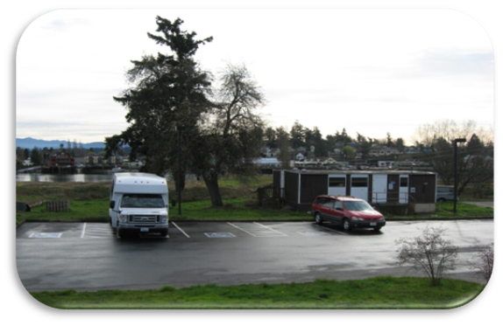
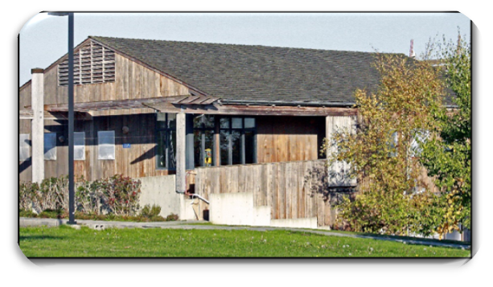
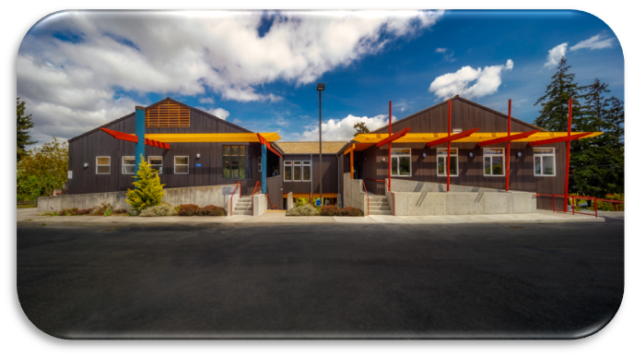

Evolution of Swinomish Dental Clinic
Old IHS Provided
Dental Trailer
(1975-1997)
After Swinomish Exercised Self- Governance in 1997, new dental clinic built in 1998.
Newly expanded & current Dental Clinic with 14 dental suites (2019)

Slide 11
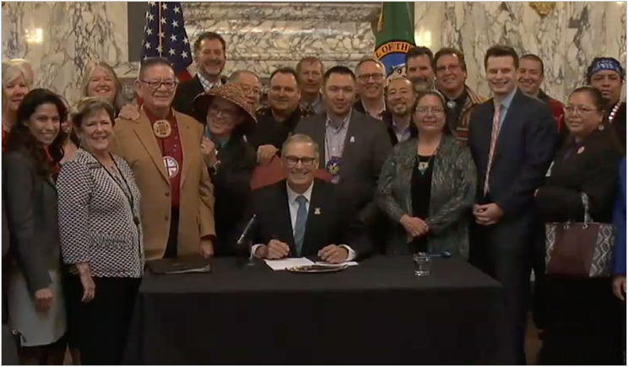
Washington Authorization of Dental Health Aide Therapists
IHCIA 25 U.S.C. § 1616l(3)(A):
  Subparagraph (B) of paragraph (2) shall not apply in the case of an election made by an Indian tribe or tribal organization located in a State (other than Alaska) in which the use of dental health aide therapist services or midlevel dental health provider services is authorized under State law…”
Washington RCW 70.350.020
  (1) Dental health aide therapist services are authorized by this chapter under the following conditions:
  (a) The person providing services is certified as a dental health aide therapist by:
  (i) A federal community health aide program certification board; or
  (ii) A federally recognized Indian tribe that has adopted certification standards that meet or exceed the requirements of a federal community health aide program certification board;

Slide 12
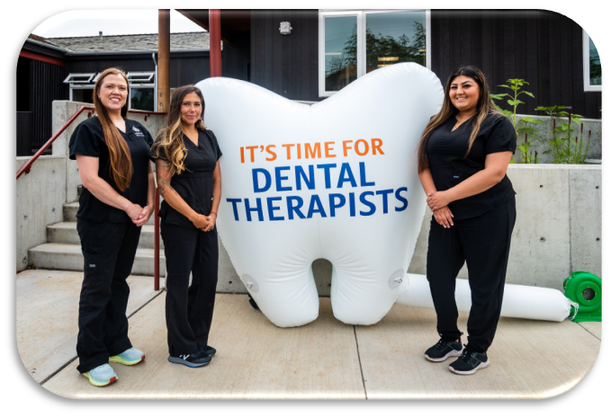
Washington Medicaid Reimbursement for Dental Therapists
Swinomish worked with the Washington Health Care Authority to include dental therapists as eligible for Medicaid reimbursement similar to doctors, dentists, hygienists, nurse practitioners, etc.
CMS disapproved the State Plan Amendment (SPA) on the alleged theory that it violated the Medicaid free choice of provider provision, which guarantees every Medicaid beneficiary access to any qualified provider willing to treat them.
2018: After CMS denial, Washington State and Swinomish requested reconsideration and pursued an administrative hearing.
2020: The CMS Administrative hearing officer rejected CMS’ legal analysis and decision, ruling that the proposed SPA did not violate the Federal Medicaid law.
2021: On the last day of the Trump administration, the CMS and HHS refused to adopt the hearing officer’s recommendation, and instead disapproved the SPA.

Slide 13
9th Circuit Reverses Trump Administration Decision to Deny Medicaid Reimbursement for Dental Therapists
2021: Washington State and Swinomish jointly filed a petition in the 9th Circuit to reverse the determination by HHS to disapprove the State Plan Amendment.
2022: oral argument was held at the Seattle location of the 9th Circuit Court of Appeals.
2023: 9th Circuit ruled unanimously in favor of the State of Washington and Swinomish, and reversed the CMS/HHS decision to deny the State Plan Amendment. (WA State Health Care Authority; Swinomish Indian Tribal Community v. CMS, 57 F.4th 703 [9th Cir. 2023])
  The Court rejected CMS’s reasoning “on the ground that the underlying Washington statute does not violate Section 1396a(a)(23) because it merely authorizes where and how DHATs can practice and does not in any way restrict Medicaid recipients’ ability to obtain services from DHATs relative to non-Medicaid recipients. “
  CMS approved the State Plan Amendment on June 21, 2023, with an effective date of July 23, 2017.
Finally, after a decade long battle, not only was Swinomish able to license dental therapists for itself and other Tribes; but now all Tribes who have licensed dental therapists can get reimbursement for Medicaid funding to help cover costs of dental care.

Slide 14
Washington Expansion of Dental Therapists Beyond the Reservation
2023: Washington House Bill 1678 was passed by the Washington State Legislature and signed into law by the Governor.
The Law establishes and authorizes the profession of dental therapy to practice in federally qualified health centers (FQHC) and FQHC look-alikes. This law expands the practice of dental therapy to many uninsured and low-income populations throughout the State.
Swinomish assisted in the creation of the bill to assure consistency with the existing Washington Tribal dental therapy statute and testified at the State hearings to advocate for bill passage.

Slide 15
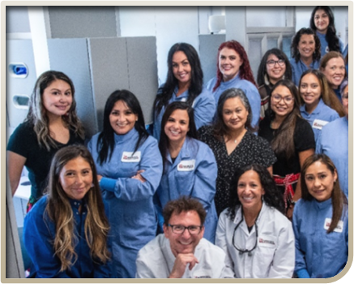
Successful Impacts of Dental Therapists at Swinomish
Our Dental Therapists have broken the cycle of historically poor traumatic dental care by providing culturally responsive oral health care.
Improved accessibility through reduced appointment wait times from 2-3 months to 1-2 weeks. Completion of treatment plans take months versus years.
Increase of prevention has led to decreases in emergency walk-ins and referrals.
Providers are working at the top of their scope. Dentists are focusing at least 50% more on in-depth procedures like crowns, bridges, and partials. We have also started an implant program.
Expansion of prevention and restorative treatment practices in community settings (pre-school, daycare, & home visits) to reach patients unable to come to the clinic.

Slide 16
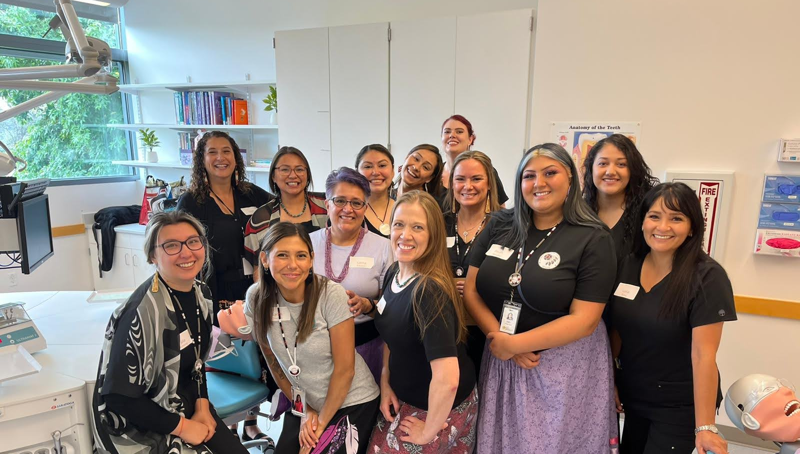
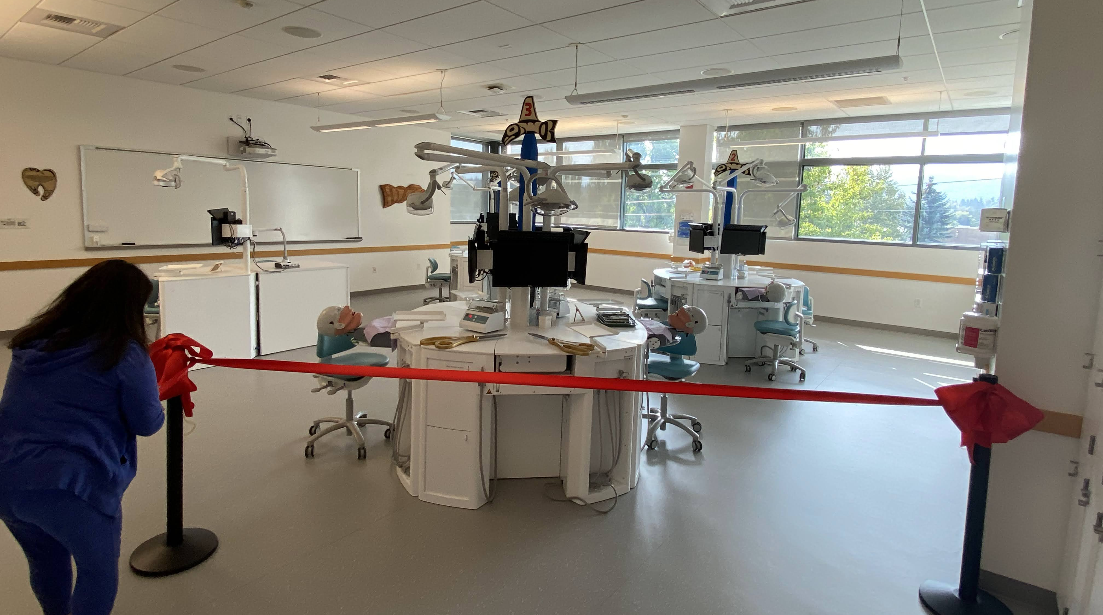
Swinomish and Skagit Valley College dəxʷx̌ayəbus Dental Therapy Education Program
Swinomish in partnership with Skagit Valley College developed the first Dental Therapy Education Program in Washington State.
  Associate of Applied Science in Dental Therapy
dəxʷx̌ayəbus is one of three accredited dental therapy education programs by the Commission on Dental Accreditation (CODA).
The program is a 2-year program and preceptorship co-located at Skagit Valley College’s Mt. Vernon Campus and Swinomish Indian Tribal Community’s Dental Clinic.
The dental therapy education program will help address on-going dental workforce shortages and oral health disparities among American Indians and Alaska Natives.
A cohort of 12 students is accepted each Fall. Our first cohort of 6 students started the program in September 2022.

Slide 17
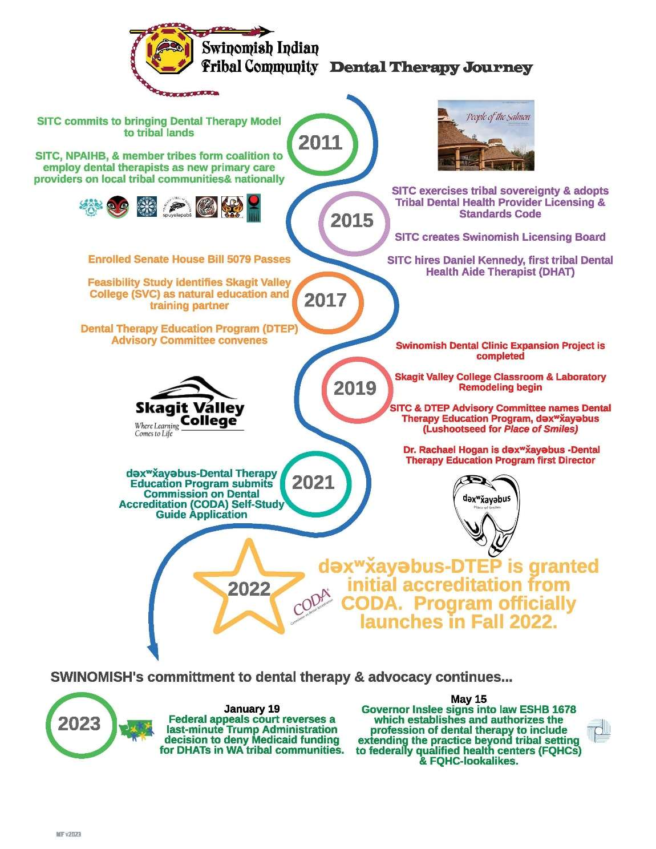
Swinomish Indian Tribal Community Dental Therapy Journey

Slide 18
Remaining Needs
Dental therapists and other CHAP providers must be eligible for scholarship and loan repayment programs.
Recognition of Tribal Self-Governance throughout the expansion of CHAP.
Update the IHS Circular 20-06.
Outreach and education about CHAP providers.
CHAP funding for Tribes and Area Certification Boards.

Slide 19
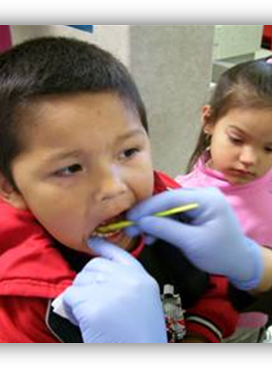
Questions?
Contact Information
Senator Brian Wilbur
bwilbur@swinomish.nsn.us
Sarah Sullivan, Health Policy Director
Sarah.Sullivan@didgwalic.com
(360) 707-8035

